Slide 1
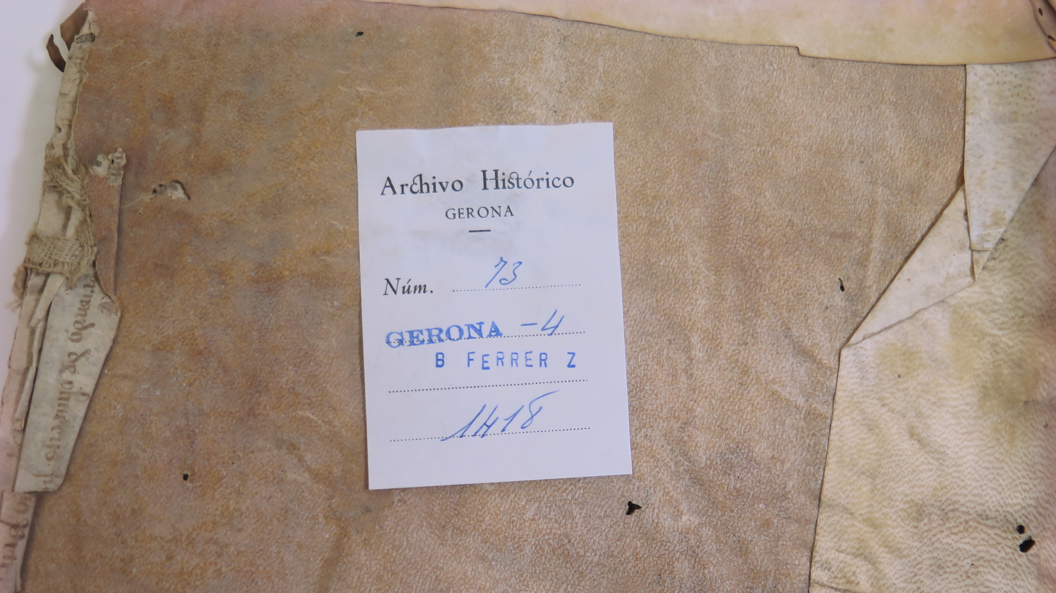
COLLABORATIVE RESEARCH & THE MEDIEVAL JEWISH COMMUNITY OF GIRONA

Slide 2
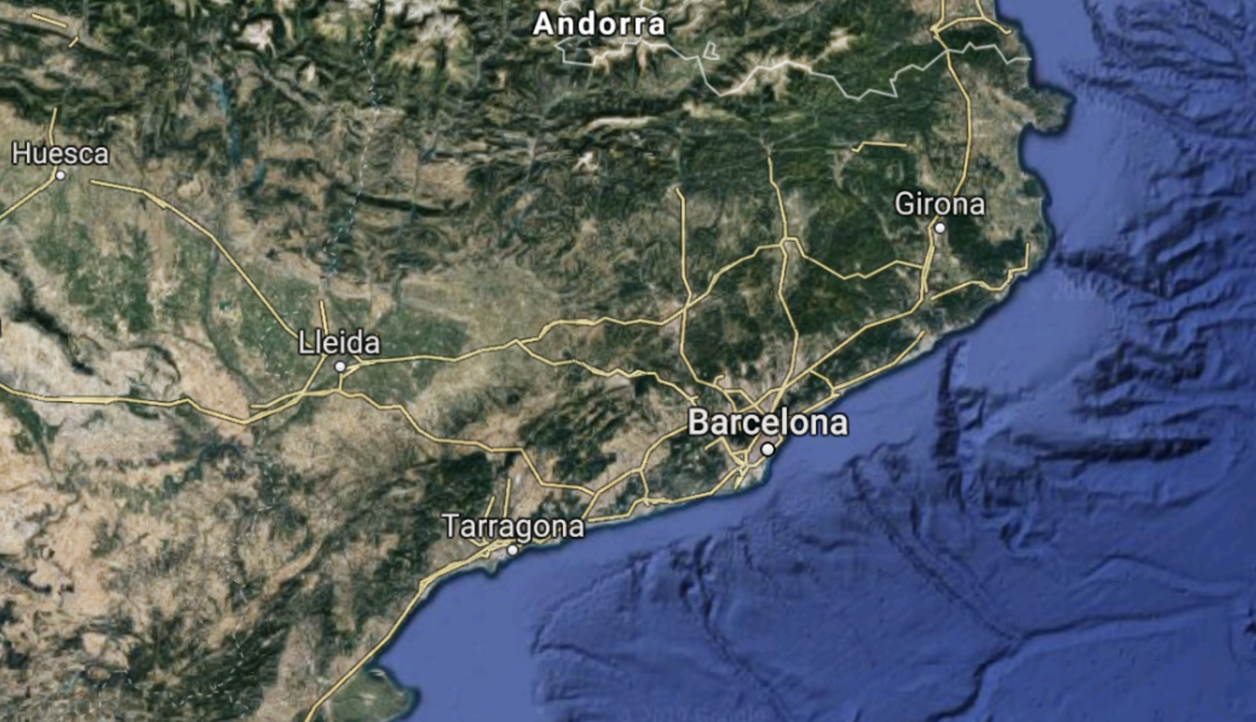
GIRONA, SPAIN

Slide 3
GIRONA, 1391-1430

Slide 4
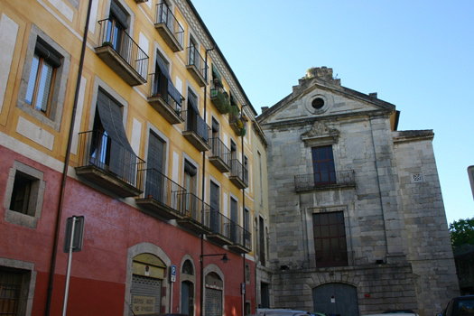
Historical Archives of Girona (AHG)

Slide 6
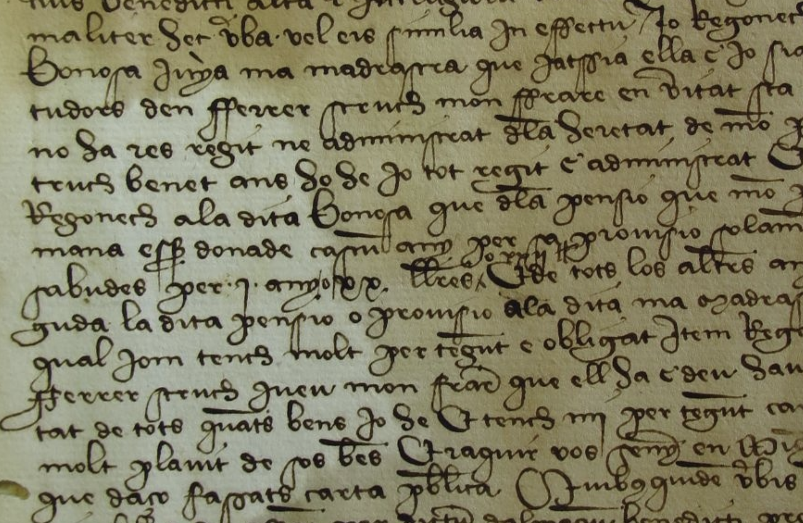
If we were lucky, we got registers that looked like this

Slide 7
But often they looked like this…

Slide 8
Or worse…

Slide 9
WHAT IS A NOTARIAL DOCUMENT?

Slide 10
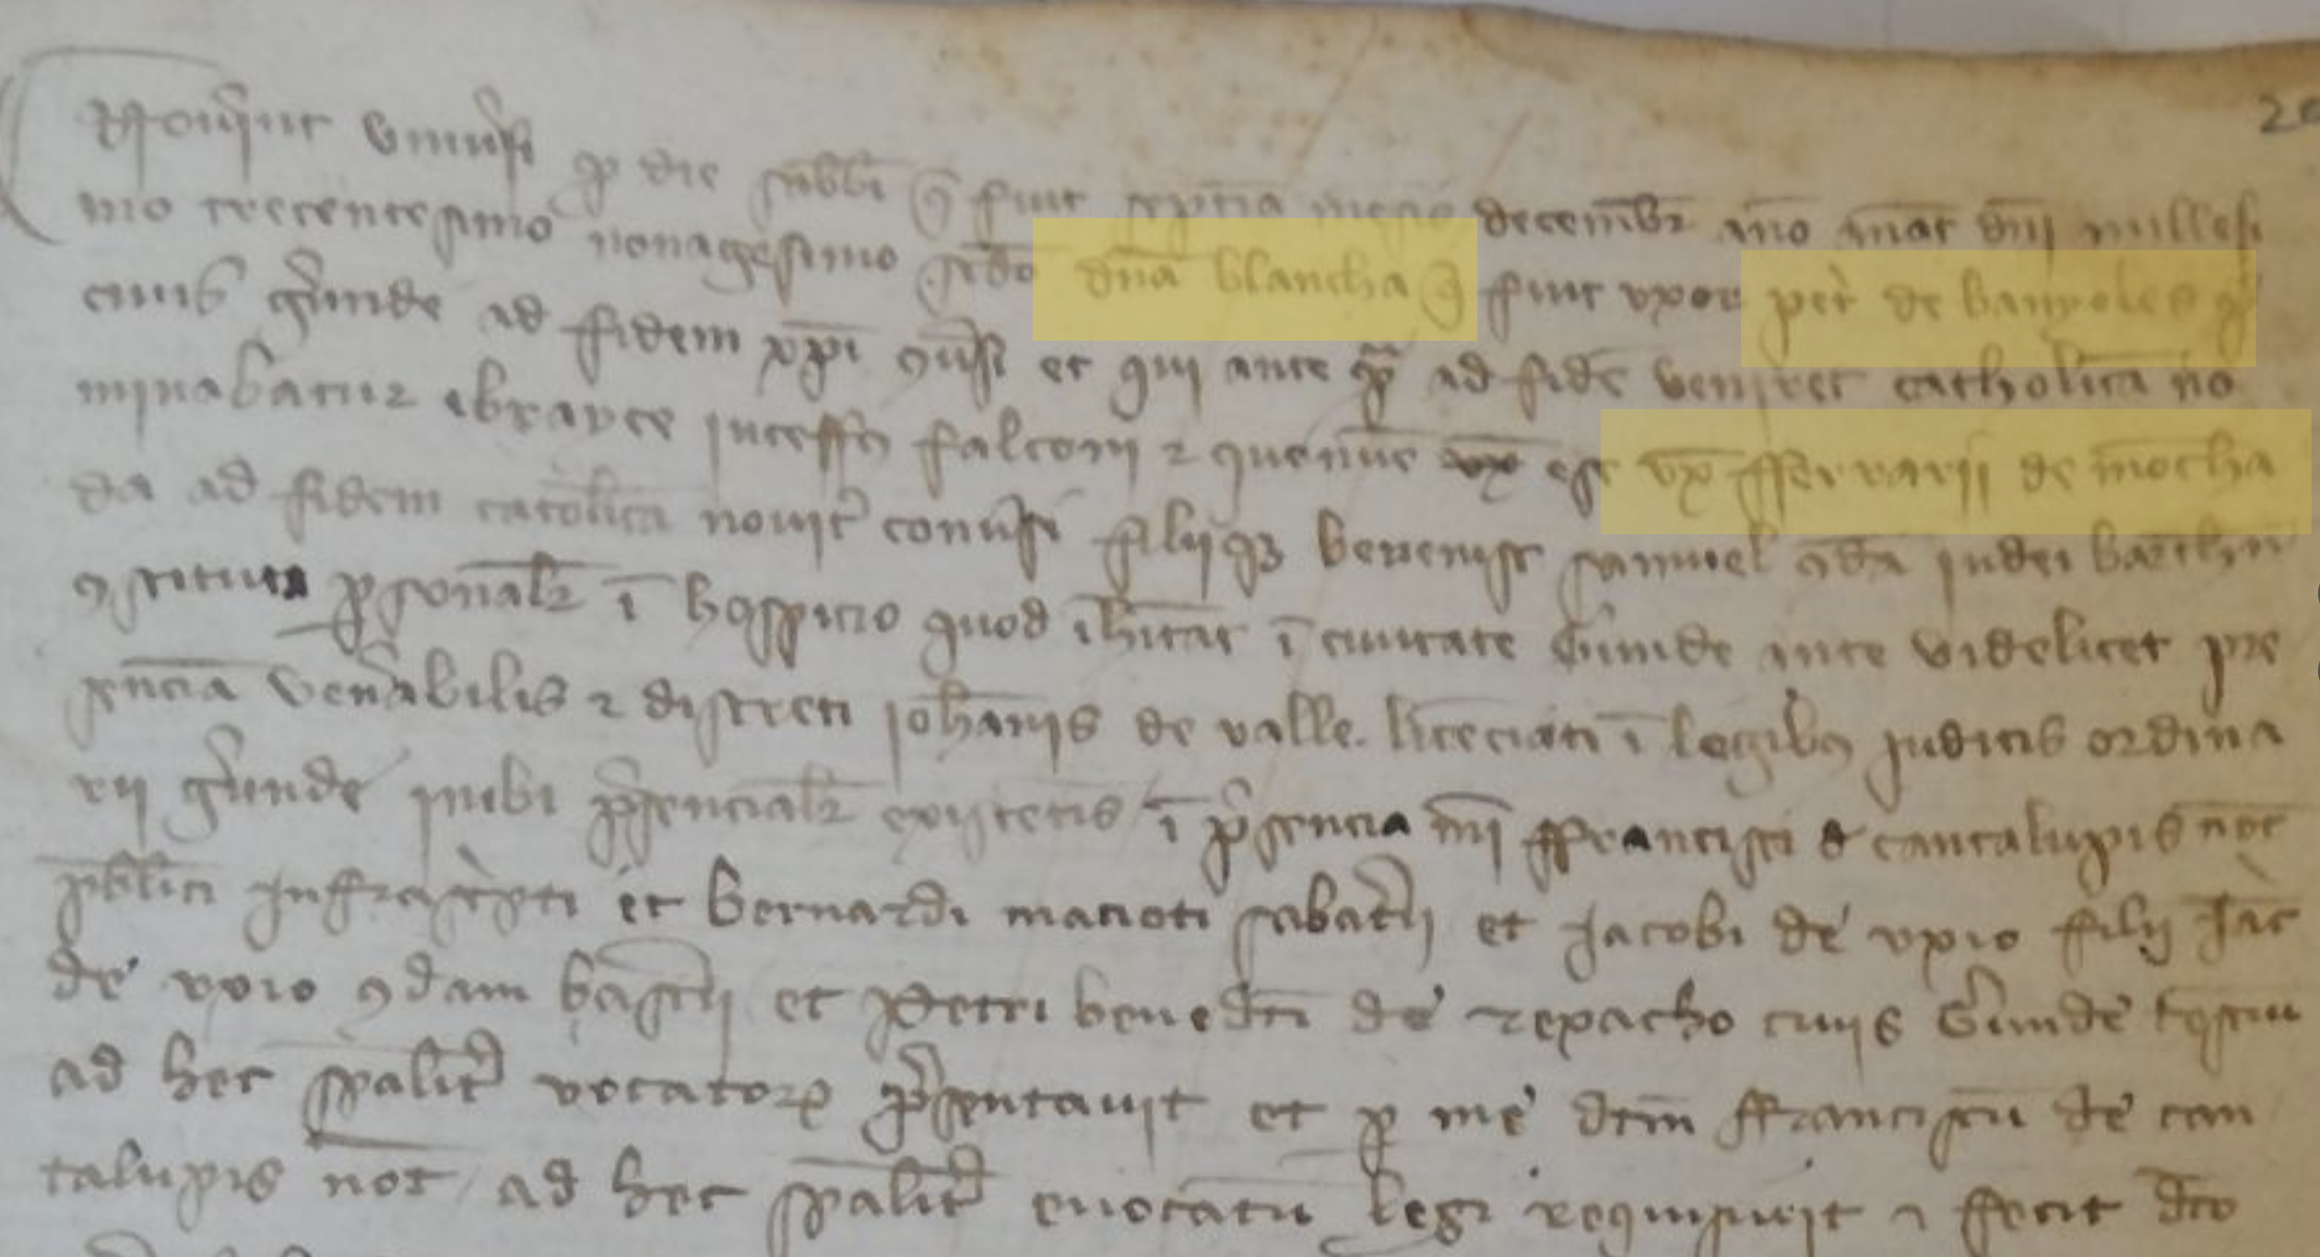
Blanca, wife of Pere de Banyoles

Slide 11
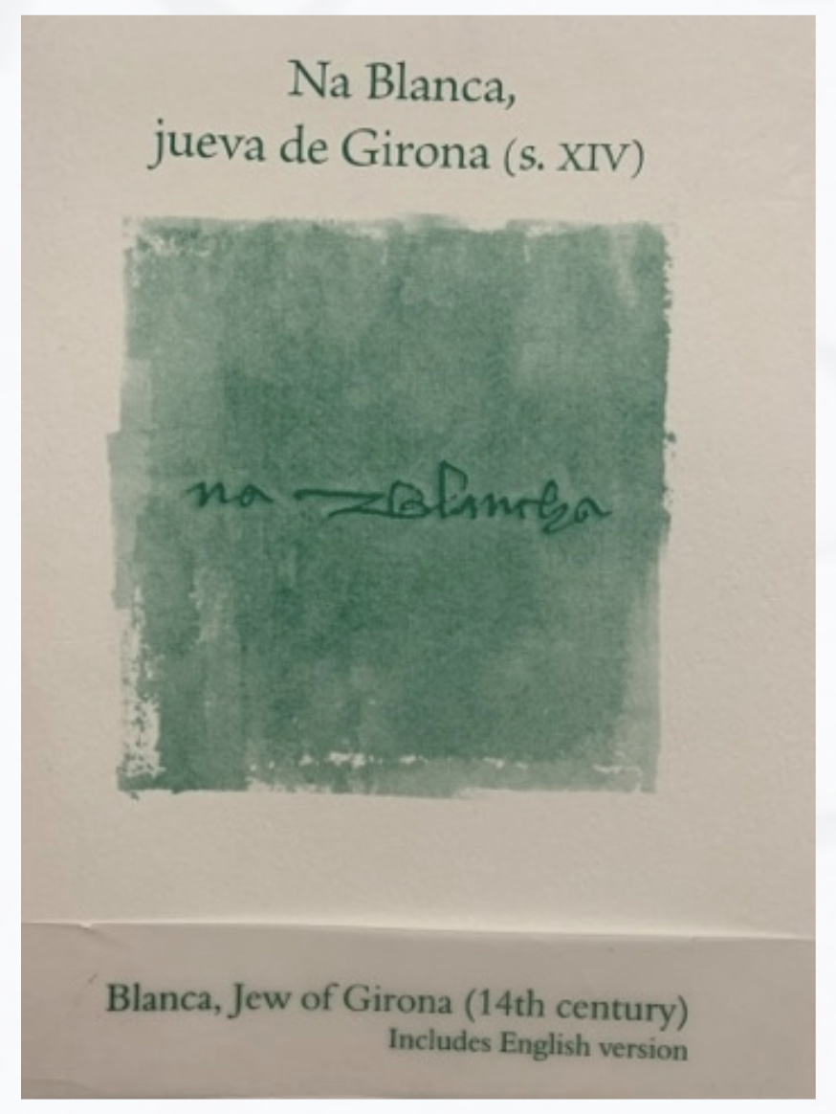
Blanca, Jew of Girona
Sílvia Planas

Slide 12
NEGOTIATING CONVERSION: JEWISH WOMEN & COMMUNITY IN GIRONA, 1391-1425
Working title of our project

Slide 13
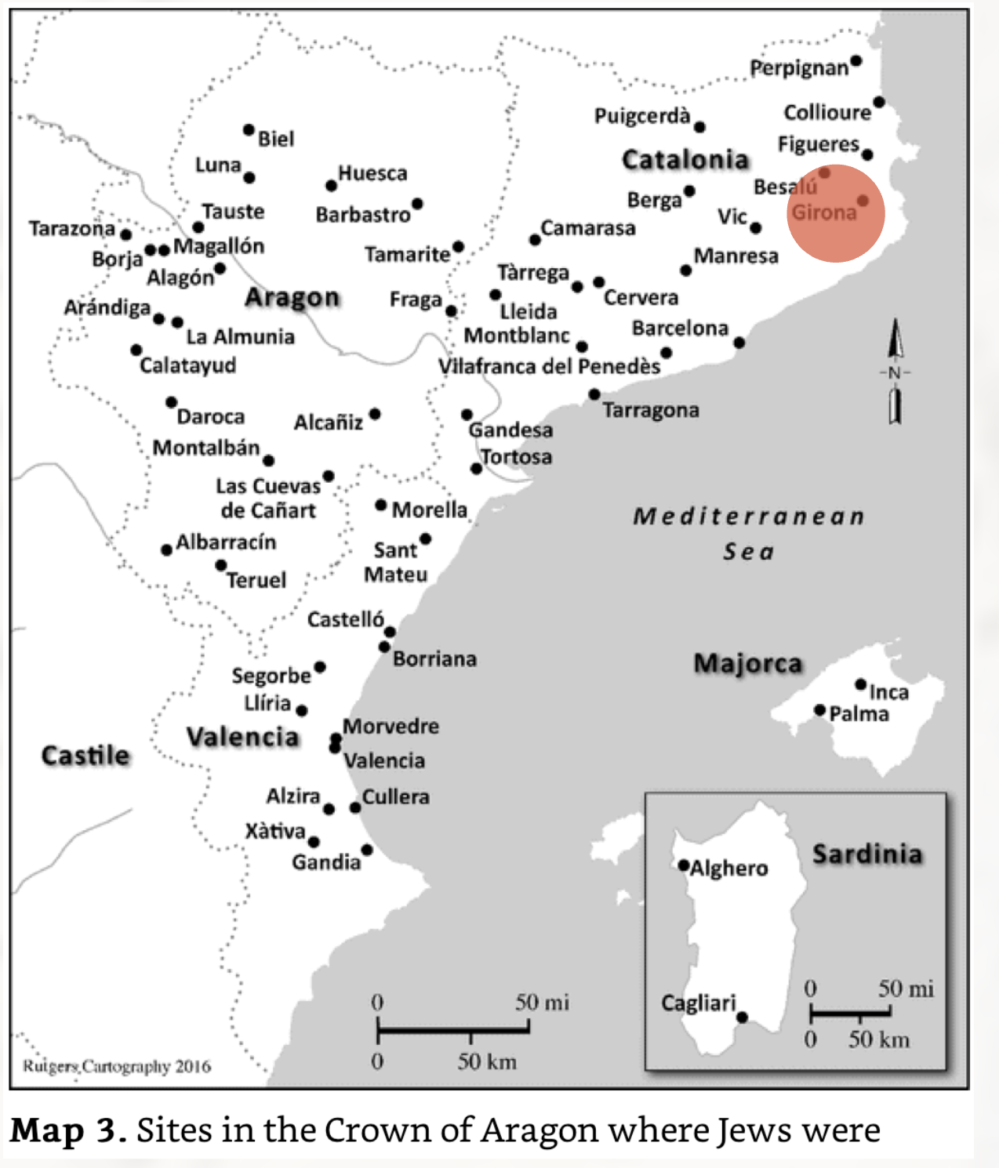
Anti-Jewish violence of 1391
Maps in Benjamin Gampel, Anti-Jewish Riots in the Crown of Aragon and the Royal Response 1391-1392 (Cambridge: Cambridge University Press, 2016)

Slide 14
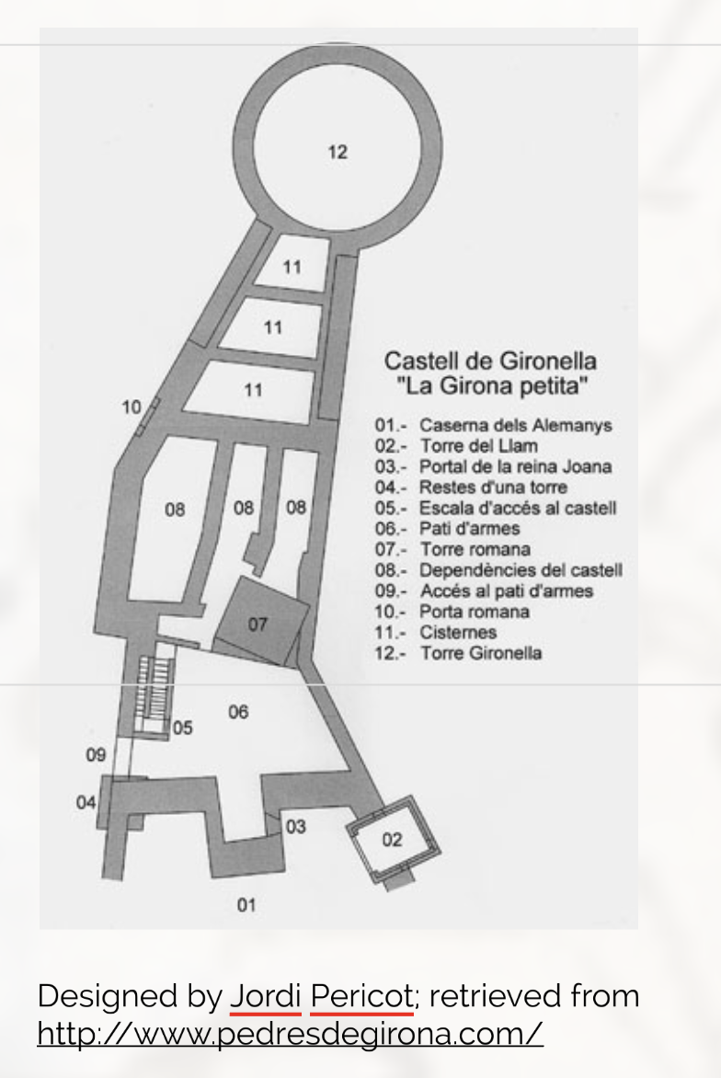
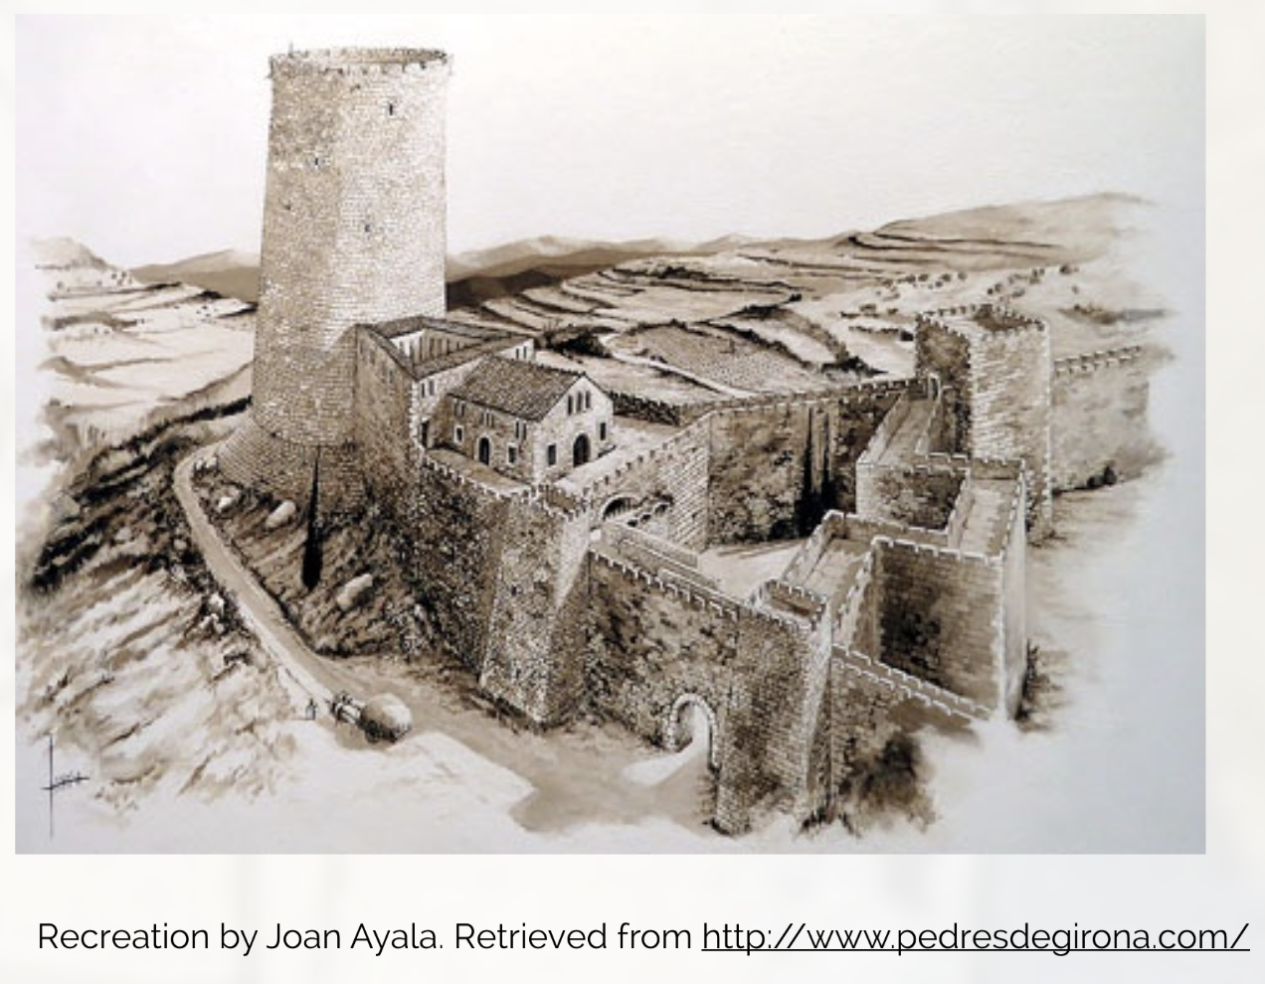
Gironella Tower

Slide 16
Early 15th-century a difficult time for the Jews of Girona

Slide 17
GIRONA ARCHIVES
Arxiu Històric de Girona (Historical Archive of Girona)
Arxiu Històric Ciutat de Girona (Historical Archive of the City of Girona)
Arxiu Diocesà de Girona (Diocesan Archive of Girona)

Slide 18
GIRONA ARCHIVES
Arxiu Històric de Girona (Historical Archive of Girona)
Girona_01, 1330-1906 Girona_02, 1364-1918 Girona_03, 1349-1859 Girona_04, 1328-1918 Girona_05, 1311-1857 Girona_06, 1332-1870 Girona_07, 1330-1918 Girona_08, 1321-1863 Girona_09, 1366-1857 Girona_10, 1363-1918 Girona_11, 1365-1899 Girona. Catàleg de testaments, 1279-1606

Slide 19
COLLABORATIVE RESEARCH

Slide 20
Importance of notarial records
Family history
Details such as family names, occupations, property, debts owed, credit held

Slide 21
But not without problems
Formulaic
Lack of context

Slide 22
Short documents

Slide 23
Notarial records & Jewish history
Libri judeorum (book of Jews)
Problems in Girona because of lack of libri judeorum

Slide 24
Advantage of collaborative work
Shared expertise
Can cover twice as much ground

Slide 29
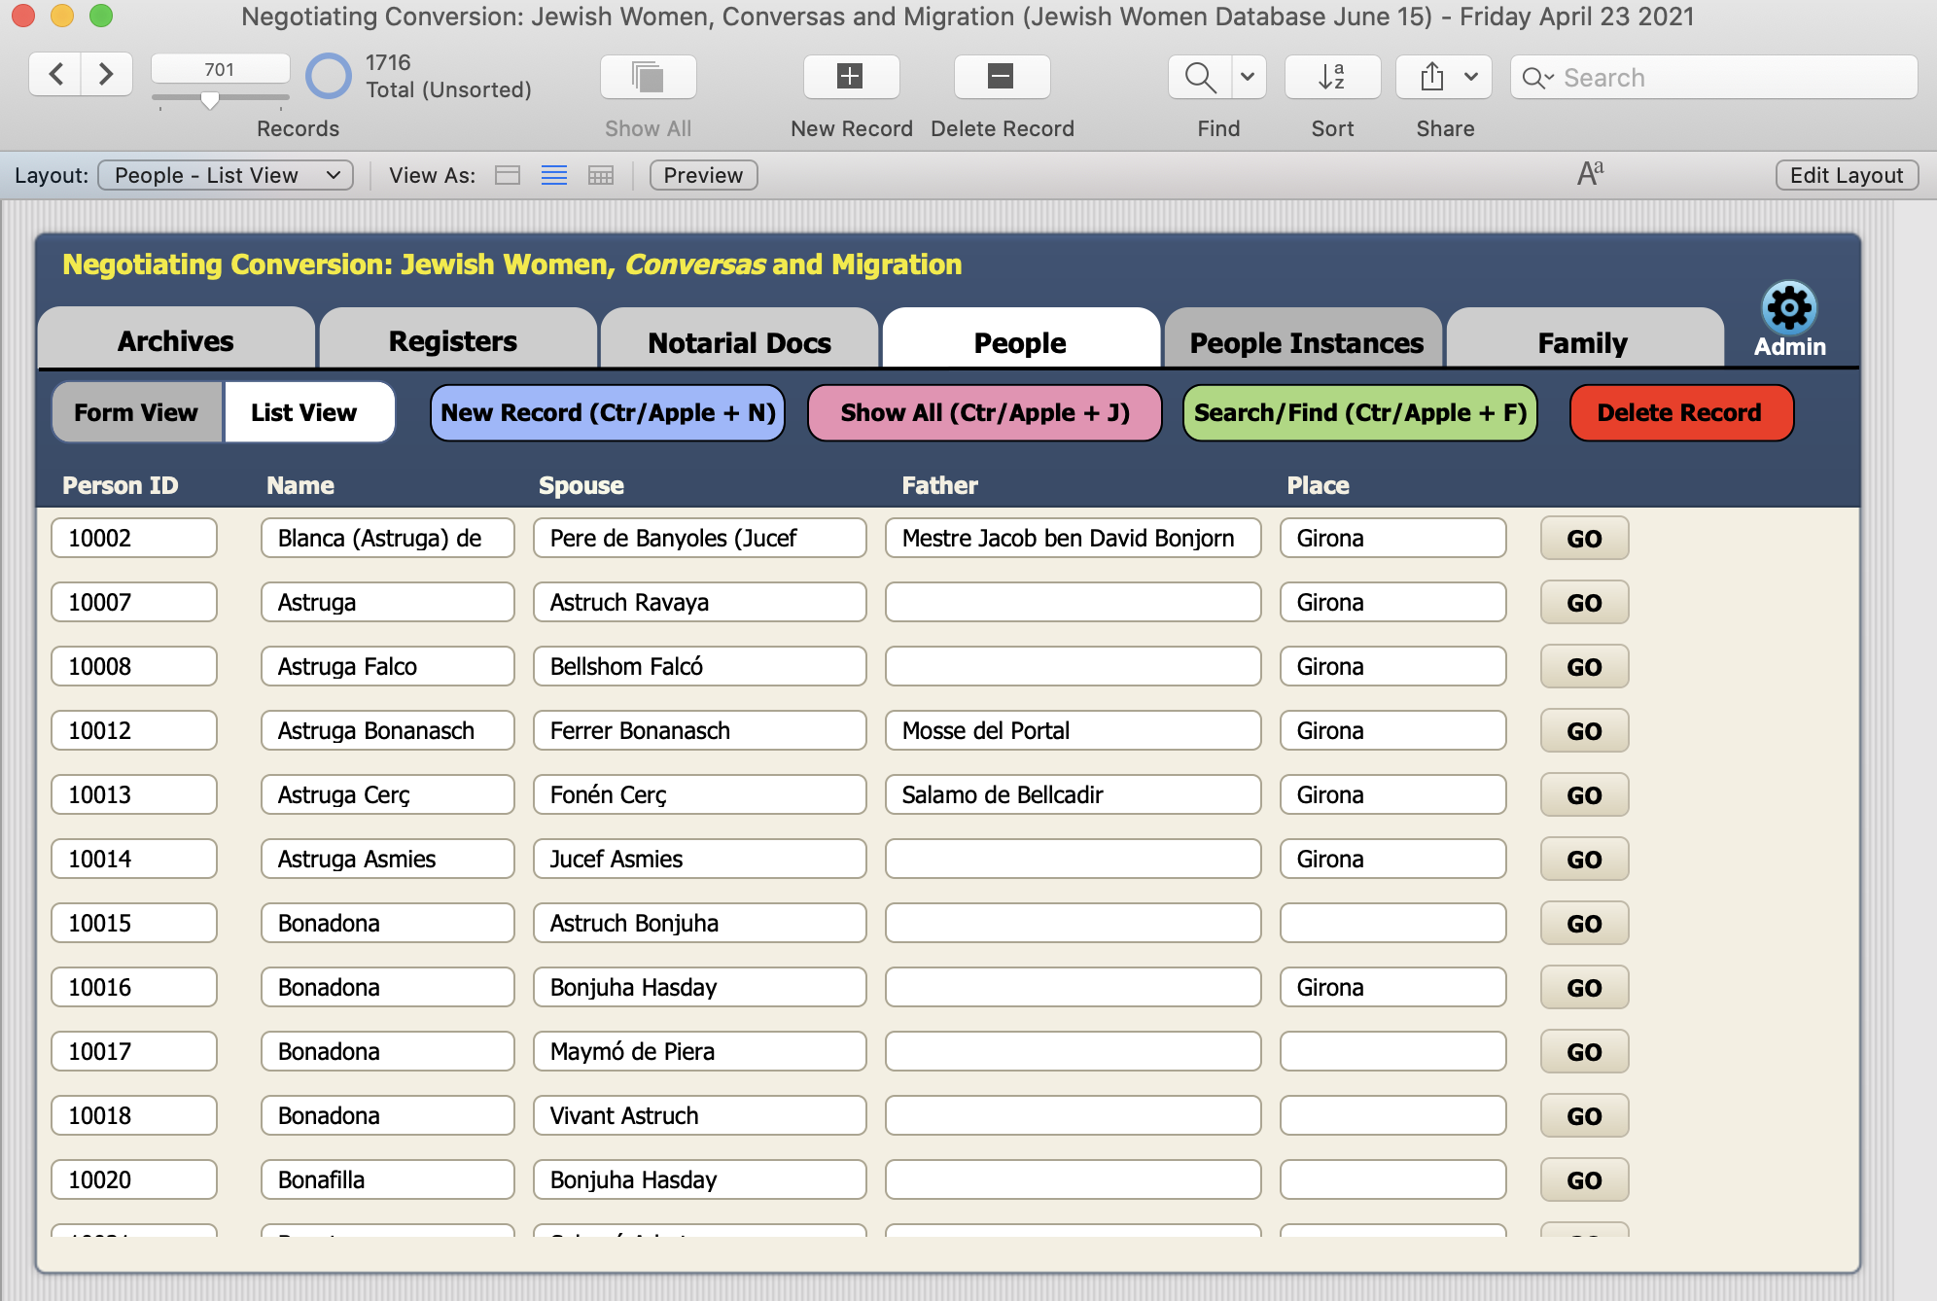
LIST VIEW

Slide 30
ZOTERO

Slide 31
BLANCA DE BANYOLES

Slide 32
FALCÓ FAMILY

Slide 33
TIMELINE
August 10, 1391 - Astruga & Jucef Falcó convert to Christianity, adopting the names Blanca and Pere de Banyoles
Early September 1391 – Their son Miquel is born
August, 1392 – Pere de Banyoles dies
October 1392 – Blanca receives permission to remarry
November/December 1392 – Blanca marries the converso Ferrer de Montcada, from Barcelona
June & August 1394 – Blanca and Ferrer de Montcada arrested in Caldes de Malavella
1395 – Blanca selling credit notes to her sister-in-law Astruga Falcó
1409 – Blanca, Ferrer, and Miquel flee to Portugal
May 1410 – Queen Violant ordered that all property belonging to Blanca, Ferrer, and Miquel be seized

Slide 34
CONCLUSION

Slide 35
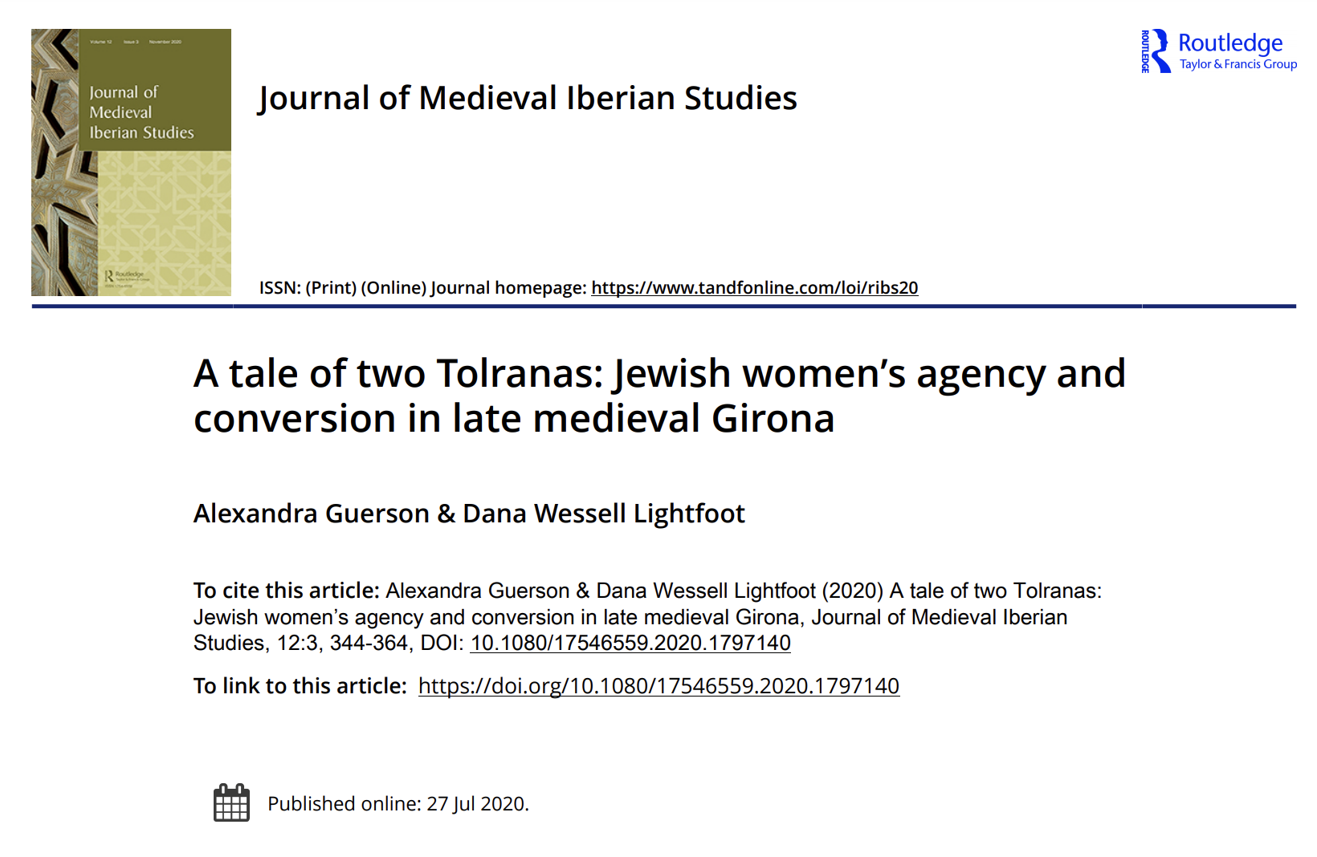

Slide 36
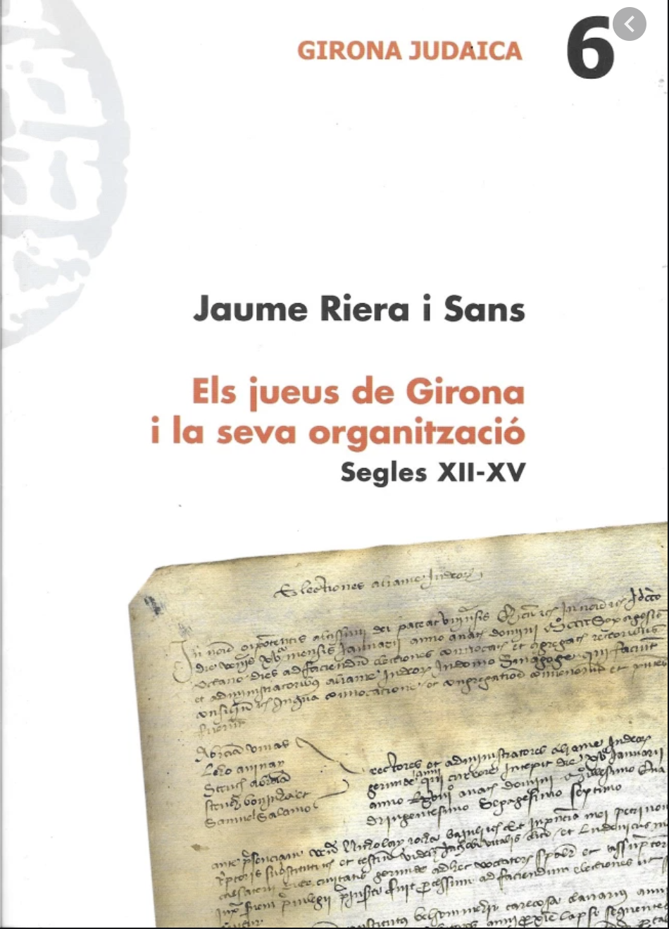
Jaume Riera
archivist at the Archives of the Crown of Aragon

Slide 37
NEXT WEEK: Conversos, the Spanish Inquisition, and the expulsion of the Jews

