Slide 1
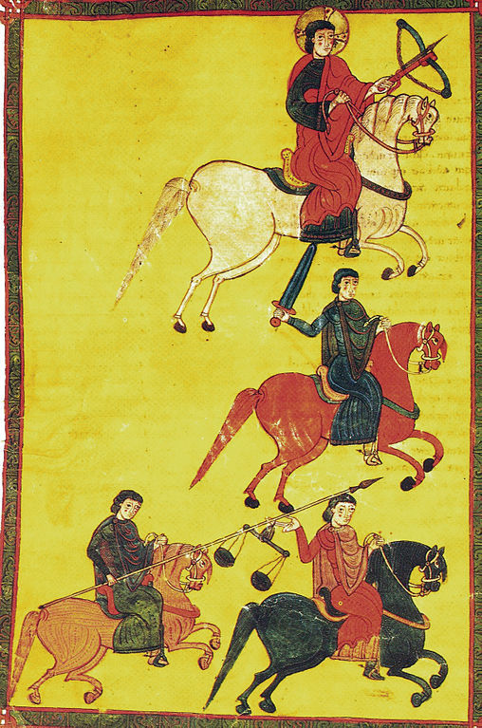
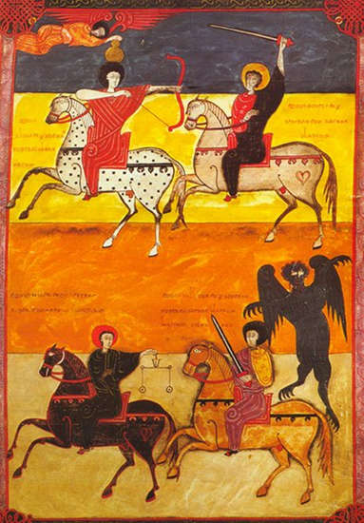
The Tumultuous 14th century: War, Famine, Plague, and Death

Slide 2
Challenges of the 14th century
Internal and external wars
Disease
Famine
Death

Slide 3
Our focus today…
External War:
“War of the Two Pedros” (1356-1369)
Internal War:
Civil War between Pedro I of Castile and Enrique Trastamara (1351-1369)
Civil War between Pere IV of the Crown of Aragon and his nobles in Valencia and Aragon (1347-1348)
Black Death (arrived 1348) and its consequences

Slide 4
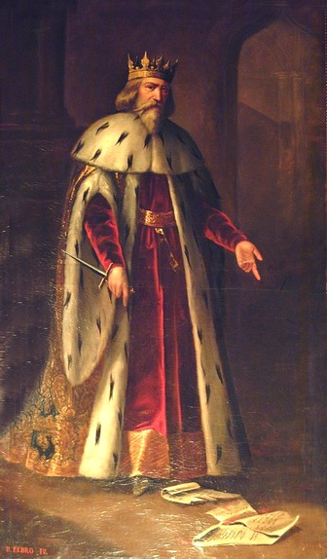
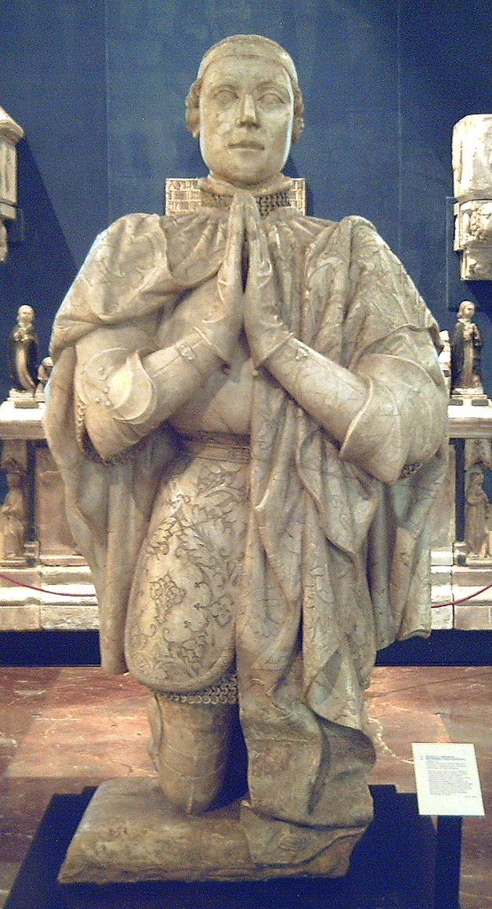
Pere IV “The Ceremonious” of Aragon
(ruled 1336-1387)
Pedro I ”The Cruel” of Castile
(ruled 1350-1369)

Slide 5
War of the Two Pedros
Part One: Border Wars (1356)

Slide 6
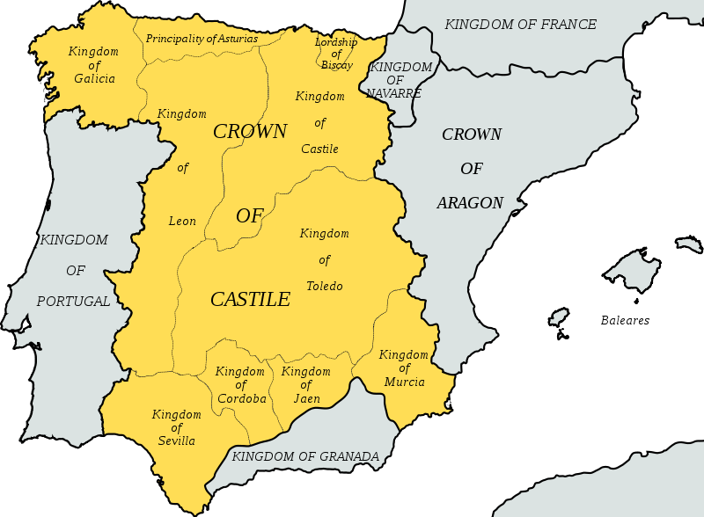
Pedro I attacks 1356
Valencia

Slide 7
War of the Two Pedros
Part One: Border Wars (1356)
Part Two: Outside Alliances (1357-1363)

Slide 8
Forging Alliances
Pere IV of Aragon + Enrique Trastamara + France
Pedro I of Castile + England

Slide 9
War of the Two Pedros
Part One: Border Wars (1356)
Part Two: Outside Alliances (1357-1363)
Part Three: Initial Peace and Pedro I’s Defeat (1363-1369)

Slide 10
Peace at Murviedro
Terms: Pere IV loses half of the kingdom of Aragon
July 1363
Conflict between Pedro I and his half-brother Enrique
Enrique + French Allies
Pedro I + English Allies (including Edward “The Black Prince)
1366-1369

Slide 11
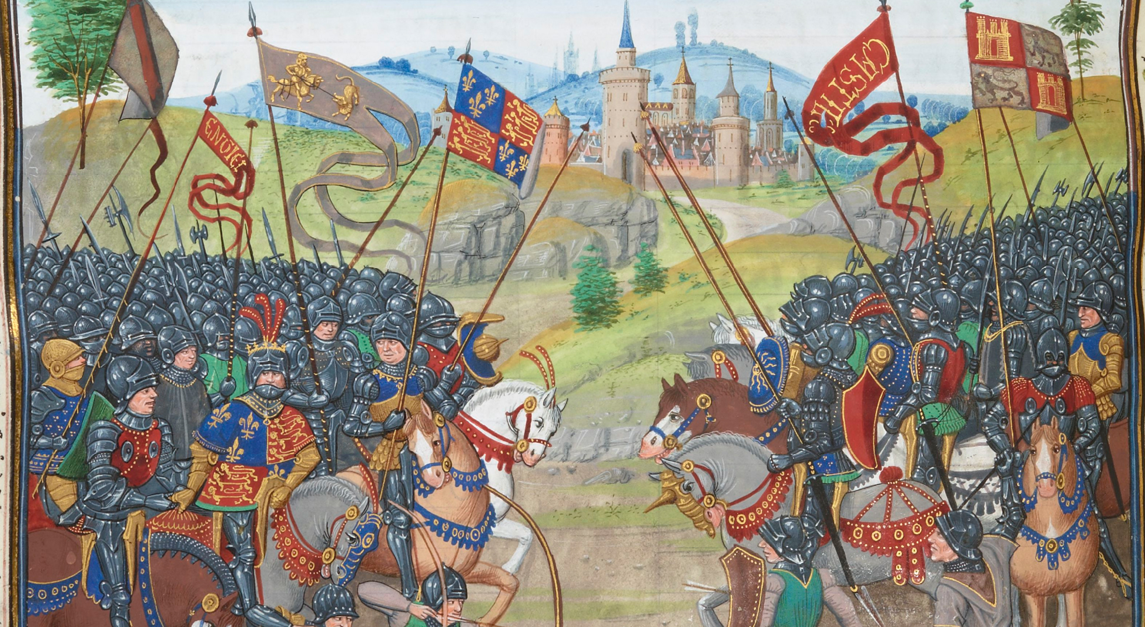
Battle of Nájera (3 April 1367)
Pedro I vs. Enrique Trastamara

Slide 12
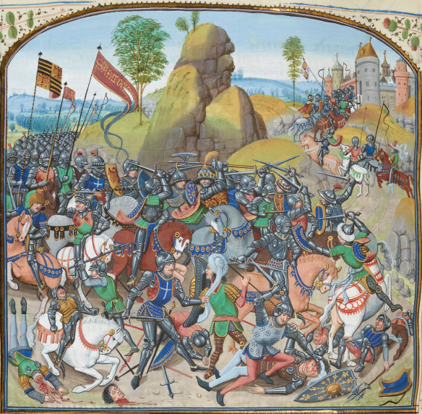
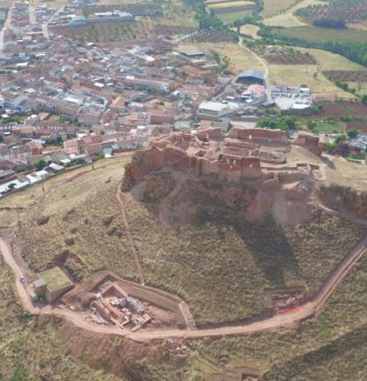
Battle of Montiel (March 1369)
Overhead view of Montiel Castle

Slide 13
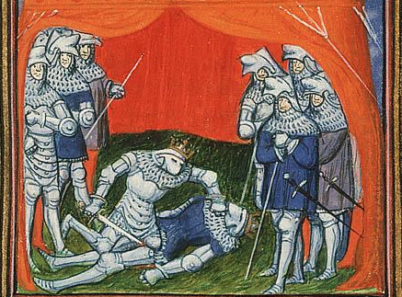
Execution of Pedro by his brother Enrique

Slide 14
Our focus today…
External War:
“War of the Two Pedros” (1356-1369)
Internal War:
Civil War between Pedro I of Castile and Enrique Trastamara (1351-1369)
Civil War between Pere IV of the Crown of Aragon and his nobles in Valencia and Aragon (1347-1348)
Black Death (arrived 1348) and its consequences

Slide 15
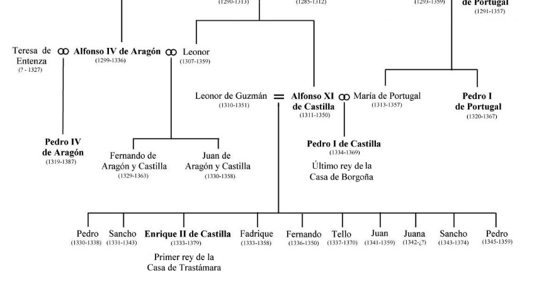

Slide 16
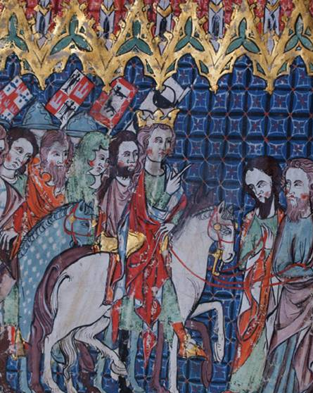
Castilian Civil War: Seeds
Alfonso XI and the Siete Partidas (1348)
Alfonso XI’s Coronation (14th c.)

Slide 18
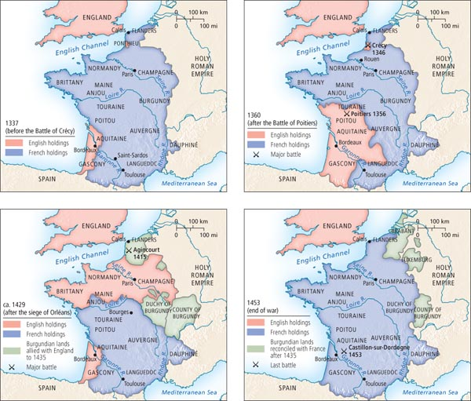
100 Years’ War
(1337-1453)
Fought between France and England (plus allies)

Slide 19
Our focus today…
External War:
“War of the Two Pedros” (1356-1369)
Internal War:
Civil War between Pedro I of Castile and Enrique Trastamara (1351-1369)
Civil War between Pere IV of the Crown of Aragon and his nobles in Valencia and Aragon (1347-1348)
Black Death (arrived 1348) and its consequences

Slide 20
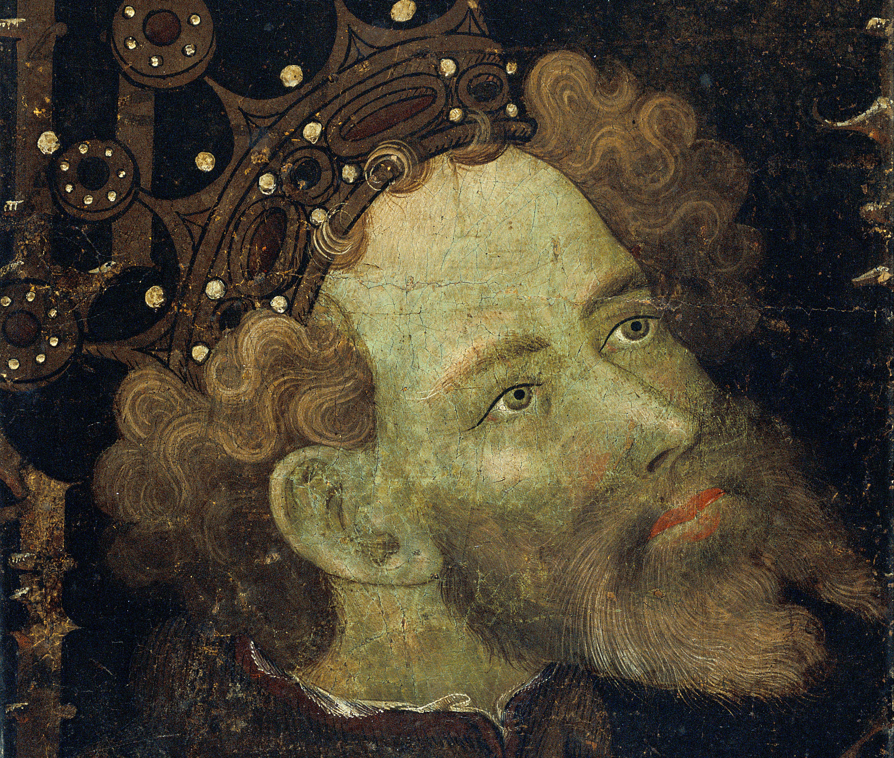
Image from 1427
Pere IV vs.
his nobles (Aragon and Valencia)
Catholic Church officials

Slide 21
Conflict with the Unions of Aragon and Valencia (1347-48): Problem of Succession
Zaragoza,
1347
Pere’s Choice: Daughter Constança
Aragon’s Choice: His Brother Jaume
Valencia’s Choice: His stepbrother Ferran
Died 1347
Named heir of Aragon ONLY 1348

Slide 22
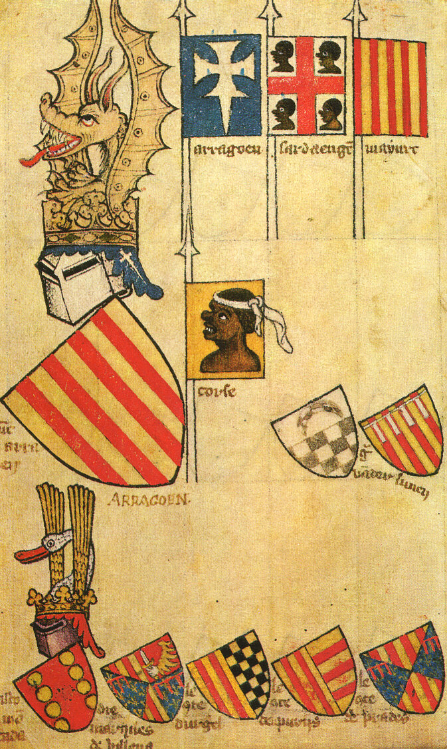
War between Pere and Unions of Aragon and Valencia
Disrupted by the arrival of the plague in 1348
Pere victorious Dec. 1348

Slide 23
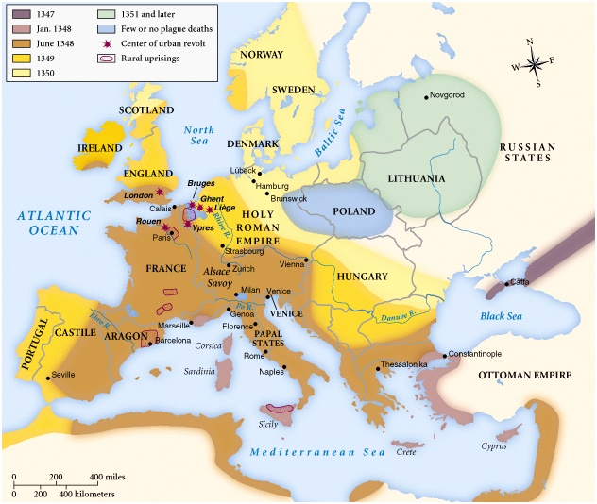
1347
Arrives in Europe
1348
Arrives in Iberia (east)
1349
Spreads to western Iberia

Slide 24
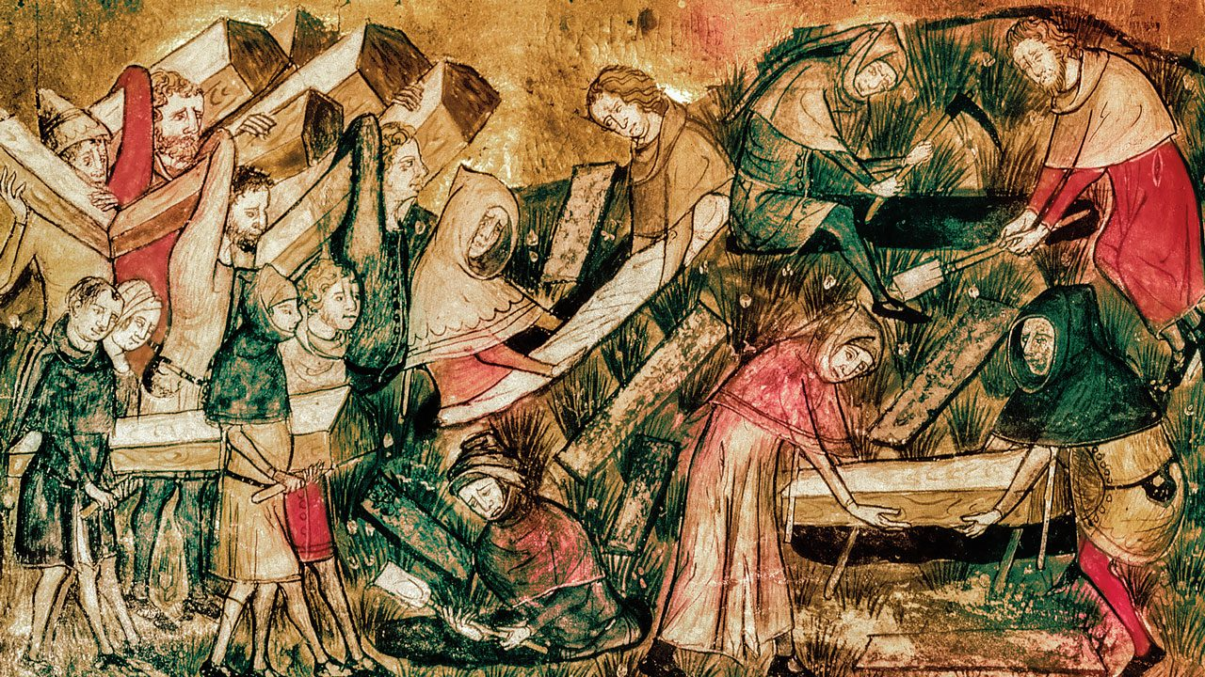
Crown of Aragon:
Greater population loss (around 30-40%)
Slower recovery (e.g. of Valencia)
45000 (1420) -> 75 000 (1480s)
28 outbreaks (1400-1512)
1439 (7200); 1450 (11 000); 1459 (12 000)
Castile:
Loses 15-20% of population
Recovery by 1400-25
Expansion by 1425

Slide 25
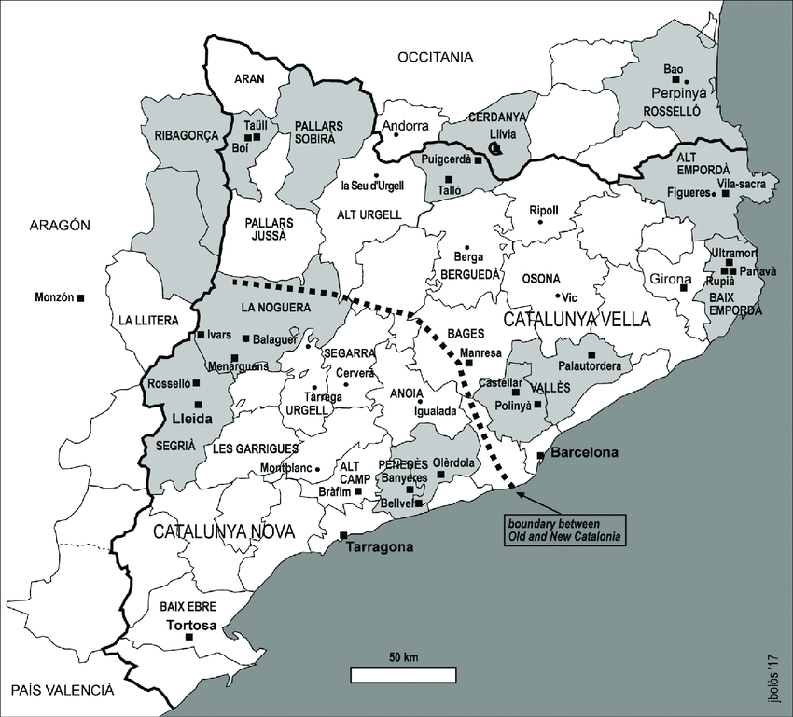
Consequences of the Black Death
Tension between lords and peasants
E.g. of Catalonia
Shortage of labour
Conflict over control of land
Enactment of serfdom
Expansion of mals usos (bad customs)

