Slide 1
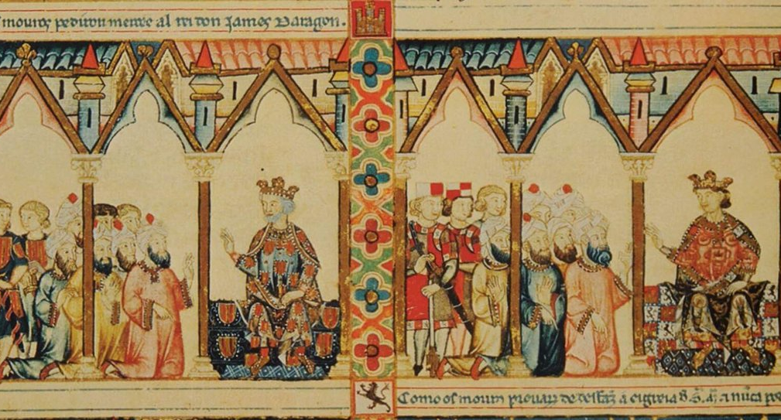
Kingship and Institutions in the 13th century

Slide 2
Our focus today…
Alfonso X of Castile “The Wise”
(1212-1284)
Jaume I of Aragon “The Conqueror”
(1213-1276)
Kingship and military conflict
Use of law codes and representative assemblies (Cortes/Corts

Slide 3
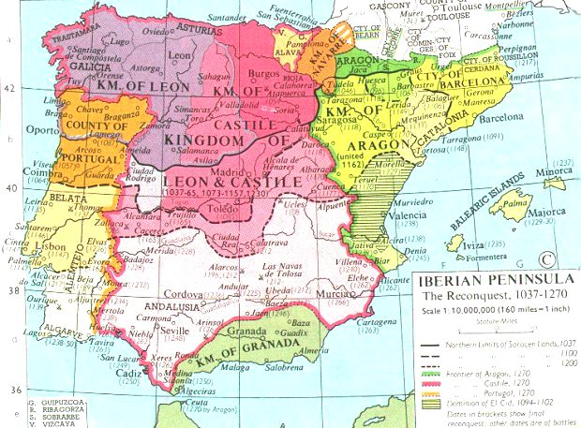

Slide 4
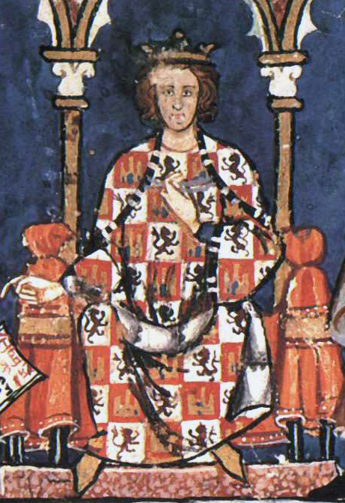
The Idea of Kingship
Castile
Role of frontier
Military role of king
Directs colonization efforts

Slide 5
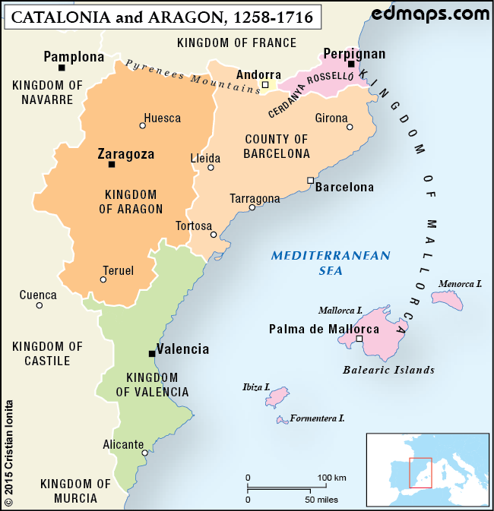
King of the Crown of Aragon
Count of Barcelona
Contractual relationship with nobility
King of Aragon
Nobility have land through conquest
King of the Balearic Islands
King of Valencia

Slide 6
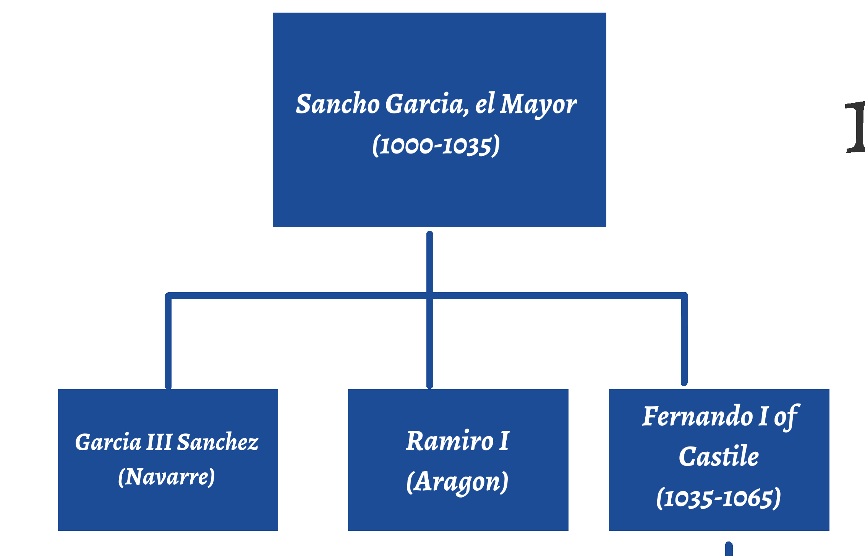

Slide 7
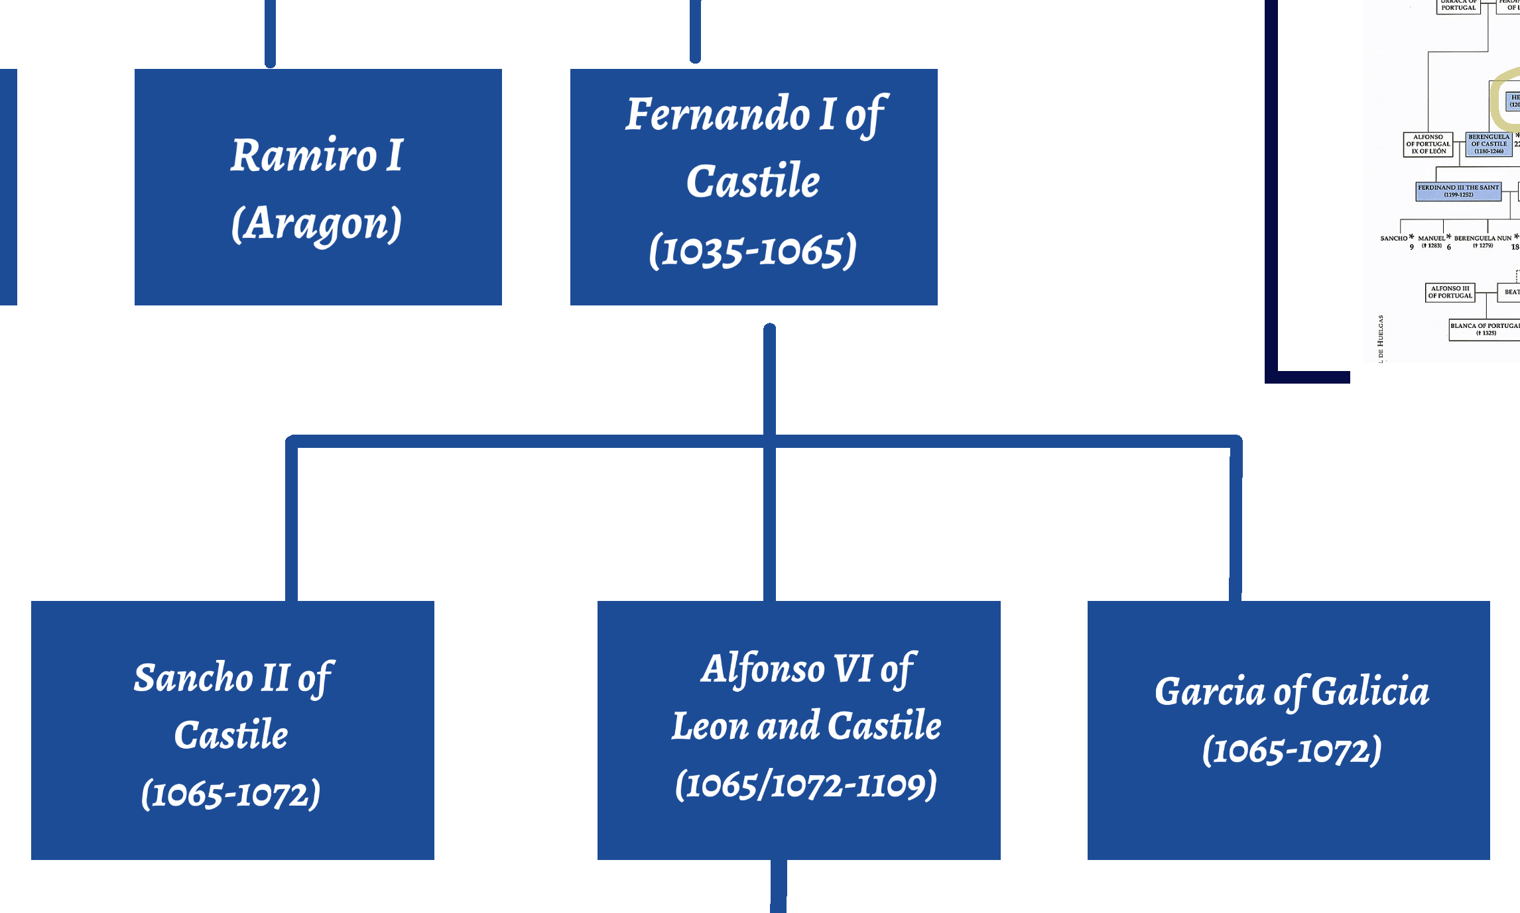

Slide 8
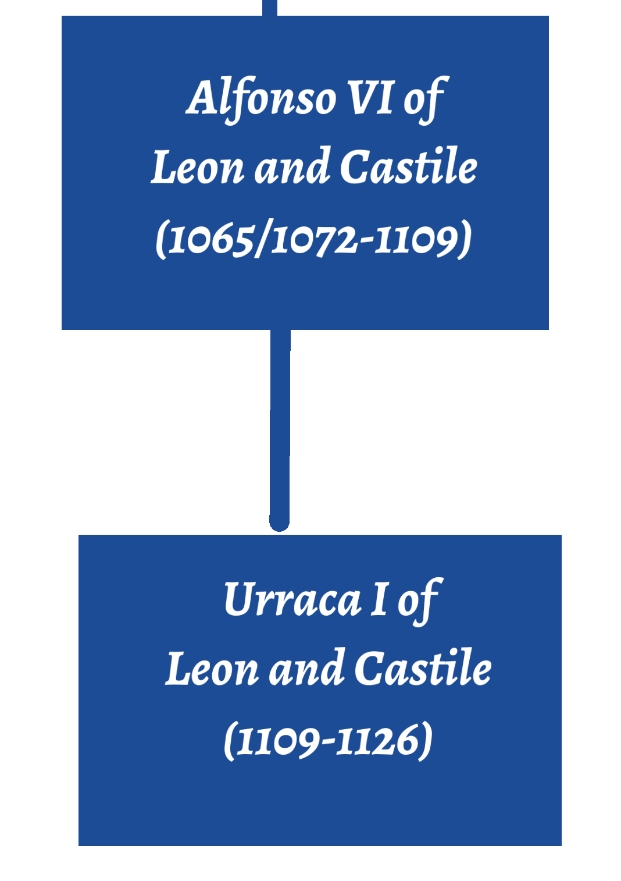
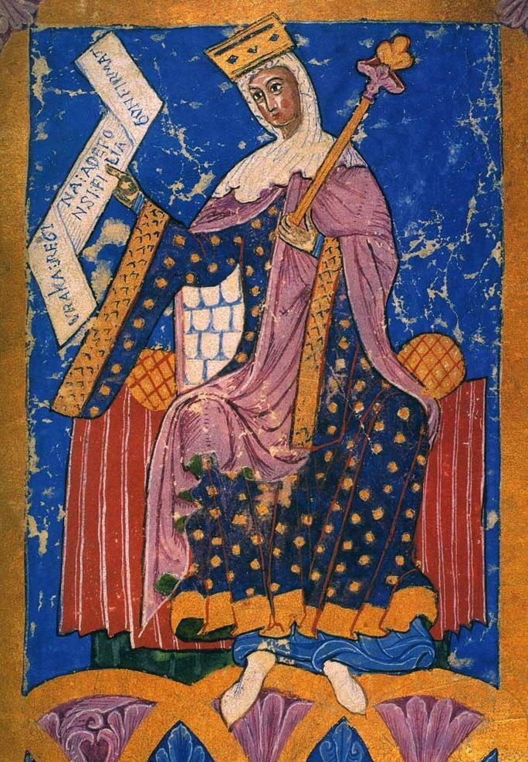

Slide 9
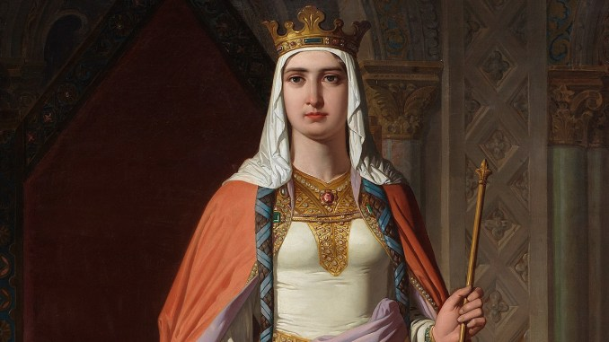
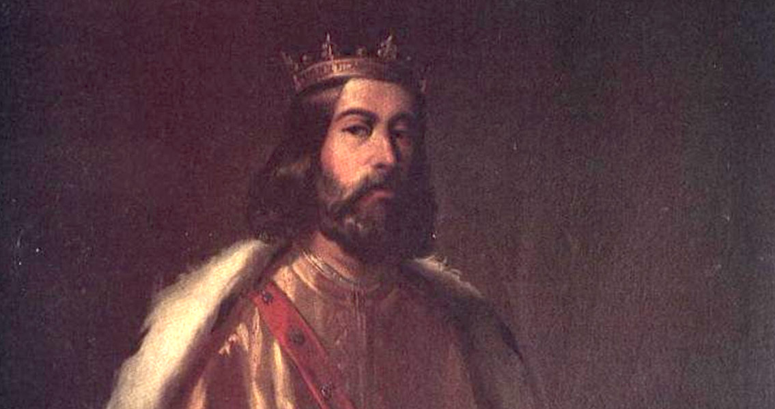
Married 1109
Separated 1112
At War 1112-1126
Urraca of Castile
Alfonso I of Aragon and Navarre

Slide 10
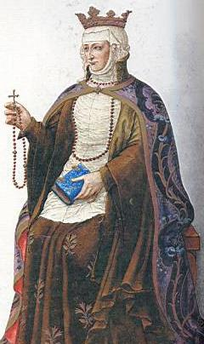
Berenguela of Castile
Daughter of Alfonso VIII
Heir of Father after brother Enrique died (1217)
Stepped aside for son Fernando III (1217-1252)

Slide 11
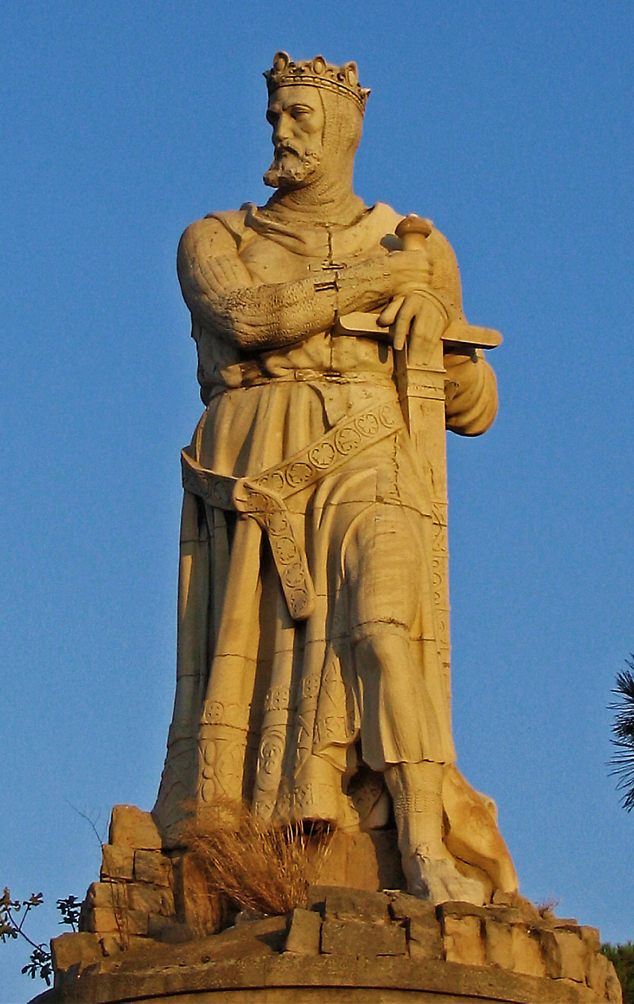
Alfonso I “The Battler”
Conquered Zaragoza
Died without heirs (1134)

Slide 12
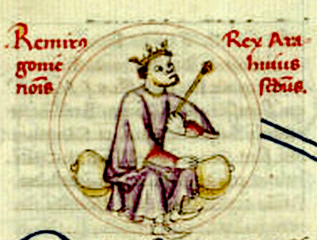
Ramiro II

Slide 13
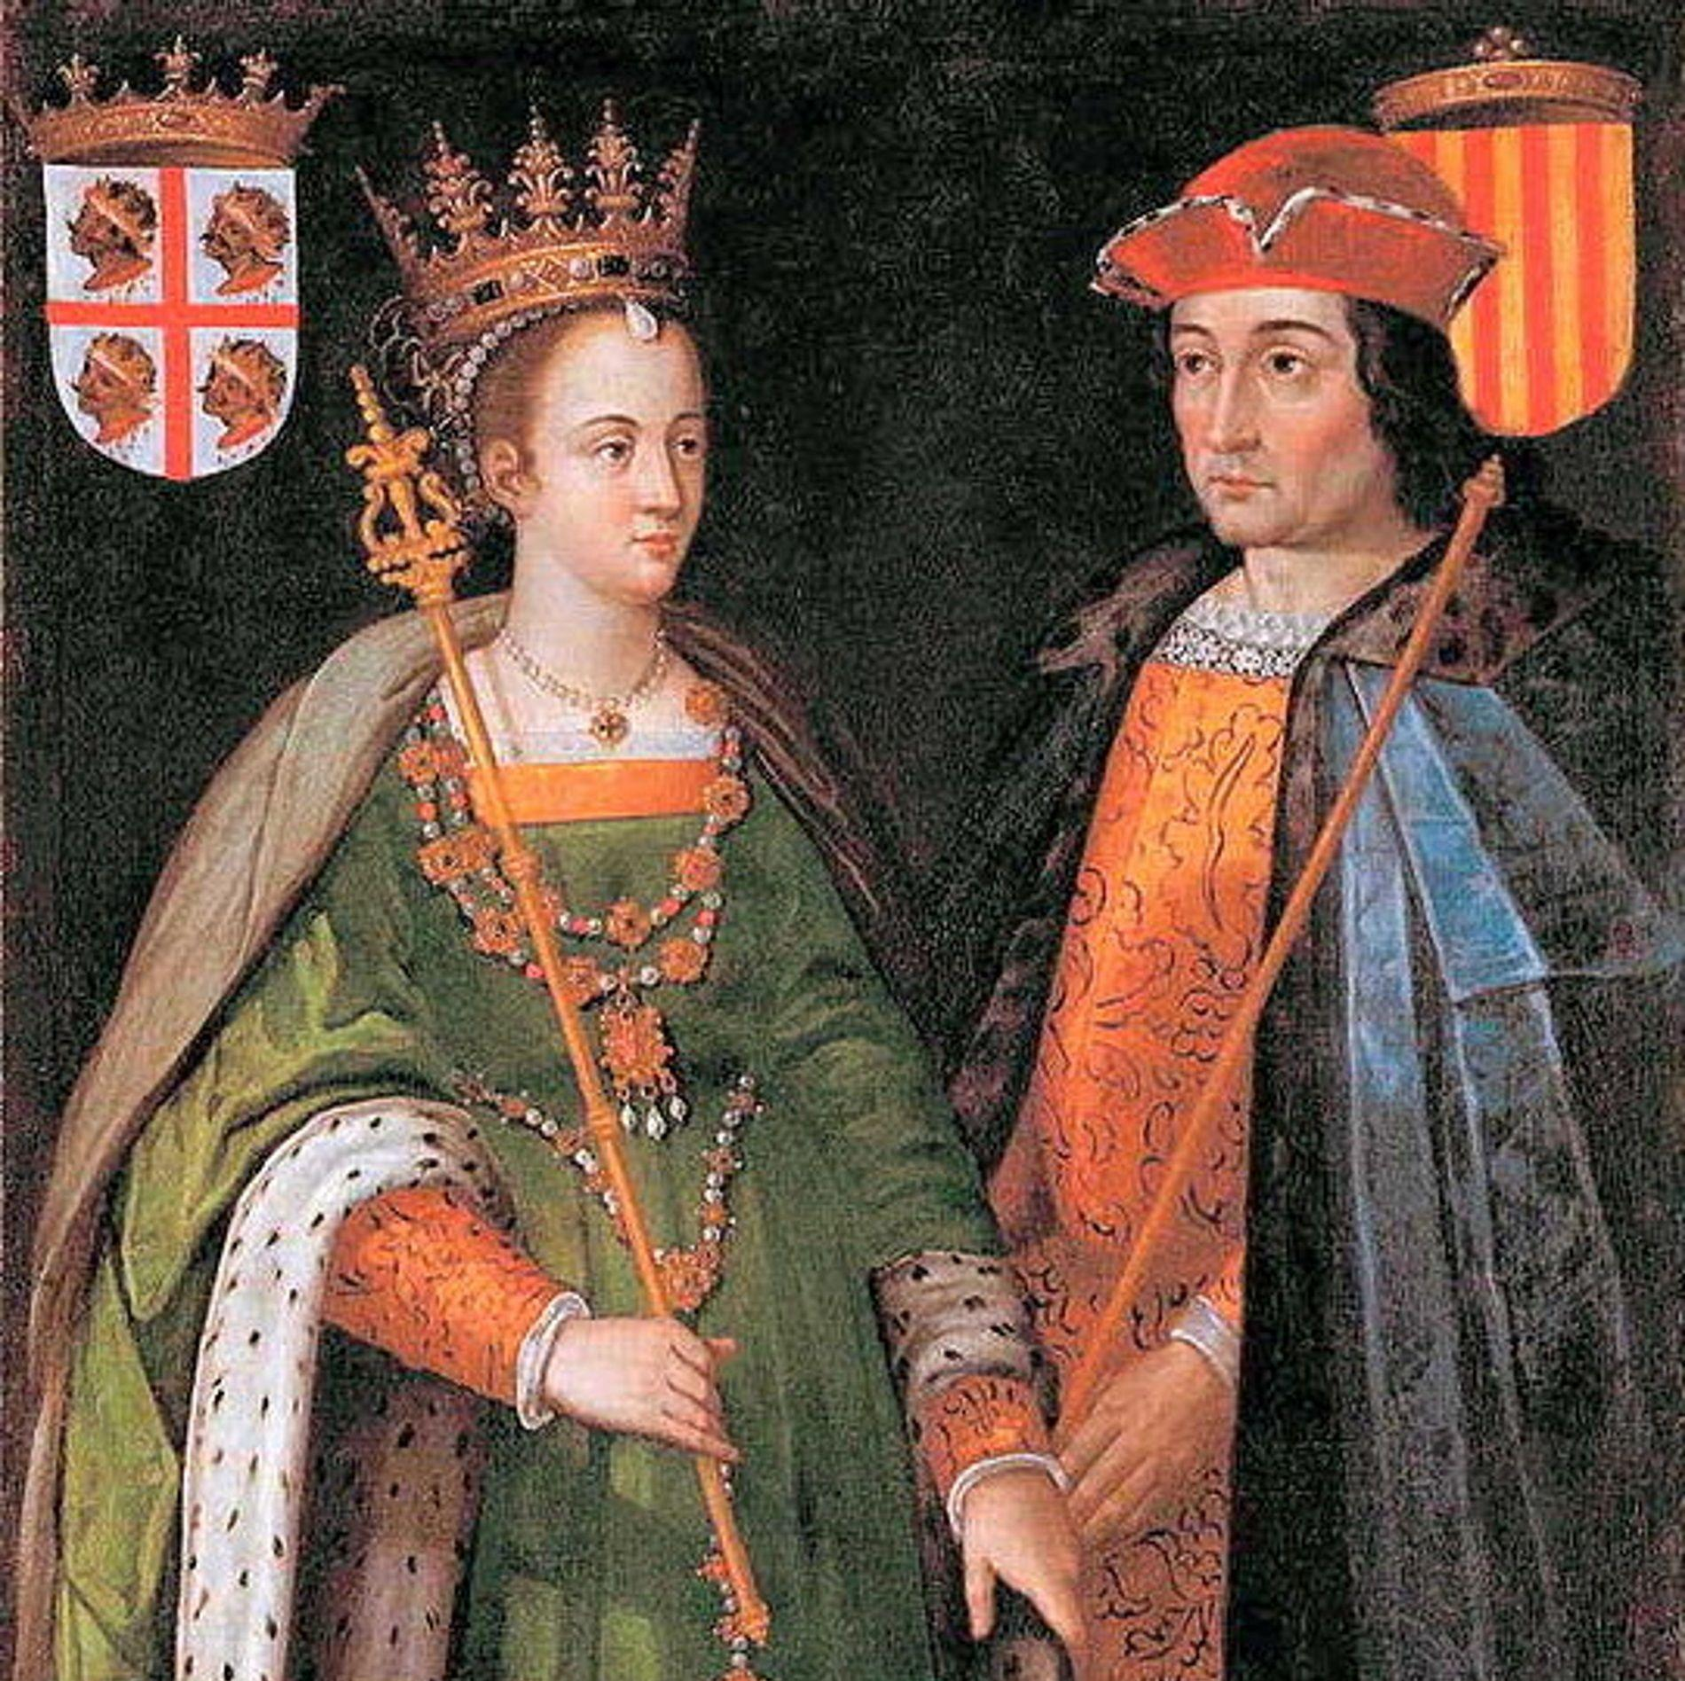
Count Ramon Berenguer IV of Catalona married Petronila, Queen of Aragon (1150)

Slide 14
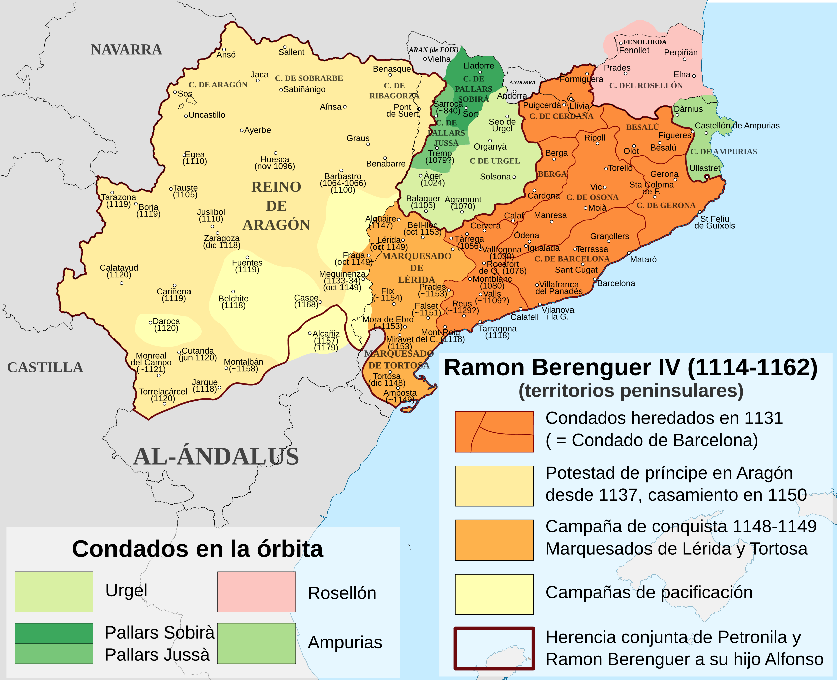
Gains through marriage

Slide 16
Alfonso X “the Wise”
Siete Partidas (1251-1265)
Based on Roman Law
Not put into force until 1348

Slide 17
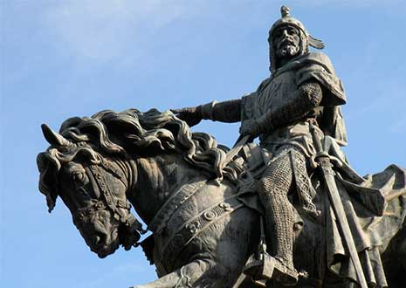
Jaume I “The Conqueror”
Fueros de Aragon (1247)
Furs de Valencia (1239)

Slide 18
Establishment of Cortes/Corts
Royal Council (curia regis)
Expanded Council (curia plena)
Cortes/Corts
Established 1188 in Castile

Slide 19
KING
CORTES/CORTS
Prelates (archbishops and bishops)
Nobles (ricos hombres and caballeros)
Townsmen

Slide 20
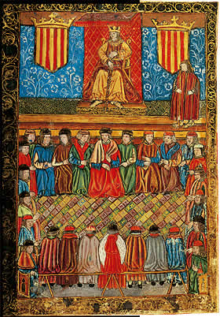
Business of Cortes/Corts
Public administration
Royal Household
Economy
Status of Muslims and Jews
Image: Meeting of the Catalan Cort, 15th c.

Slide 21
Estates present petitions to king
King gets advice
King makes determination
Cortes gives consent to king’s request for taxation

Slide 22
Corts/Cortes in the Crown of Aragon: Catalonia, Aragon, Valencia
Differences from Castile
More estates (Aragon = 4)
Townsmen as honrats ciutadans not nobles
Can’t enact legislation without consent of Corts
Had to respond to petitions before taxation granted

