Slide 1
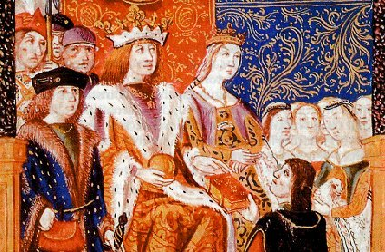
The Catholic Kings and the Spanish Inquisition

Slide 2
Our focus today…
Establishment of the Spanish Inquisition: How and Why? (1478 and 1480)
Conversos and crypto-Judaism
The “Black Legend”
The expulsion of the Jews (1492)

Slide 3
Civil war in Castile (1464-68)
Death of Martí of Aragon, 1410

Slide 4
Establishment of the Spanish Inquisition
Granted right by Pope Sixtus IV in 1478
Not established until 1480

Slide 5
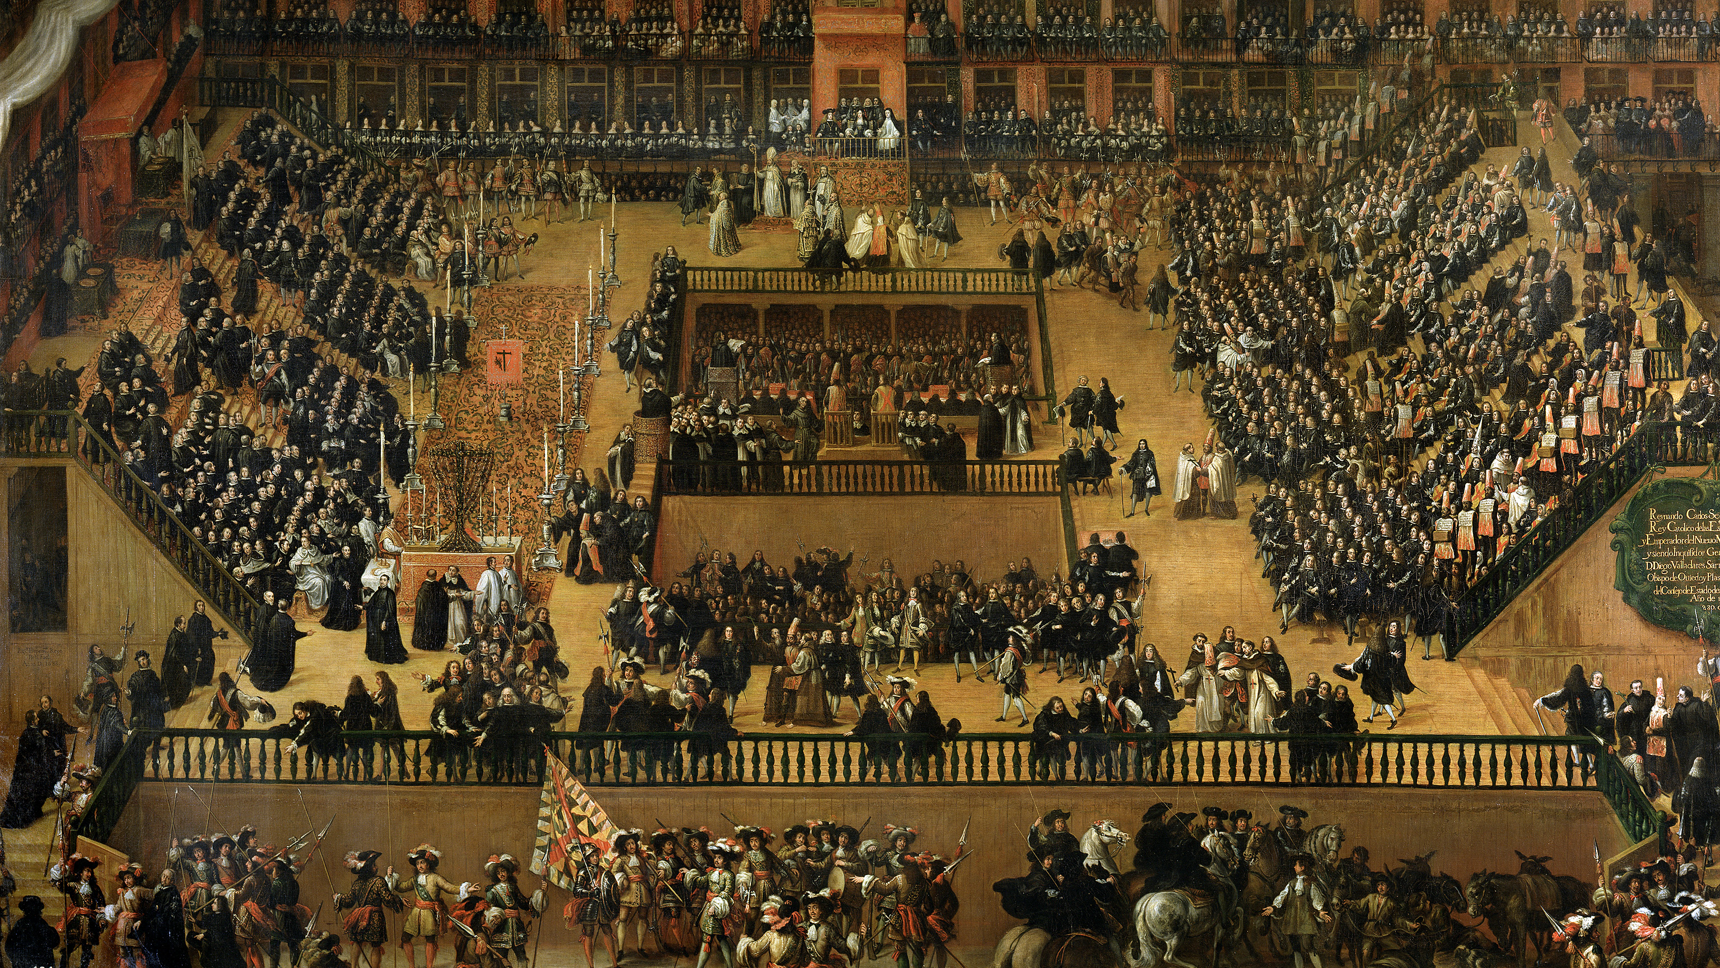
Auto de Fé (Witness of Faith)
Reconcile to the faith

Slide 6
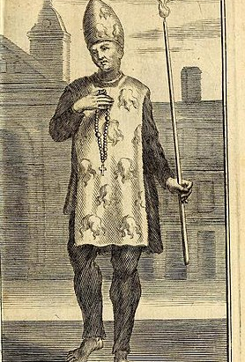
Inquisitorial Punishments: Penance
Payment of fines
Wearing of penitential garments
House arrest
Execution: repeat offenders

Slide 7
WHY? The “Converso” Problem
1391 ->
Thousands of Jews converted to Christianity
No attempt to teach them the faith
= Christian externally, but live in Jewish quarter and continue practicing Jewish customs OR leave behind Jewish past and live as Catholics

Slide 8
Purity of Blood Statues “Limpieza de Sangre”
E.g. Toledo 15th century
Prevent conversos from holding public office

Slide 9
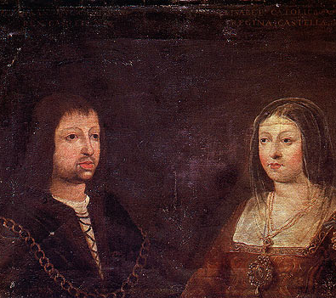
Fernando and Isabel: Motivations
Religious Zeal
Consolidation of Political Power
Monetary Gain
Fernando and Isabel, Wedding Portrait, 1469

Slide 10
Prosecution of Conversos
Height: 1480-1530
1000-1500?
Only held jurisdiction over Christians NOT Jews

Slide 11
Other Targets of the Inquisition
Alumbrados (heretical group)
Moriscos (converted Muslims)
Protestants
Other crimes: blasphemy, adultery, fornication, improper religious practices

Slide 12
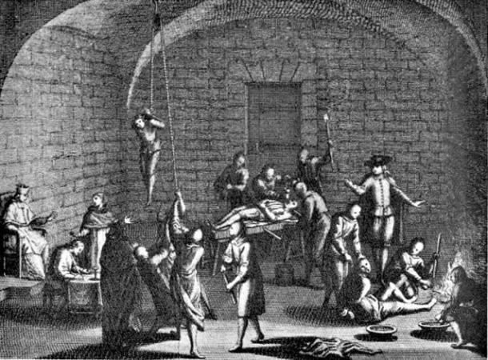
The Black Legend

Slide 13
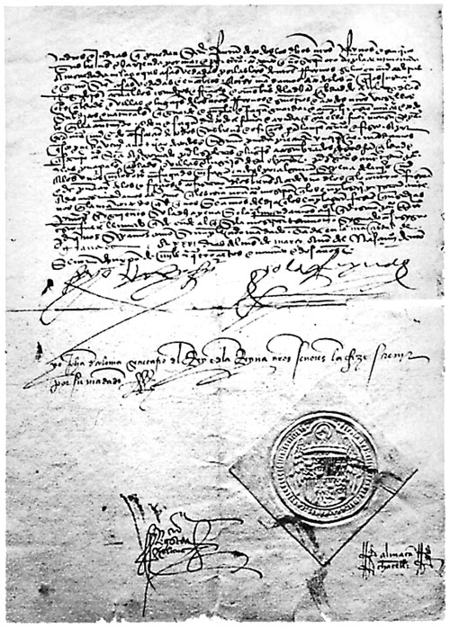
Edict of Expulsion,
March 31, 1492
No access to kosher food or Jewish texts for Judaizing Conversos
Judaism as male religion = study Talmud, Torah, and Midrash

Slide 14
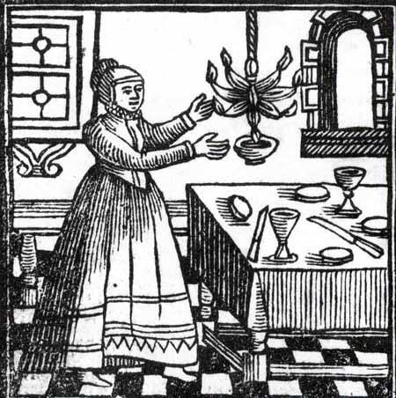
Domestication of Judaism
Lit candles on Fridays
Prepared Sabbath meals
Observed dietary laws (kosher)

Slide 15
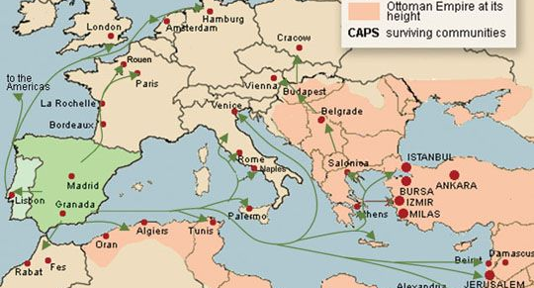

Slide 16
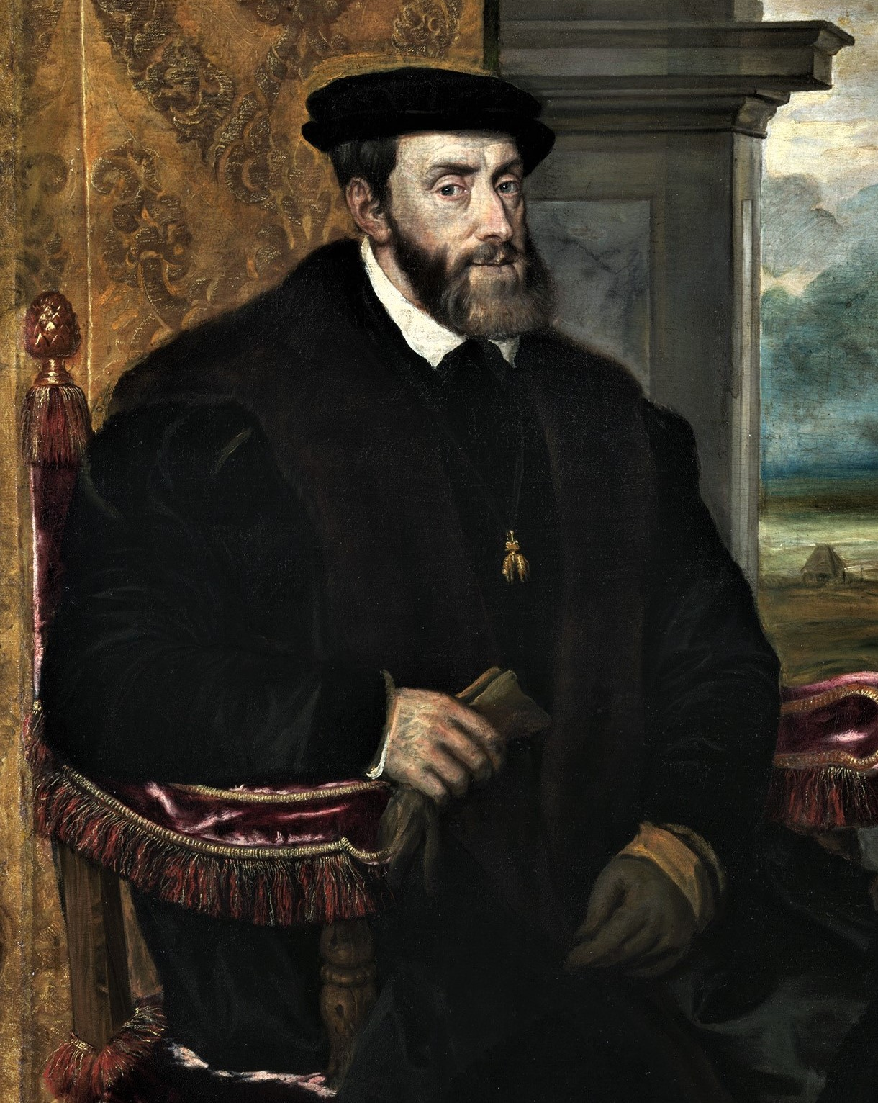
Isabel d. 1504
Fernando d. 1516
Grandson, Carlos I as heir

