Slide 1
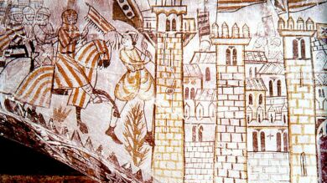
Conquest, Colonization, and the Formation of a Plural Society

Slide 2
11th/12th century changes…
Arrival of Almoravids (1080s)
Arrival of Crusaders from Western Europe (late 11th/early 12th centuries)
= shift to conflict based on religion

Slide 3
Our focus toda
1100-1300
Arrival of Almohads (1160) and impact
Battle of Las Navas de Tolosa (1212)
Conquests of Jaume I of the Crown of Aragon (1220 ->) and Fernando III of Castile (1230s ->)
Jews and Muslims under Christian rule

Slide 4
1195
1228-1248
1121-1147
1212

Slide 5
1121-1147: Foundation of Almohads
Founder = Muhammad ibn Tumart (1080-1128/30)
Guiding principle – Unity of God
Al-muwahhidun = “Unitarians” or “Upholders of Divine Unity”
Messiah = Mahdi – Caliph Abd al-Mu’min (1147 ->)

Slide 6
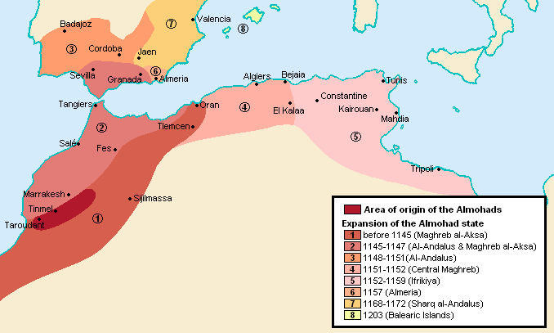
1159: Conquered Almoravids in North Africa
1160: Invaded Iberia
1173: Controlled Al-Andalus
1195: Defeated Alfonso VIII at Alarcos

Slide 7
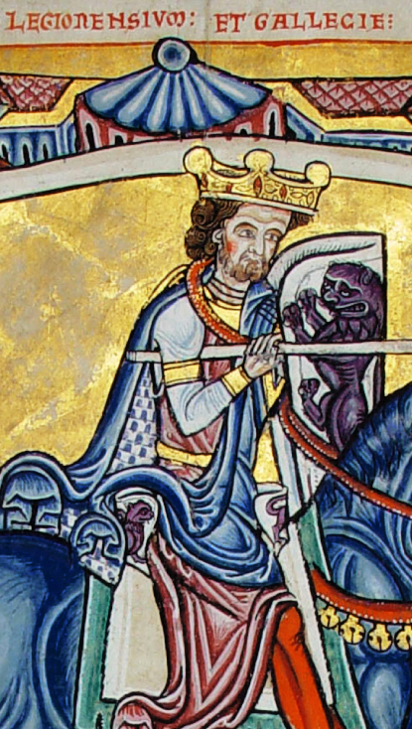
Loss at Alarcos, 1195
Christian divisions
1190: Alfonso IX of León headed coalition of Kings of Aragon, León, and Portugal against Alfonso VIII of Castile
Involvement of Popes Celestine III and Innocent III
Alfonso IX of León and Galicia,
(1171-1230)
Alfonso IX of León and Galicia
(1171-1230)
Alfonso VIII of Castile (1155-1214)

Slide 8
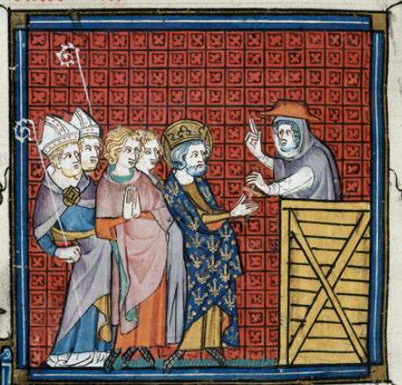
The Road to Las Navas de Tolosa (1212)
Preach a Crusade
Union of Spanish kingdoms (late May 1212)
Castile/France under Alfonso VIII
Aragon under Pedro II
Navarre under Sancho VII

Slide 9
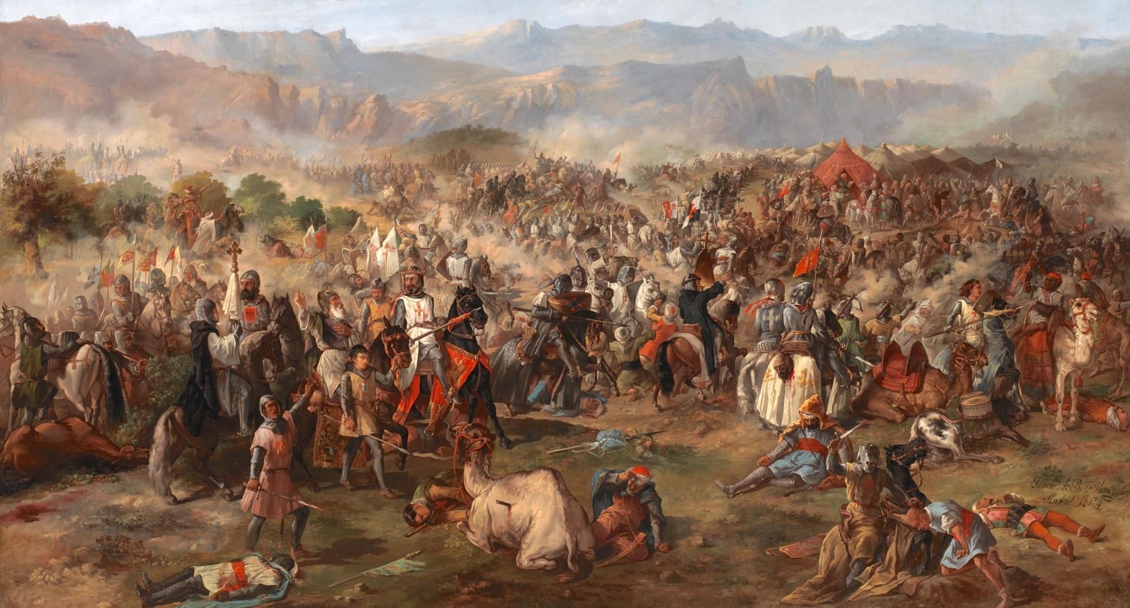
July 16, 1212: Las Navas de Tolosa

Slide 10
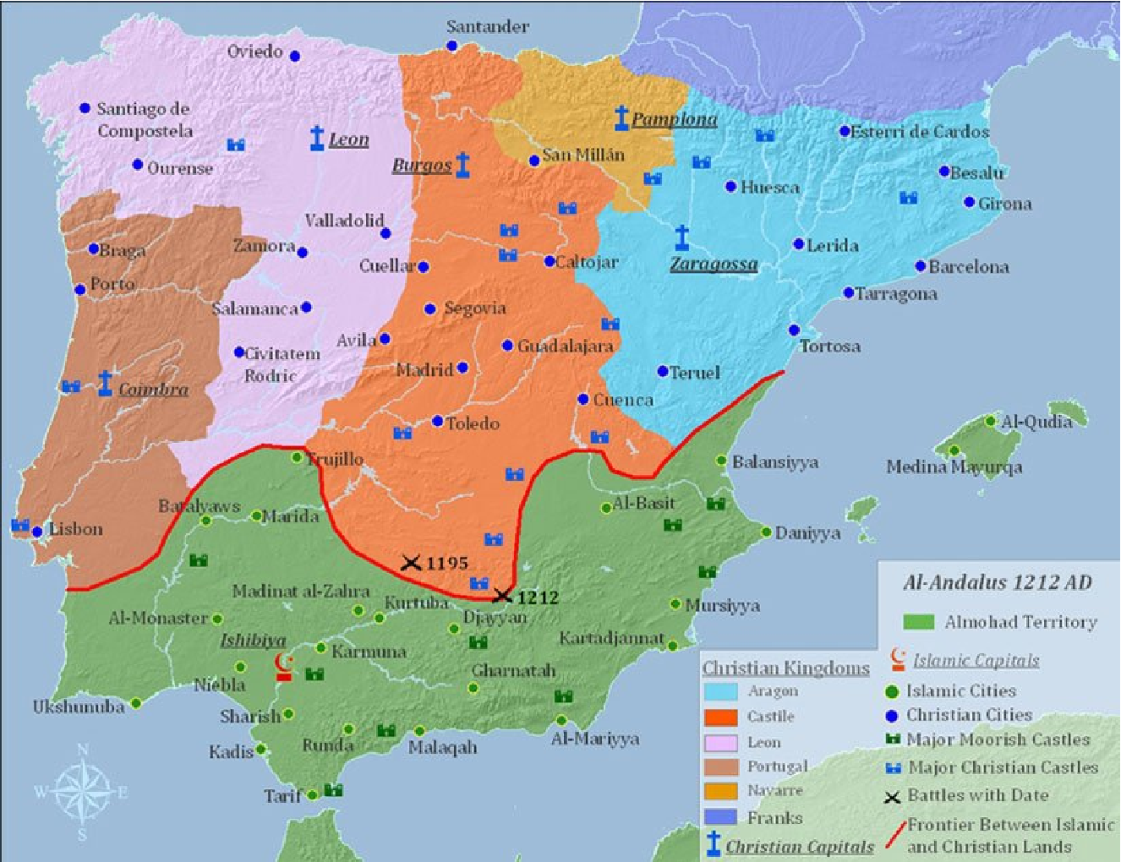
Las Navas de Tolosa

Slide 11
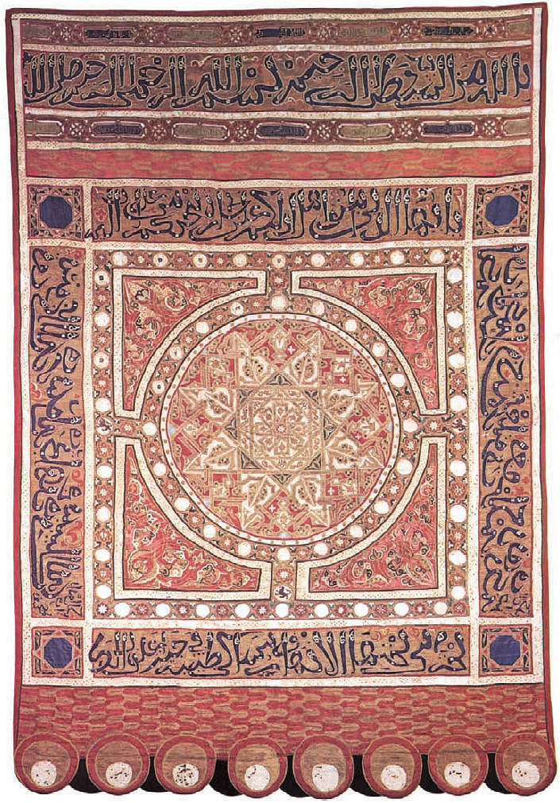
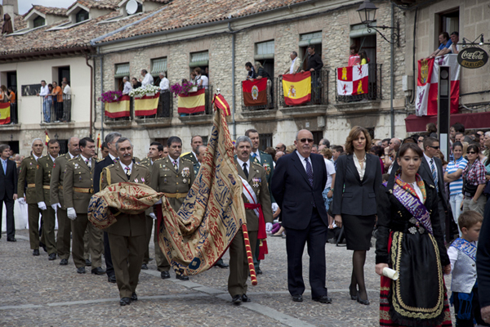
Almohad Banner, now at Monastery of Las Huelgas, Burgos

Slide 12
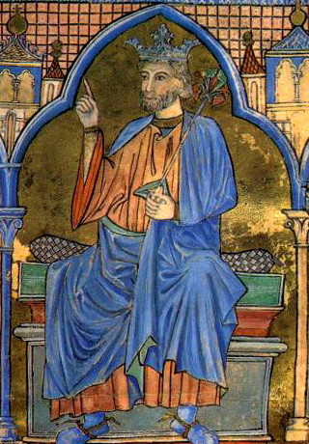
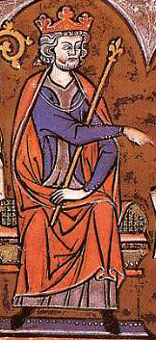
Fernando III of Castile
(r. 1217-1252)
Jaume I of Aragon
(1213-1276)

Slide 13
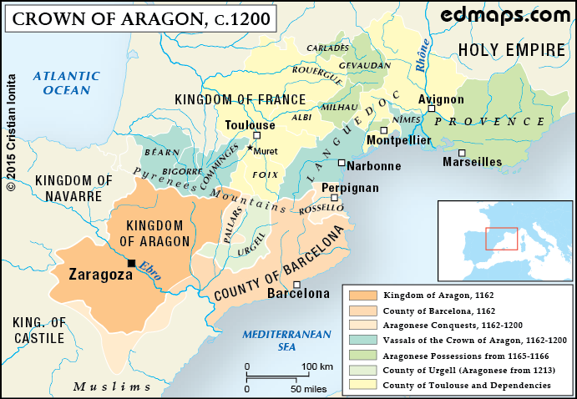

Slide 14
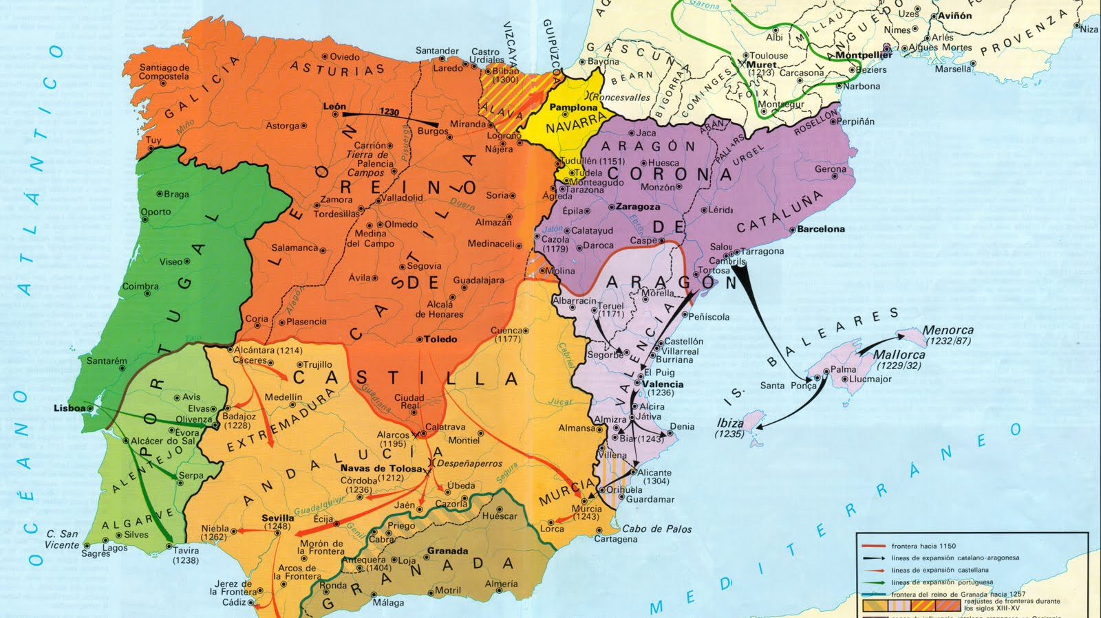
1228-1232
1236-38 with Templars, Hospitallers, Santiago, Calatrava

Slide 15
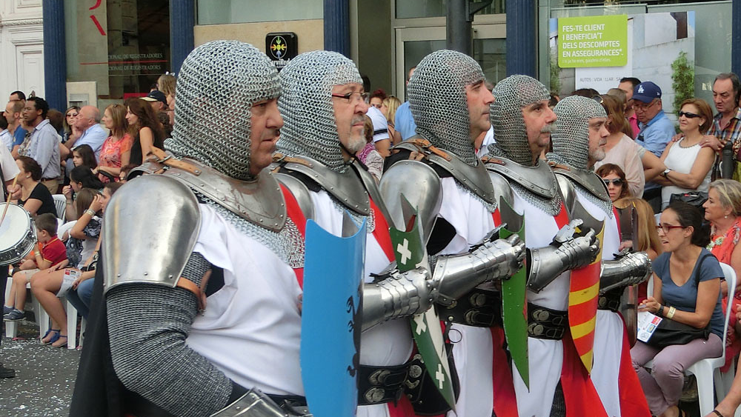
Nou D’Octubre (October 9th)

Slide 16
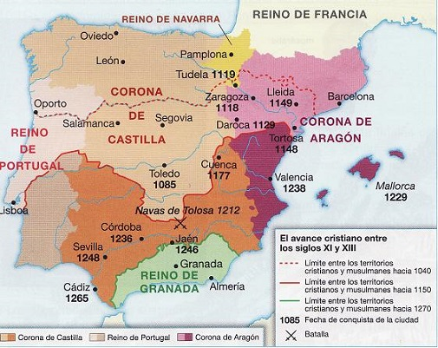

Slide 17
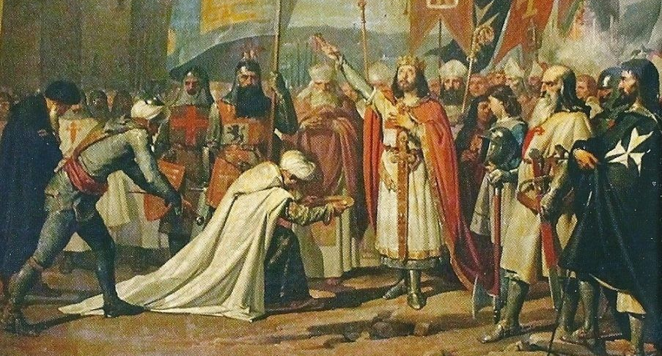
Conquest of Cordoba, June 29 1236
by Fernando III

Slide 18
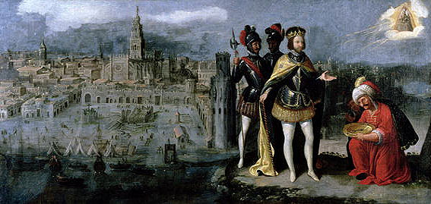
Conquest of Seville, Dec. 22, 1248 by Fernando III

Slide 19
Mudéjars post-Conquests
Some expulsions, enslavement, or executions
Aljamas
Freedom of religion, live under Sharia, choose own officials
Pay taxes to King “royal treasury”

Slide 20
Mudéjars post-Conquests
Sexual relationship forbidden
No work on Christian Sabbath
Segregation
Mosques converted to Churches

Slide 21
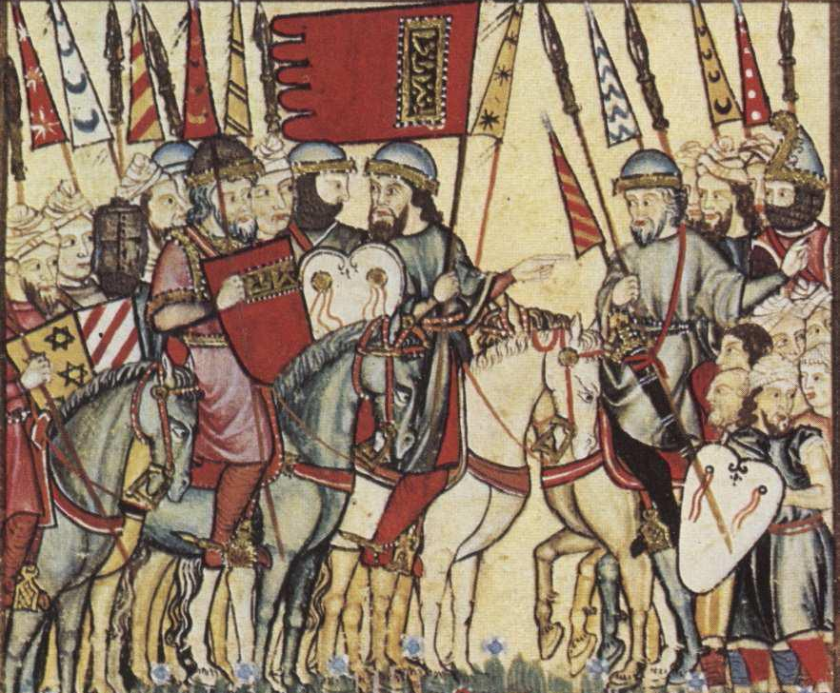
Mudéjar Revolts
Castile: 1264-66
Aragon: 1275-77

Slide 22
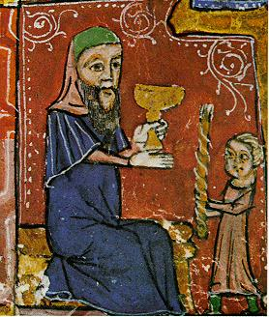
Urbanized
Advisors and officials
Bailiffs and tax collectors (until 1283 under Pere II)
Jews in the Christian Kingdoms

