Slide 1
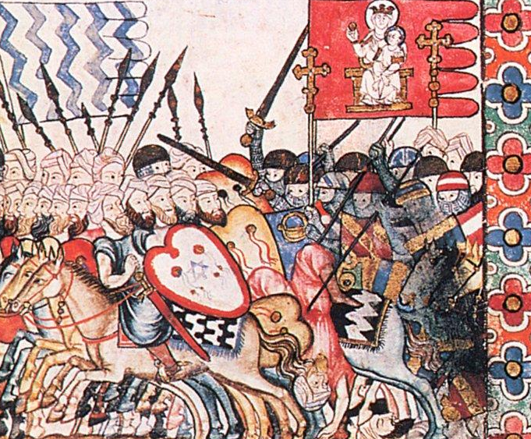

Conquest, Crusade, and Frontier Society

Slide 2
Pre-1085
Post-1085
Conflict based on wealth/territory not religion
Muslims and Christians as allies
Christians and Muslims as mercenaries
Arrival of Almoravids (fundamentalist Muslims from North Africa)
Arrival of Western European Christian warriors on pilgrimage and crusade
= conflict as jihad
/holy war

Slide 3
In today’s class…
Rise and expansion of the Almoravids (1040s ->)
Alfonso VI and the Conquest of Toledo (1085)
Arrival of Crusading Ideals into Iberia
Establishment of a Frontier Society

Slide 4
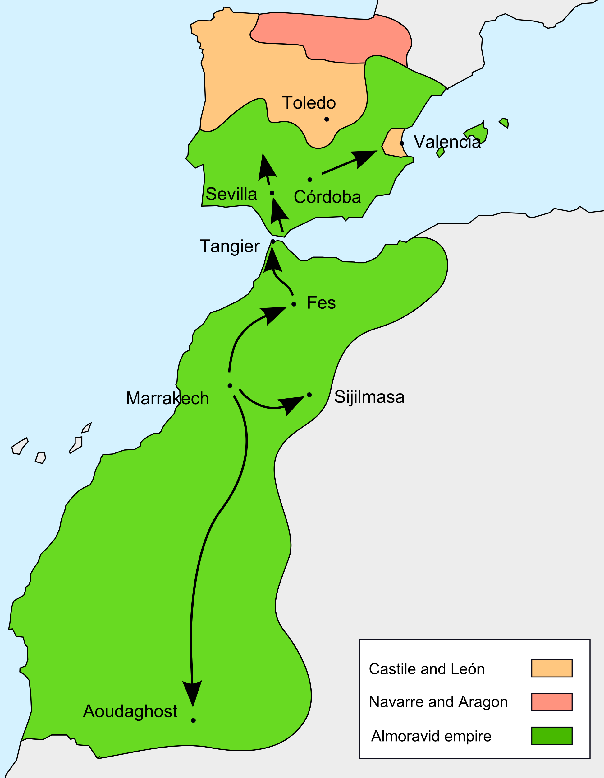
Almoravids
1040s
Established ribat by Ibn Yasin
1050s
Conquered Morocco
1070s
Conquered Ghana
1120
1086-
1108
Conquered Taifa kingdoms in Iberia

Slide 5
Almoravids and Taifas
Taifas as in a state of rebellion (not subservient to Abbasid caliph in Baghdad)
Payment of parias against Sharia

Slide 6
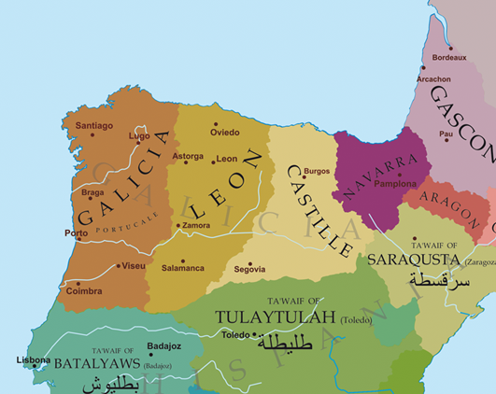
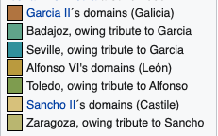
Alfonso VI of Castile-León
Defeated and imprisoned by Alfonso 1071 +1073
(1041-1109)
1065
Killed (by Alfonso?) 1072

Slide 7
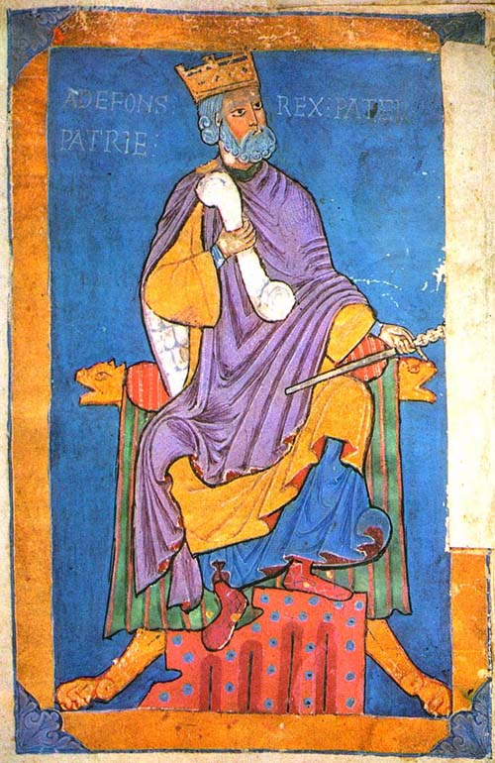
Alfonso VI and the Taifa of Toledo
Poor leadership of Al-Qadir = conquest of Toledo by Alfonso (1085)
Image: Cathedral of Santiago (13th c.)

Slide 8
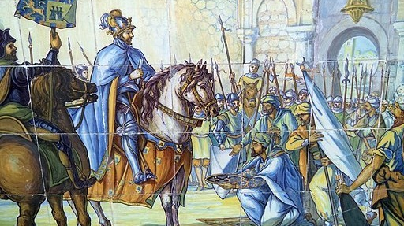
Alfonso VI conquers Toledo
Tiled image:
Plaza de España, Seville

Slide 9
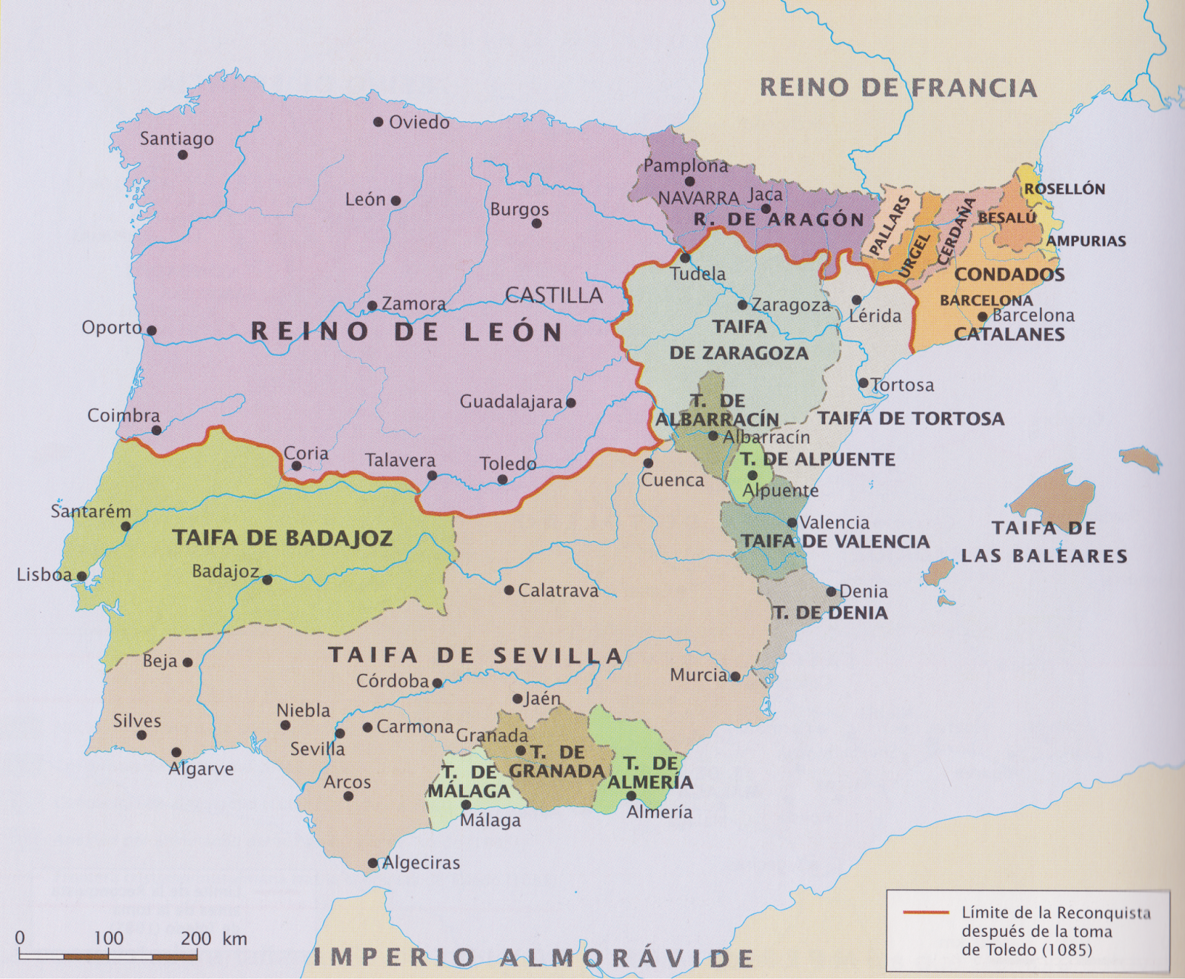

Slide 10
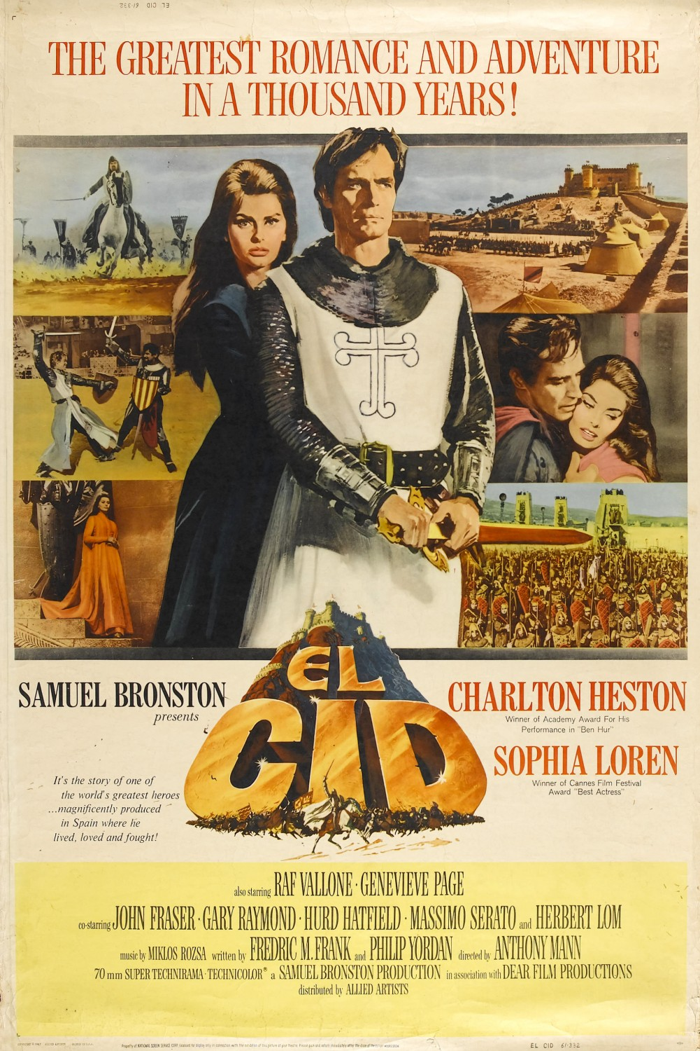

Rodrigo Díaz
de Vivar
“El Cid”
(1043?-1099)

Slide 11
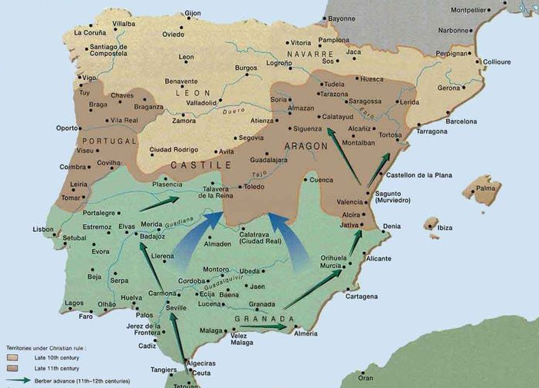
1090-1110
Almoravids conquer taifas
Almoravids defeat Alfonso VI at Badajoz (1086)

Slide 12
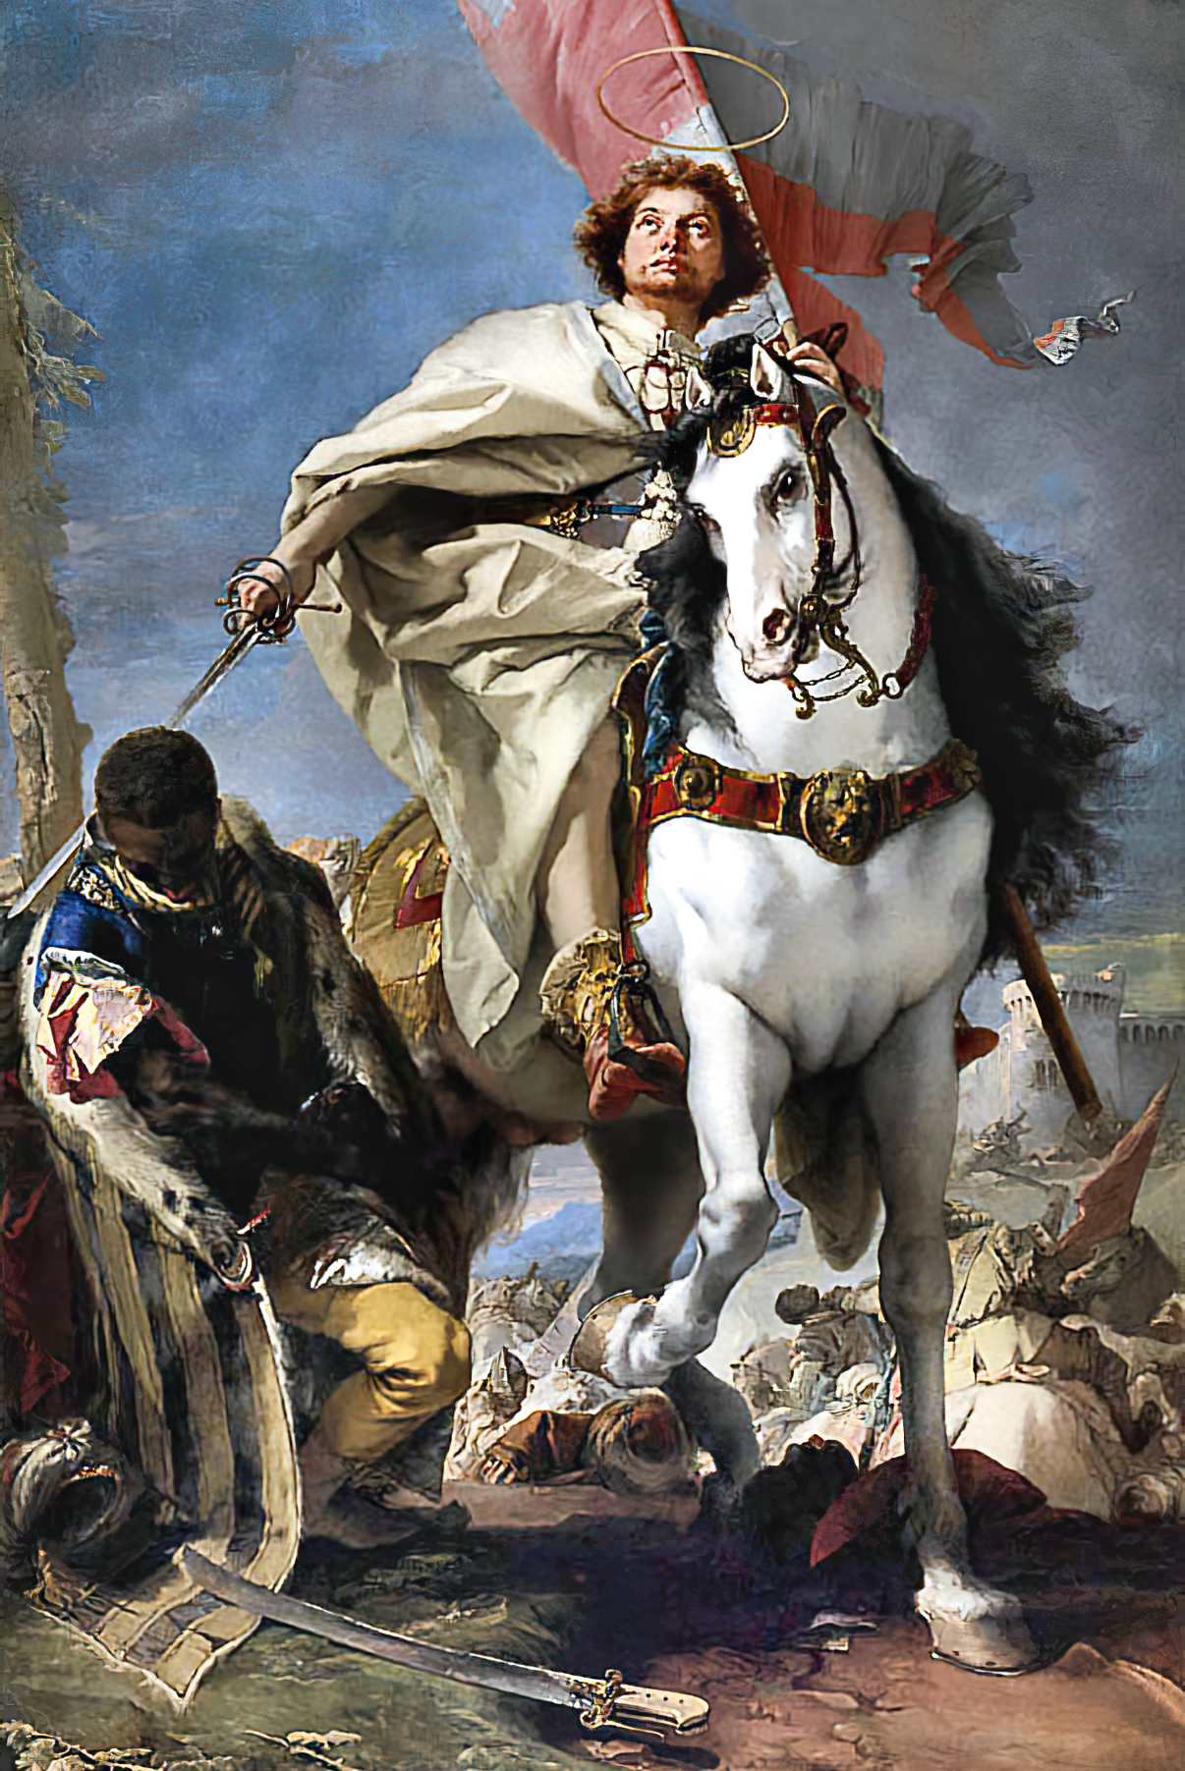
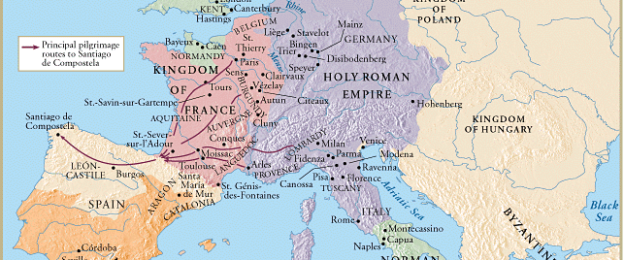
Warrior-Pilgrims and Santiago de Compostela
St. James Matamoros (Moor Slayer) 18th c.

Slide 13
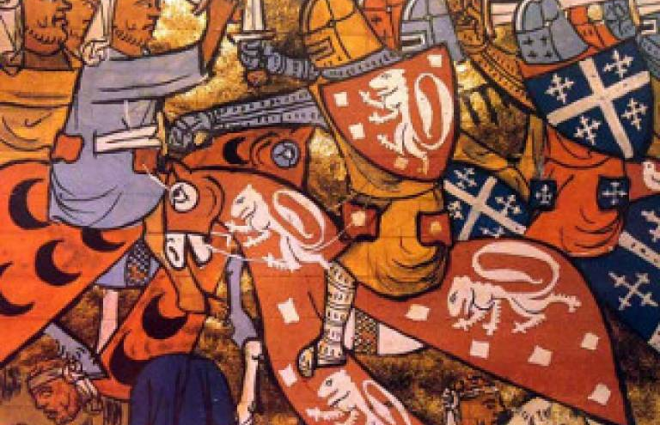
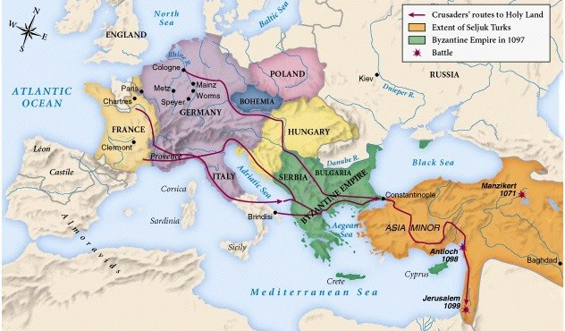
Pope Urban II (1095)
Conquest of Jerusalem (1099)

Slide 14
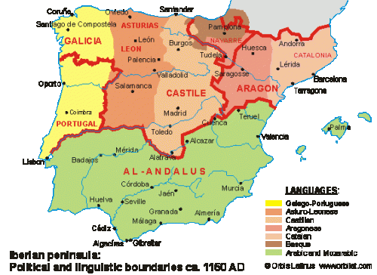
Frontier Society:
Minorities
Jews as the “royal treasury”
Muslims as mudéjars
Jews = urban
Muslims = urban and rural

Slide 15
Frontier Society:
Urban Centres
Militarized
Nobility dominated urban politics (Castile)
Role of defense

Slide 16
Frontier Society:
Women
Arrive with families
Arrive on own
Arrive as captives
Toledo (1118): all married men required to have wives and children present to own property

Slide 17
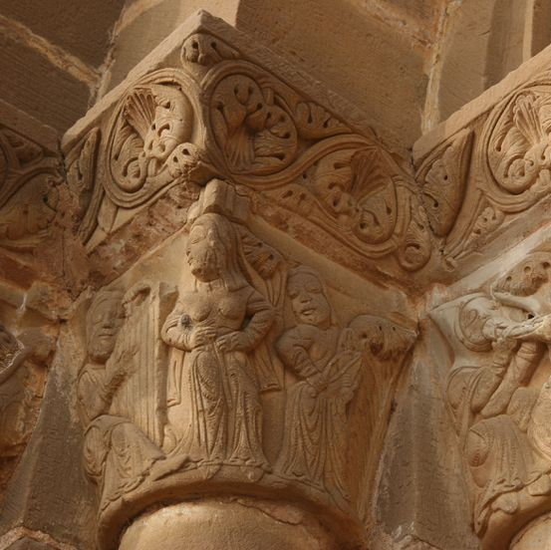
Women, Property,
and Sexual Relationships
Partible inheritance from Visigothic Code
Local fueros
Concubinage
Marriage by abduction
Image: Women carved in a church in Huesca

Slide 18
Conquest, Crusade, and Frontier Society

