Slide 1
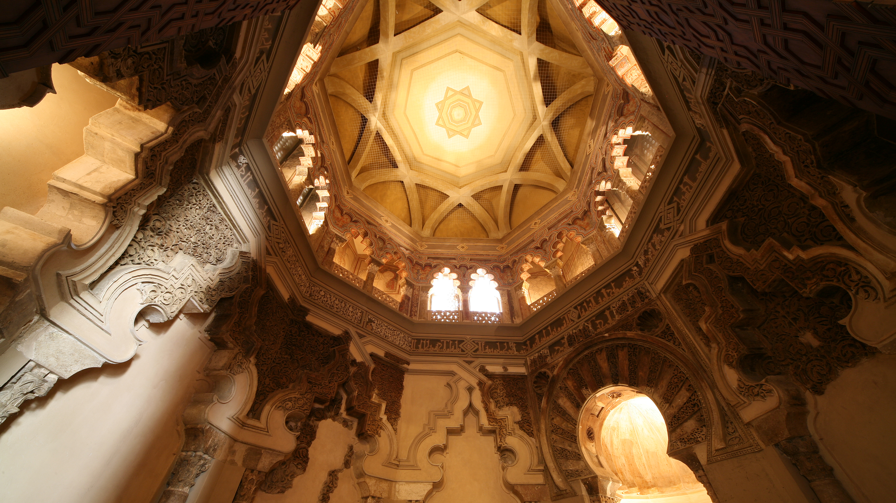
FRAGMENTATION:
Christian Northern Kingdoms and Muslim Taifas Kingdoms

Slide 2
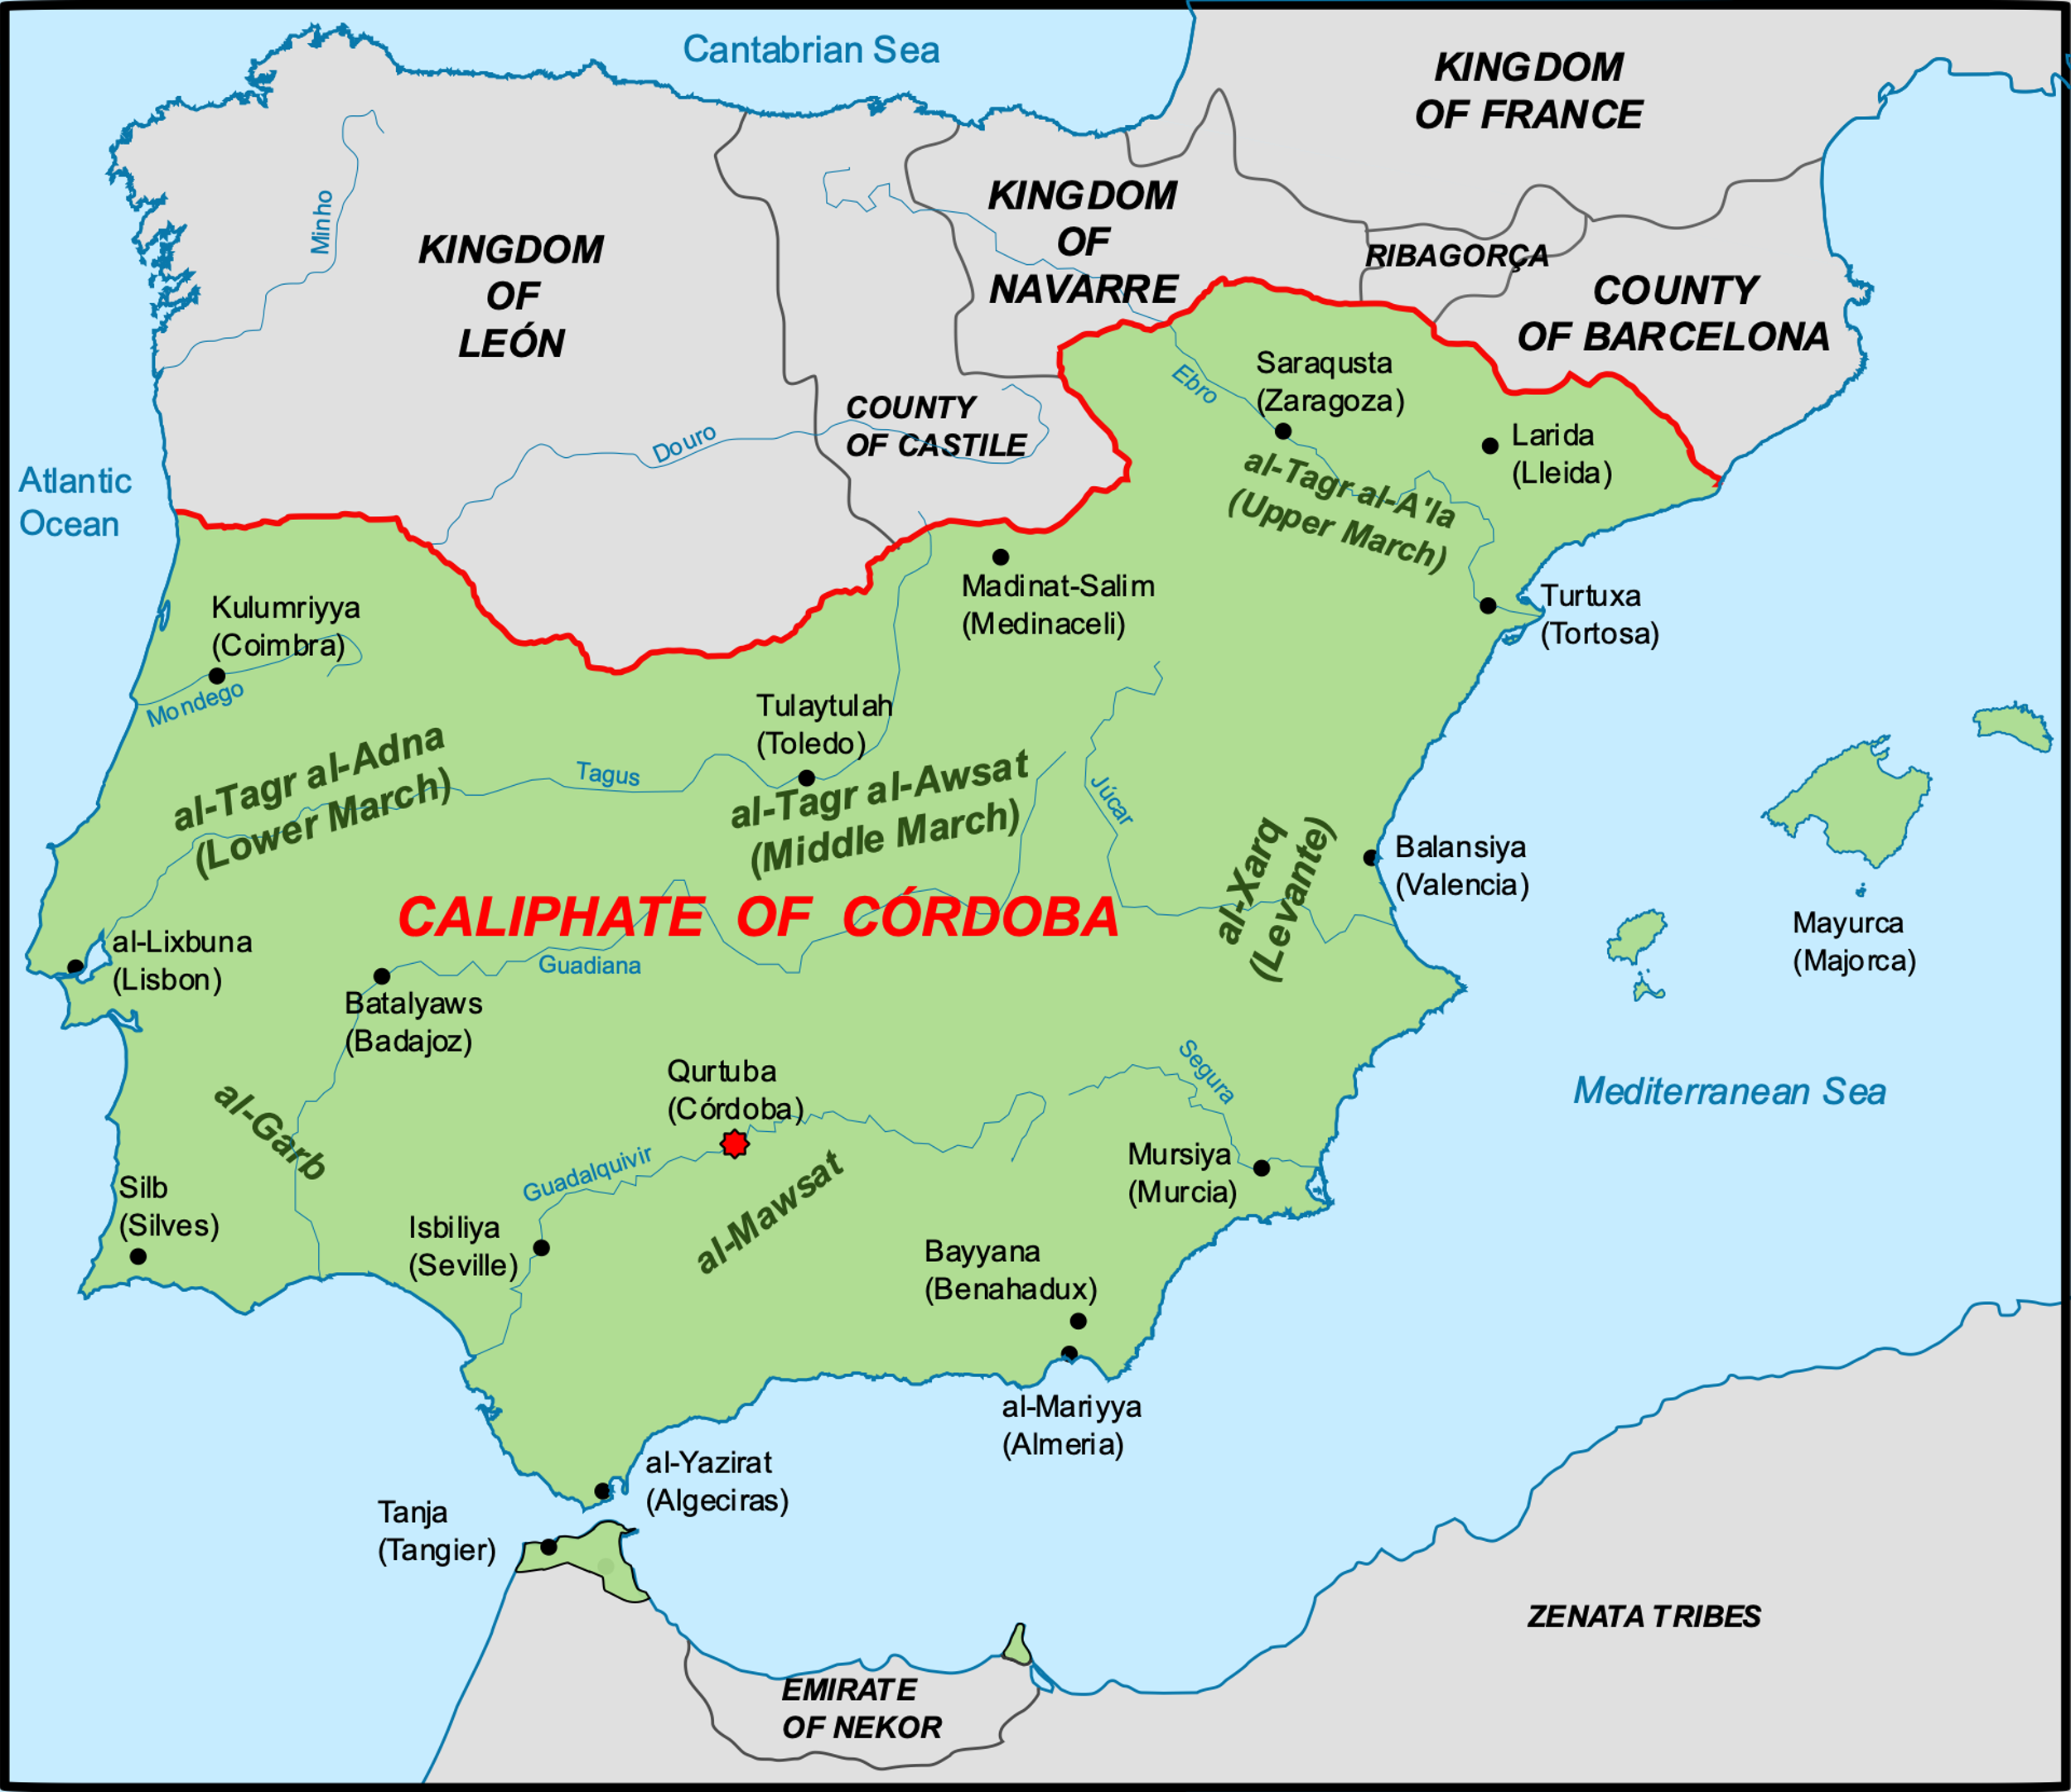
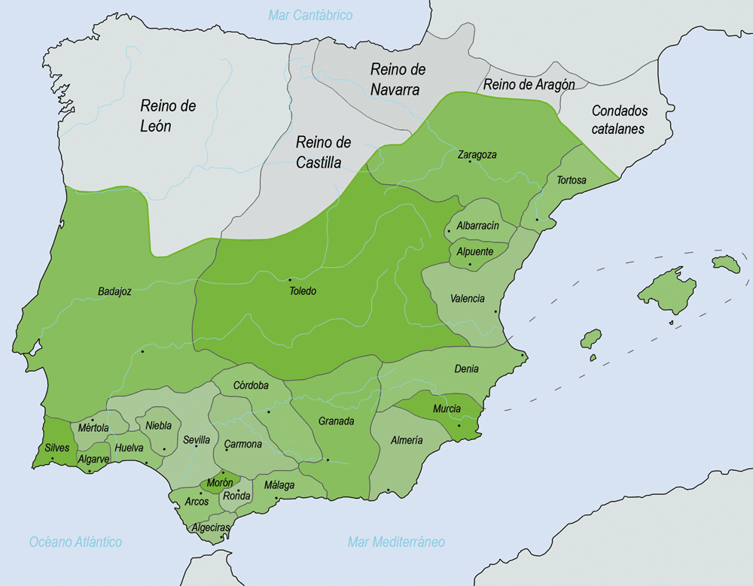
Taifa kingdoms

Slide 3
Christian Kingdoms in the North (10th c.)
Government, social and economic organization, minorities
Taifa Kingdoms (1008-1090)
Breakup of Umayyad Caliphate
Establishment of taifas
Rome of minorities

Slide 4
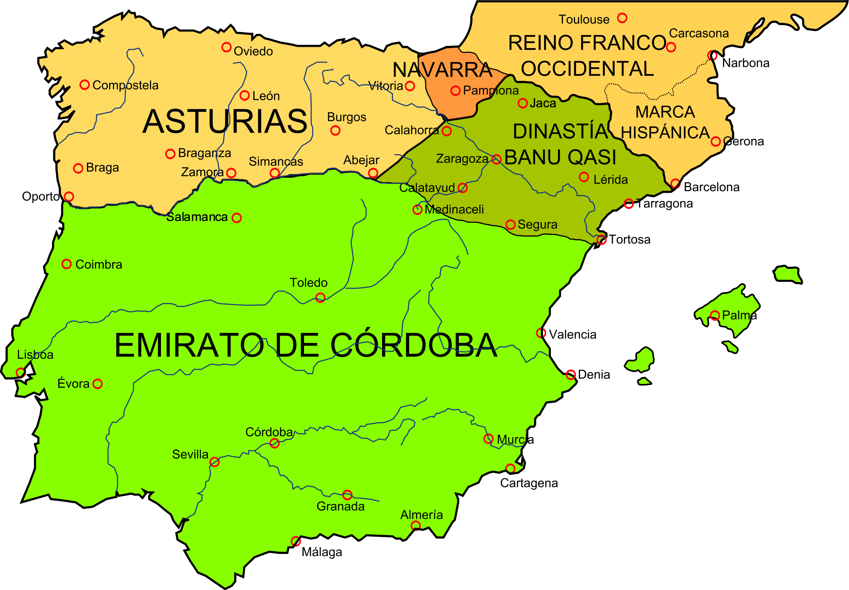
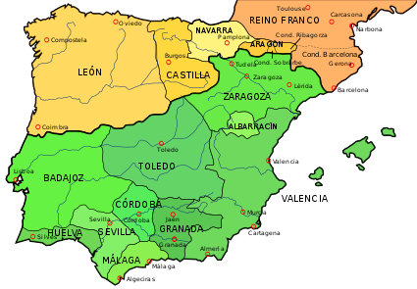
Kingdom of Asturias-León
Kingdom of León
County and then Kingdom of Castile (931)
1037
910

Slide 5
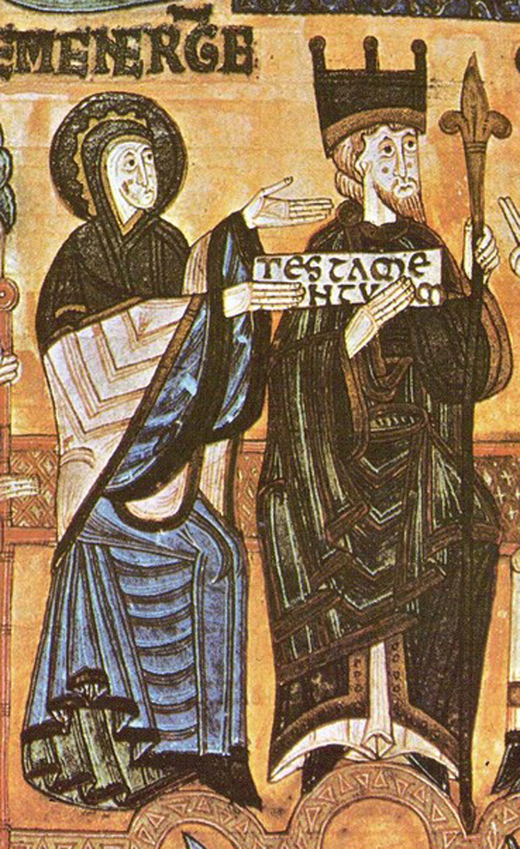
Government
Hereditary monarchy
King
Justice
Guard Catholicism
Defend frontier
Appoint officials
Itinerant government
King and royal council
Ecclesiastical affairs
Secular affairs
Image (1118): King Alfonso III (866-910) and Queen Jimena

Slide 6
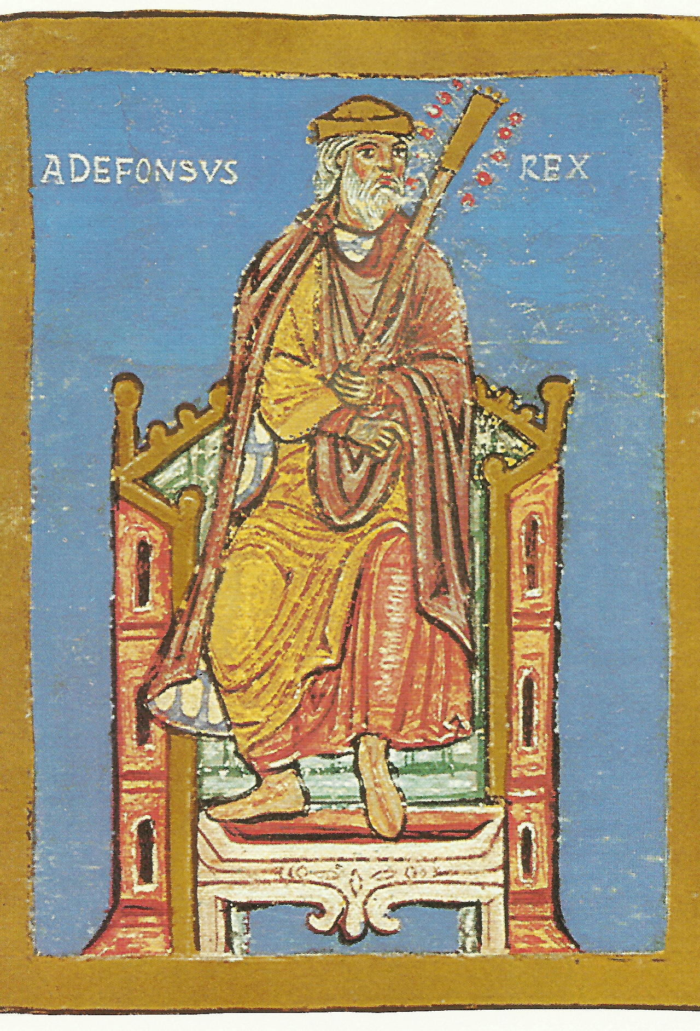
Socio-Economic Structures
Hierarchical
Nobility as warrior class
Magnates
Caballeros (knights)
Image: Alfonso III (from church of Compostela)

Slide 8
Feudalism = relationship of dependence among those of unequal status based on land tenure arrangements
Only in Catalonia (north-eastern Spain)
Other systems:
Land grants to nobles for military service
Oaths of fealty but no land grant
Rented land as tenant farmers

Slide 9
Jews and Muslims in Christian Kingdoms
Muslims as captured slaves (some freed)
Small Jewish communities
Freedom of religion
Communal autonomy
Payment of taxes

Slide 10
Collapse of the Caliphate
1008
Death of Abd al-Malik (first minister, son of Al-Mansur)
Muhammad (Caliph 1008; support of Barcelona)
1009
Suleyman (defeated Muhammad; support of Castile)
1010
Assassination of Muhammad
Restoration of Hisham II as Caliph
1013
Disappearance and presumed death of Hisham II
Suleyman as Caliph (to 1016)

Slide 11
Berbers
Slavs
Andalusians
From North Africa (10th c.)
Mercenary troops
From Francia, Germany, and other parts of Europe
Slaves and mercenary soldiers
Descendants of old Berbers, Arabs, converted Christians
No previous military role

Slide 12
Umayyad elite
Slavs
1037
Berber

Slide 13
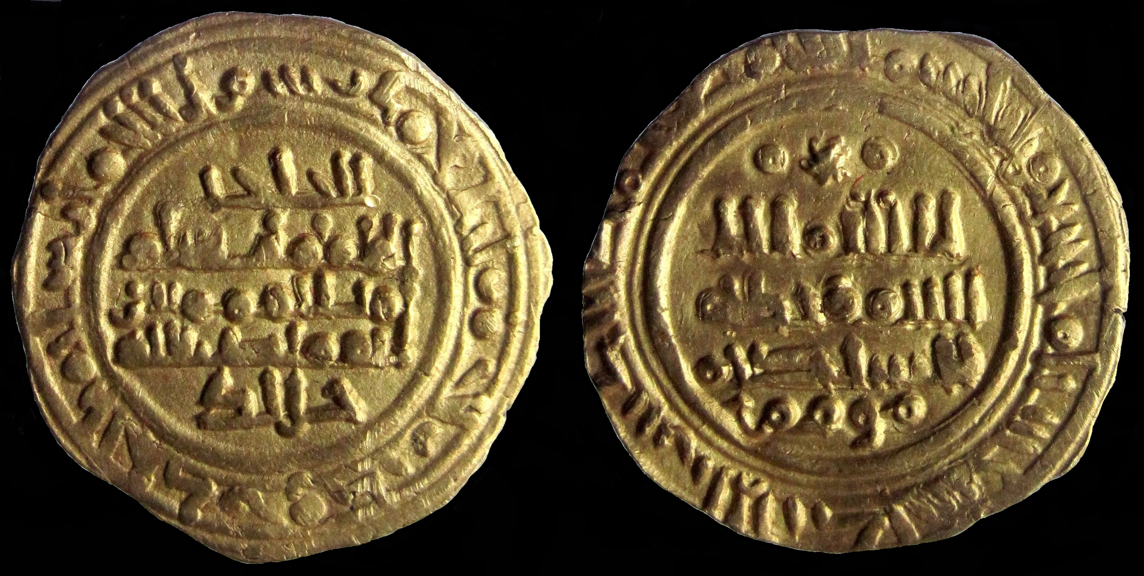
Parias =
annual tribute
Coins from mid-11th c.

Slide 14
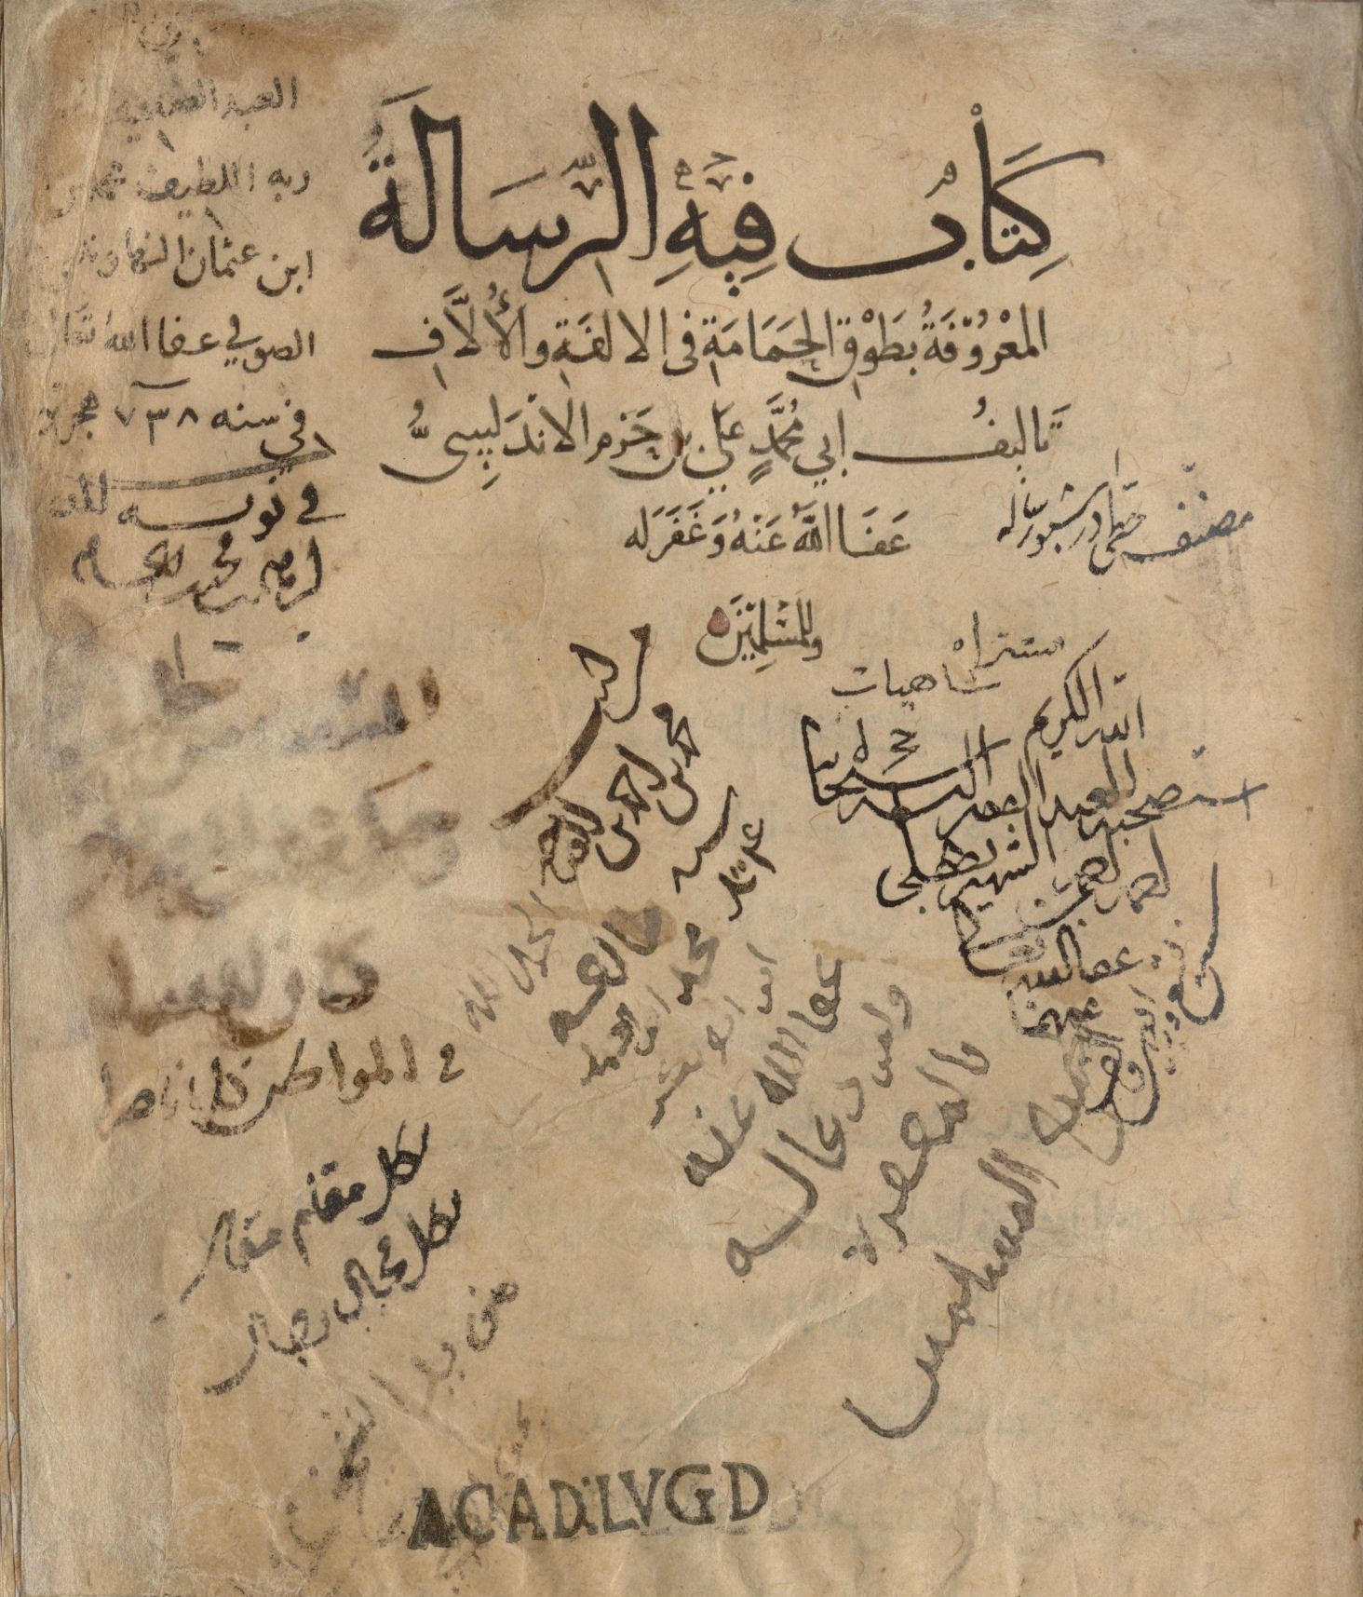
Ibn Hazm (994-1064)
Administrator
Scholarship (theology, philosophy, jurisprudence)
The Ring of the Dove

Slide 15
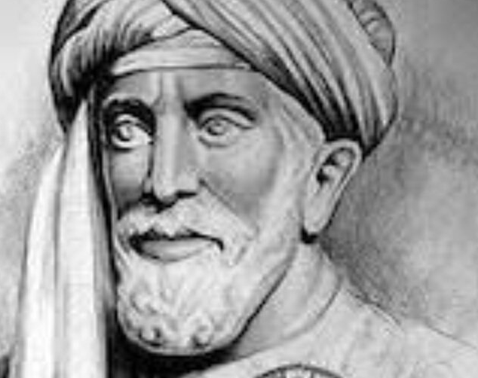
Samuel ibn Nagrila (993-1056)
General
Advisor to ruler of Granada
Leader of Jewish community

