Slide 1
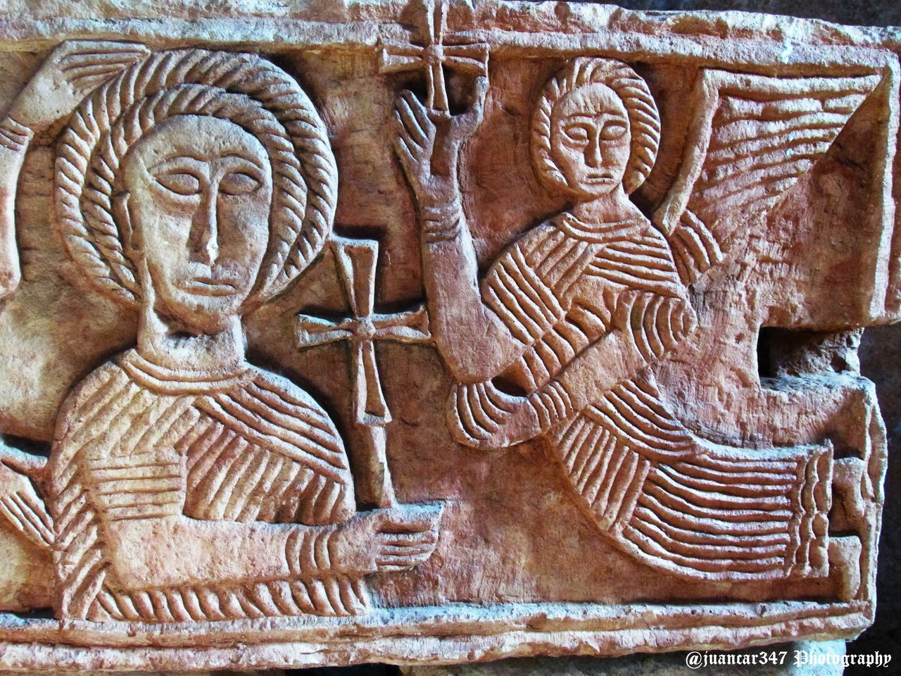
Visigoths
Image: Hermitage of Quintanilla de la Viñas
https://steemit.com/travelfeed/@juancar347/chronicle-of-visigothic-spain-quintanilla-de-las-vinas

Slide 2
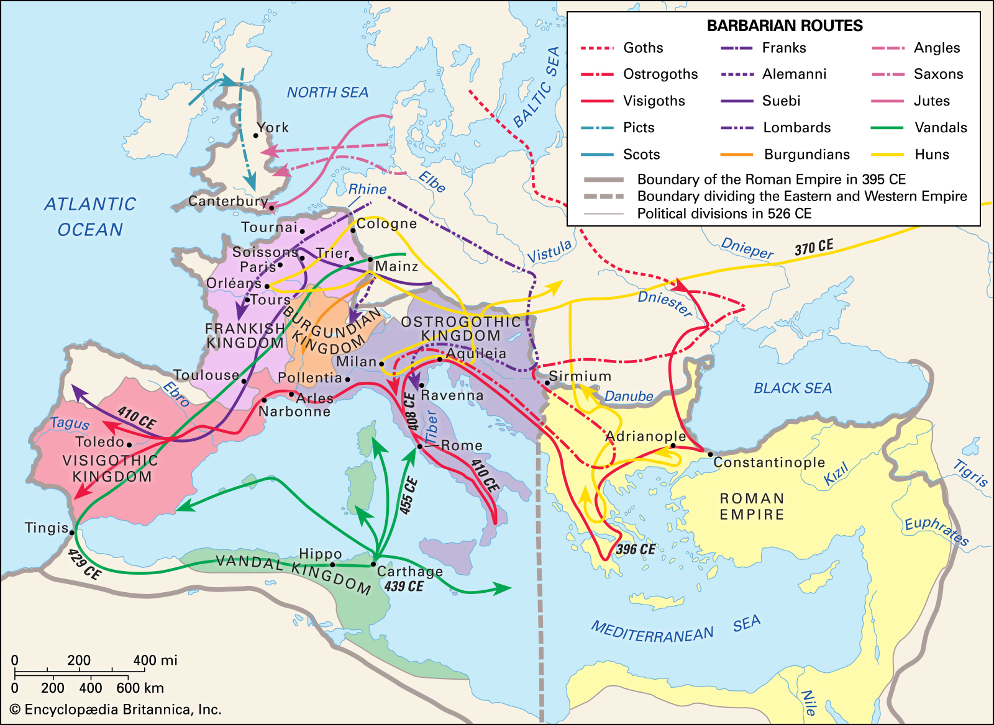
Barbarian Invasions/Migrations
(4th to 5th centuries)

Slide 3
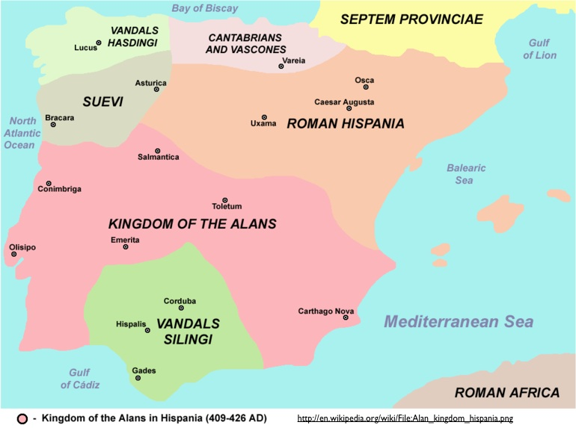
Roman and Germanic Iberia,
5th century

Slide 5
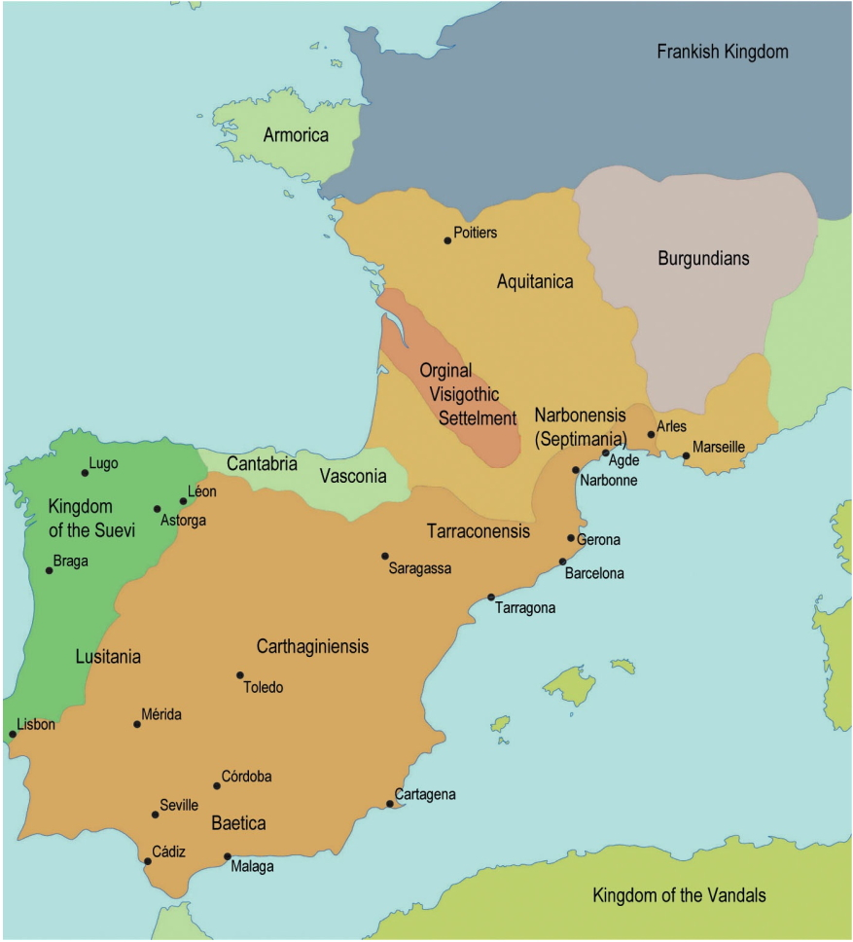
Only other unification of entire peninsula = 1580-1640
Territory conquered by Franks (507)
Visigothic Kingdom:
507-711
Visigothic Kingdom

Slide 6
In today’s class…
Kingship and Unification
Religion (Conversion to Catholicism)
Policy regarding Jews
Law and Legal Codes

Slide 8
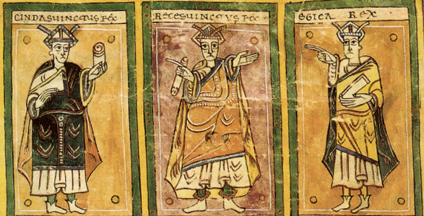
Unification and Kingship

Slide 9
416: Arrived in Spain
418-490s: Withdrew to Gaul
507: Defeat by Franks at Vouillé

Slide 10
People in Visigothic Spain
Initially separate
Eventually Visigoths adopt Latin, Catholicism, Roman administrative structure, Roman ideas of state/kingship/law
Intermarriage
Hispano-Romans (indigenous Iberians-Roman) = bulk of population
Visigoths = small ruling military elite

Slide 11
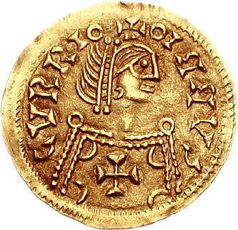
King Leovigild/Liuvigild
Ruled 569 to 586
Toledo as central city

Slide 12
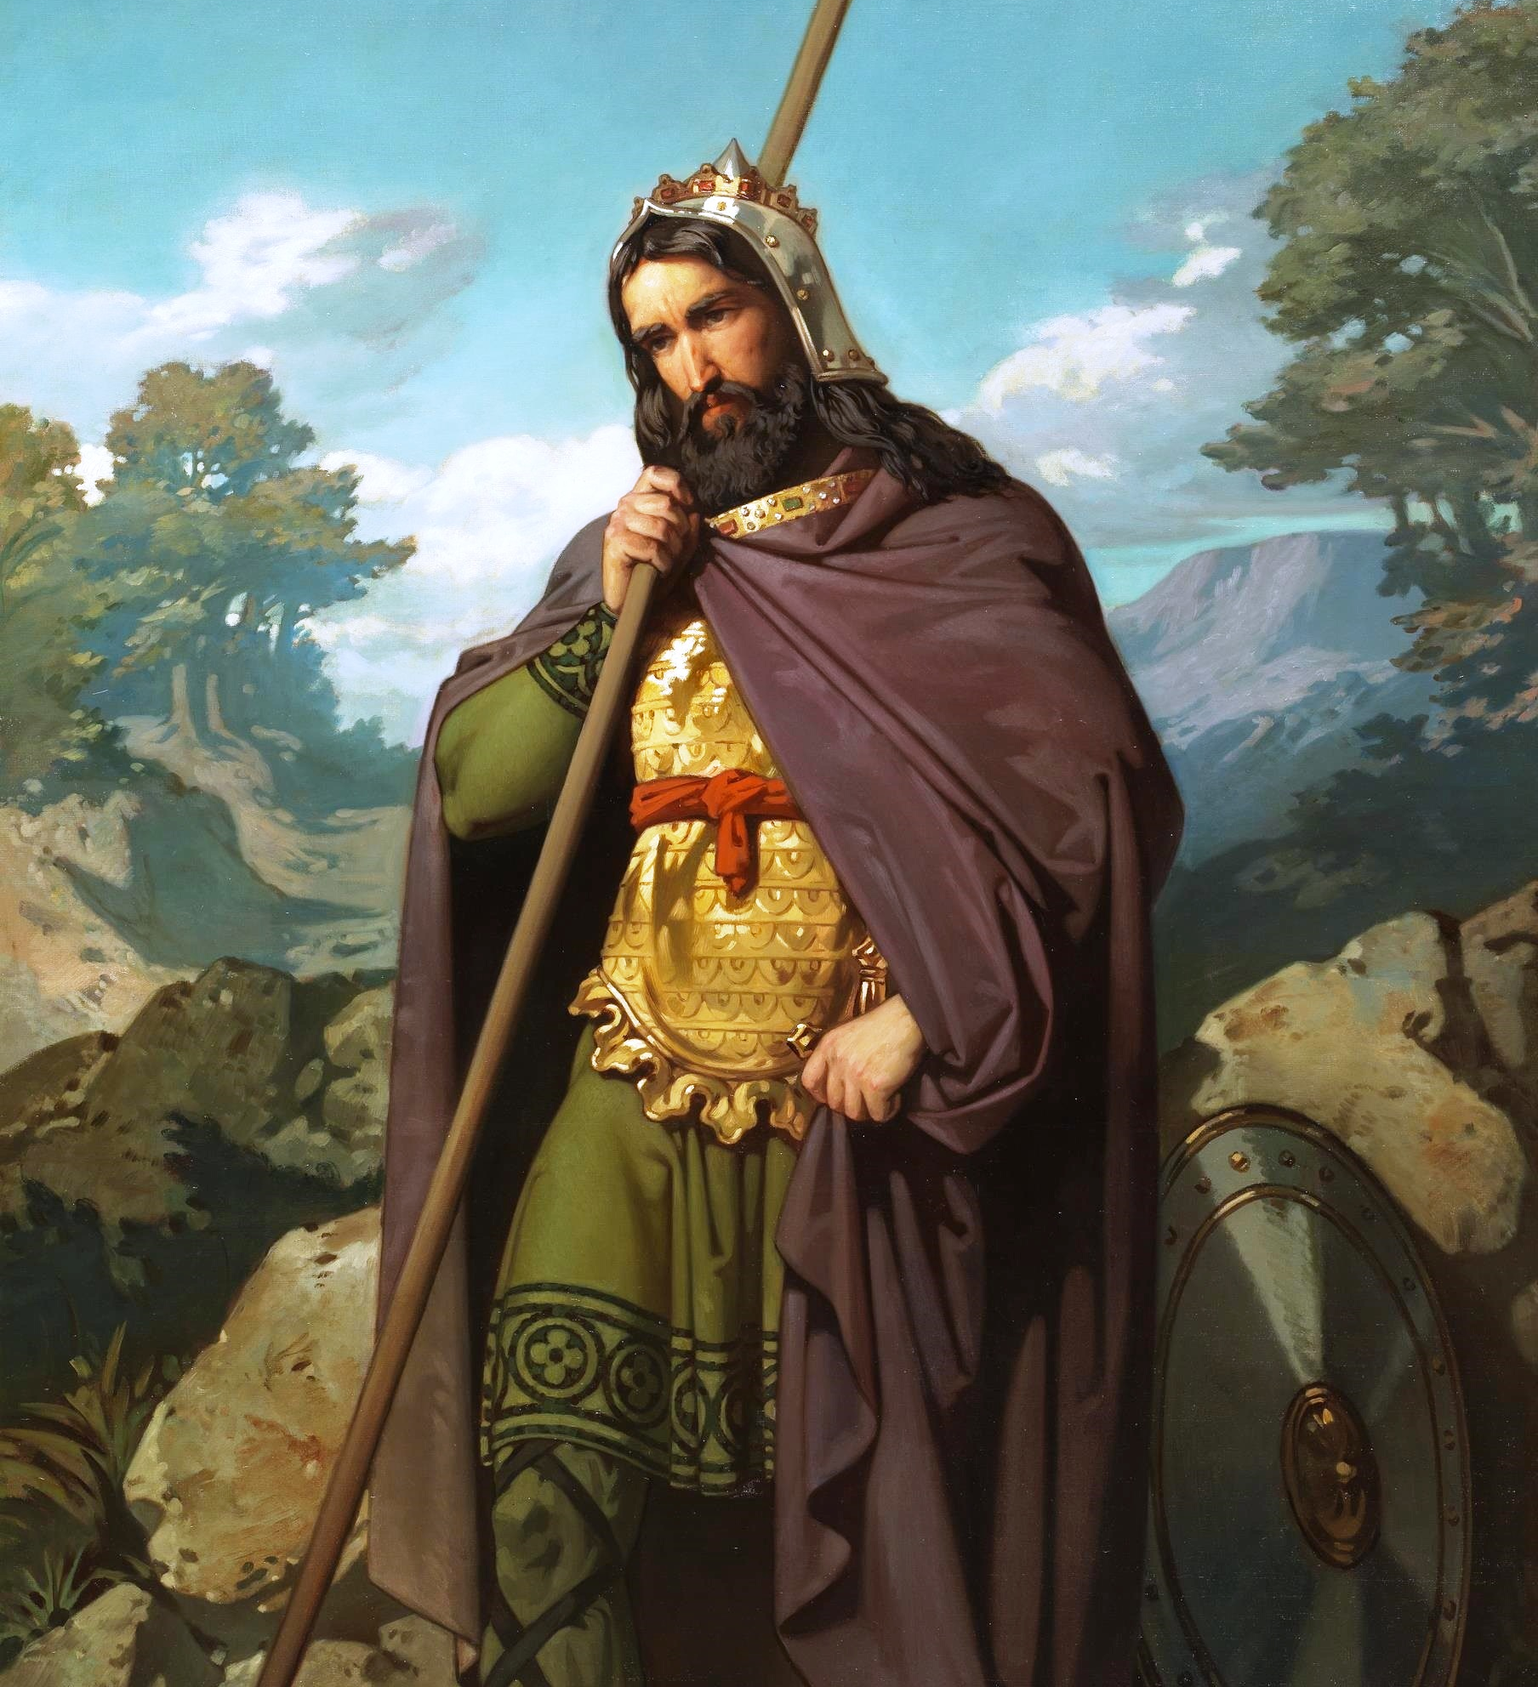
Image by Juan de Barroeta (1854)
Kingship under Leovigild
Oath of fidelity
Crown, scepter, purple mantle, sword
After Visigoths convert to Catholicism
Anointed with holy oil

Slide 13
Practicalities of Visigothic Kingship
Legislation
Administration
War
Foreign policy
Judicial tribunal

Slide 14
Kingship as ELECTIVE
Dynastic instability
Potential Problems?
Factionalism

Slide 15
Visigothic Kings (586-713)
Reccared I, 586-601
Liuva II, 601-603
Witteric, 603-610
Gundemar, 610-612
Sisbut, 612-621
Reccared II, 621
Suinthila, 621-631
Sisenand, 631-636
Chintila, 636-640
Tulga, 640-642
Chindasuinth, 642-653
Reccesuinth, 649-672
Wamba, 672-680
Erwig, 680-687
Egica, 687-702
Witiza, 700-710
Achila, 710?-13?
Roderic, 710-711

Slide 16
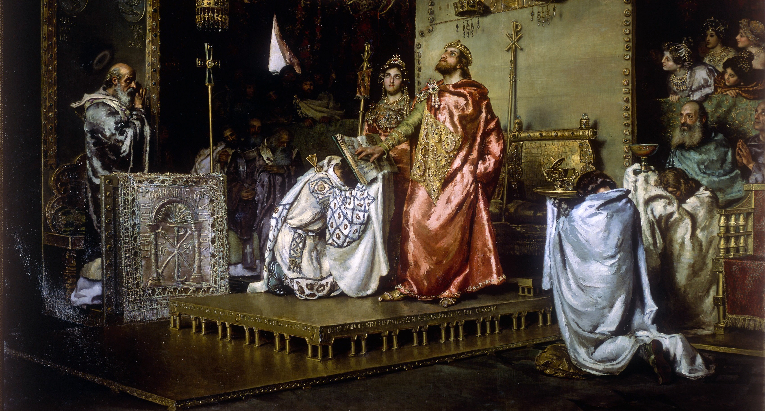
Conversion to Catholicism

Slide 17
Visigoths as Arian Christians
From Arius (4th century)
Questioned the divinity of Jesus
Did not believe in Catholic Trinity (God the Father, Son, and Holy Ghost)
Declared a heresy (325)

Slide 18
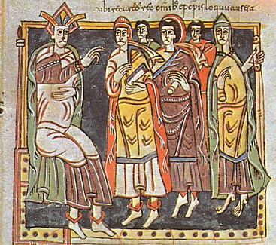
Reccared I
(r. 586-601)
Third Council of Toledo (589)
Kings take role in affairs of church
Call ecclesiastical (church) councils
Appointed church officials

Slide 19
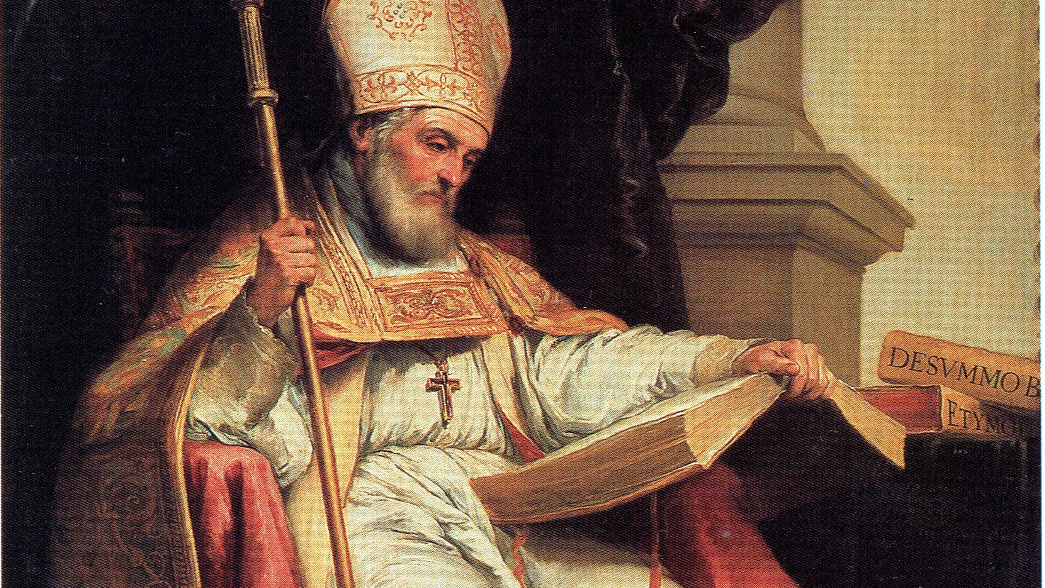
Isidore, bishop of Seville
(599-636)

Slide 20
Isidore’s Writings…were numerous!
Chapter 41. On history.
1. History is the story of what has been done, and by its means what has taken place
in the past is perceived. It is called in the Greek historia, ἀπό τοῦ ἱστορε̃ῖν, that is from
seeing (videre) and learning (cognoscere). For among the ancients no one wrote history
unless he had been present and witnessed what was to be described. For we understand
what we see better than we do what we gather by hearsay.
2. For what is seen is told without lying. This discipline belongs to grammar because
whatever is worth remembering is entrusted to letters…
Most famous for his Etymologiae

Slide 21
Visigothic Jewish Policy
In Theory = intolerance and anti-Jewish legislation
In Practice = Neglected or Supported

Slide 22
Code of Euric (475)
Liber Judiciorum/Lex Visigothorum
by King Reccesvinth (654)

Slide 23
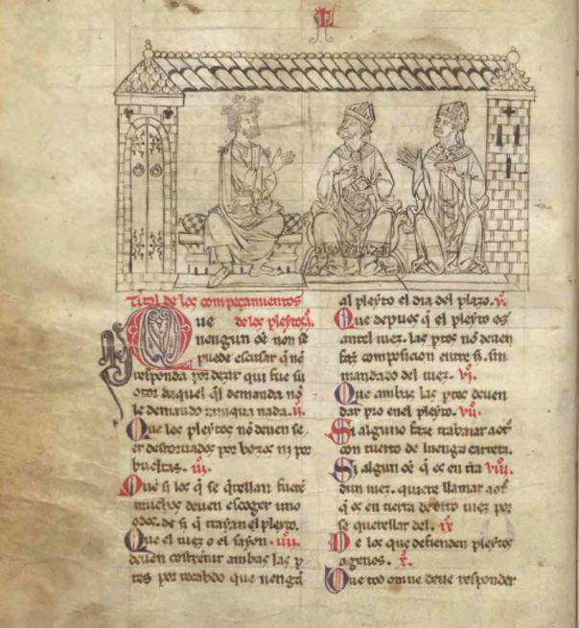
Liber Judiciorum
Civil, criminal, and procedural matters
Judges, witnesses in trials, marriage, inheritance, contracts, crimes, punishments, military obligations, heresy

Slide 24
Liber Judiciorum: significance for medieval Spain
Fuero Juzgo (13th c.)
Partible inheritance
Different to primogeniture
All children, male and female, had right to equal inheritance
Immoveable versus moveable goods

