Slide 1
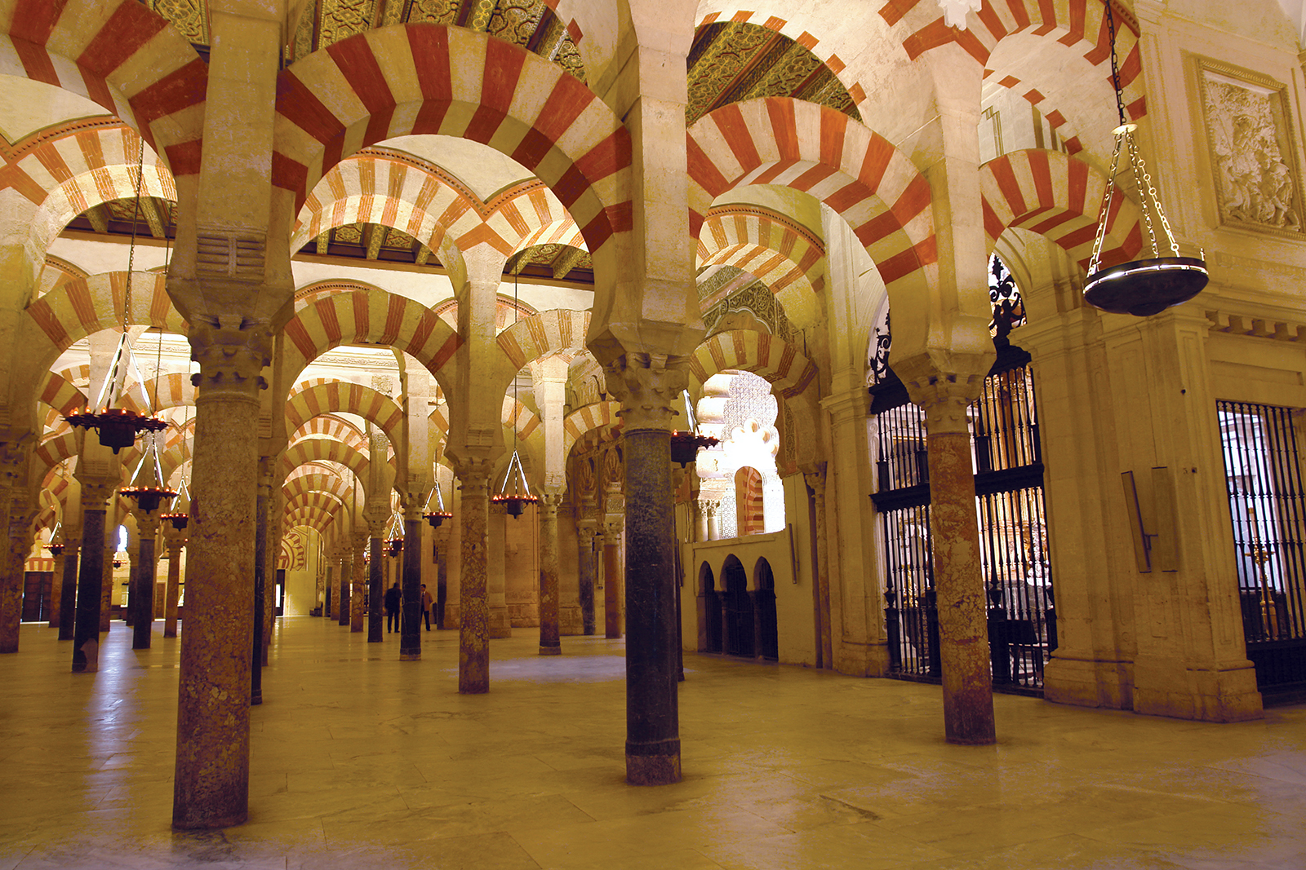
The Muslim Conquest and the Umayyad Caliphate

Slide 2
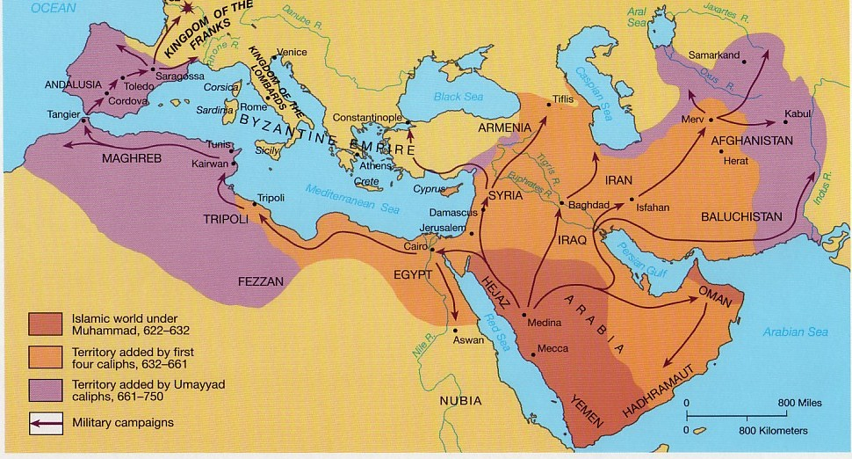

Slide 3
In today’s class…
Timeline 711-1031
Muslim Invasion and aftermath
Establishment of Al-Andalus
Abd Al-Rahman III and Umayyad Caliphate

Slide 4
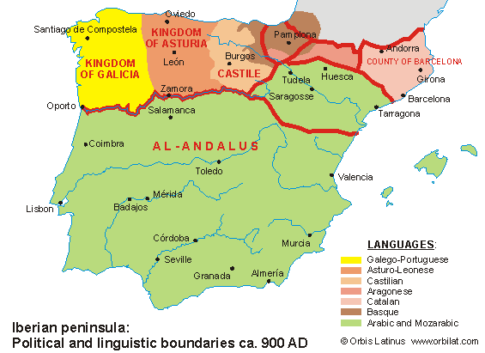

Slide 5
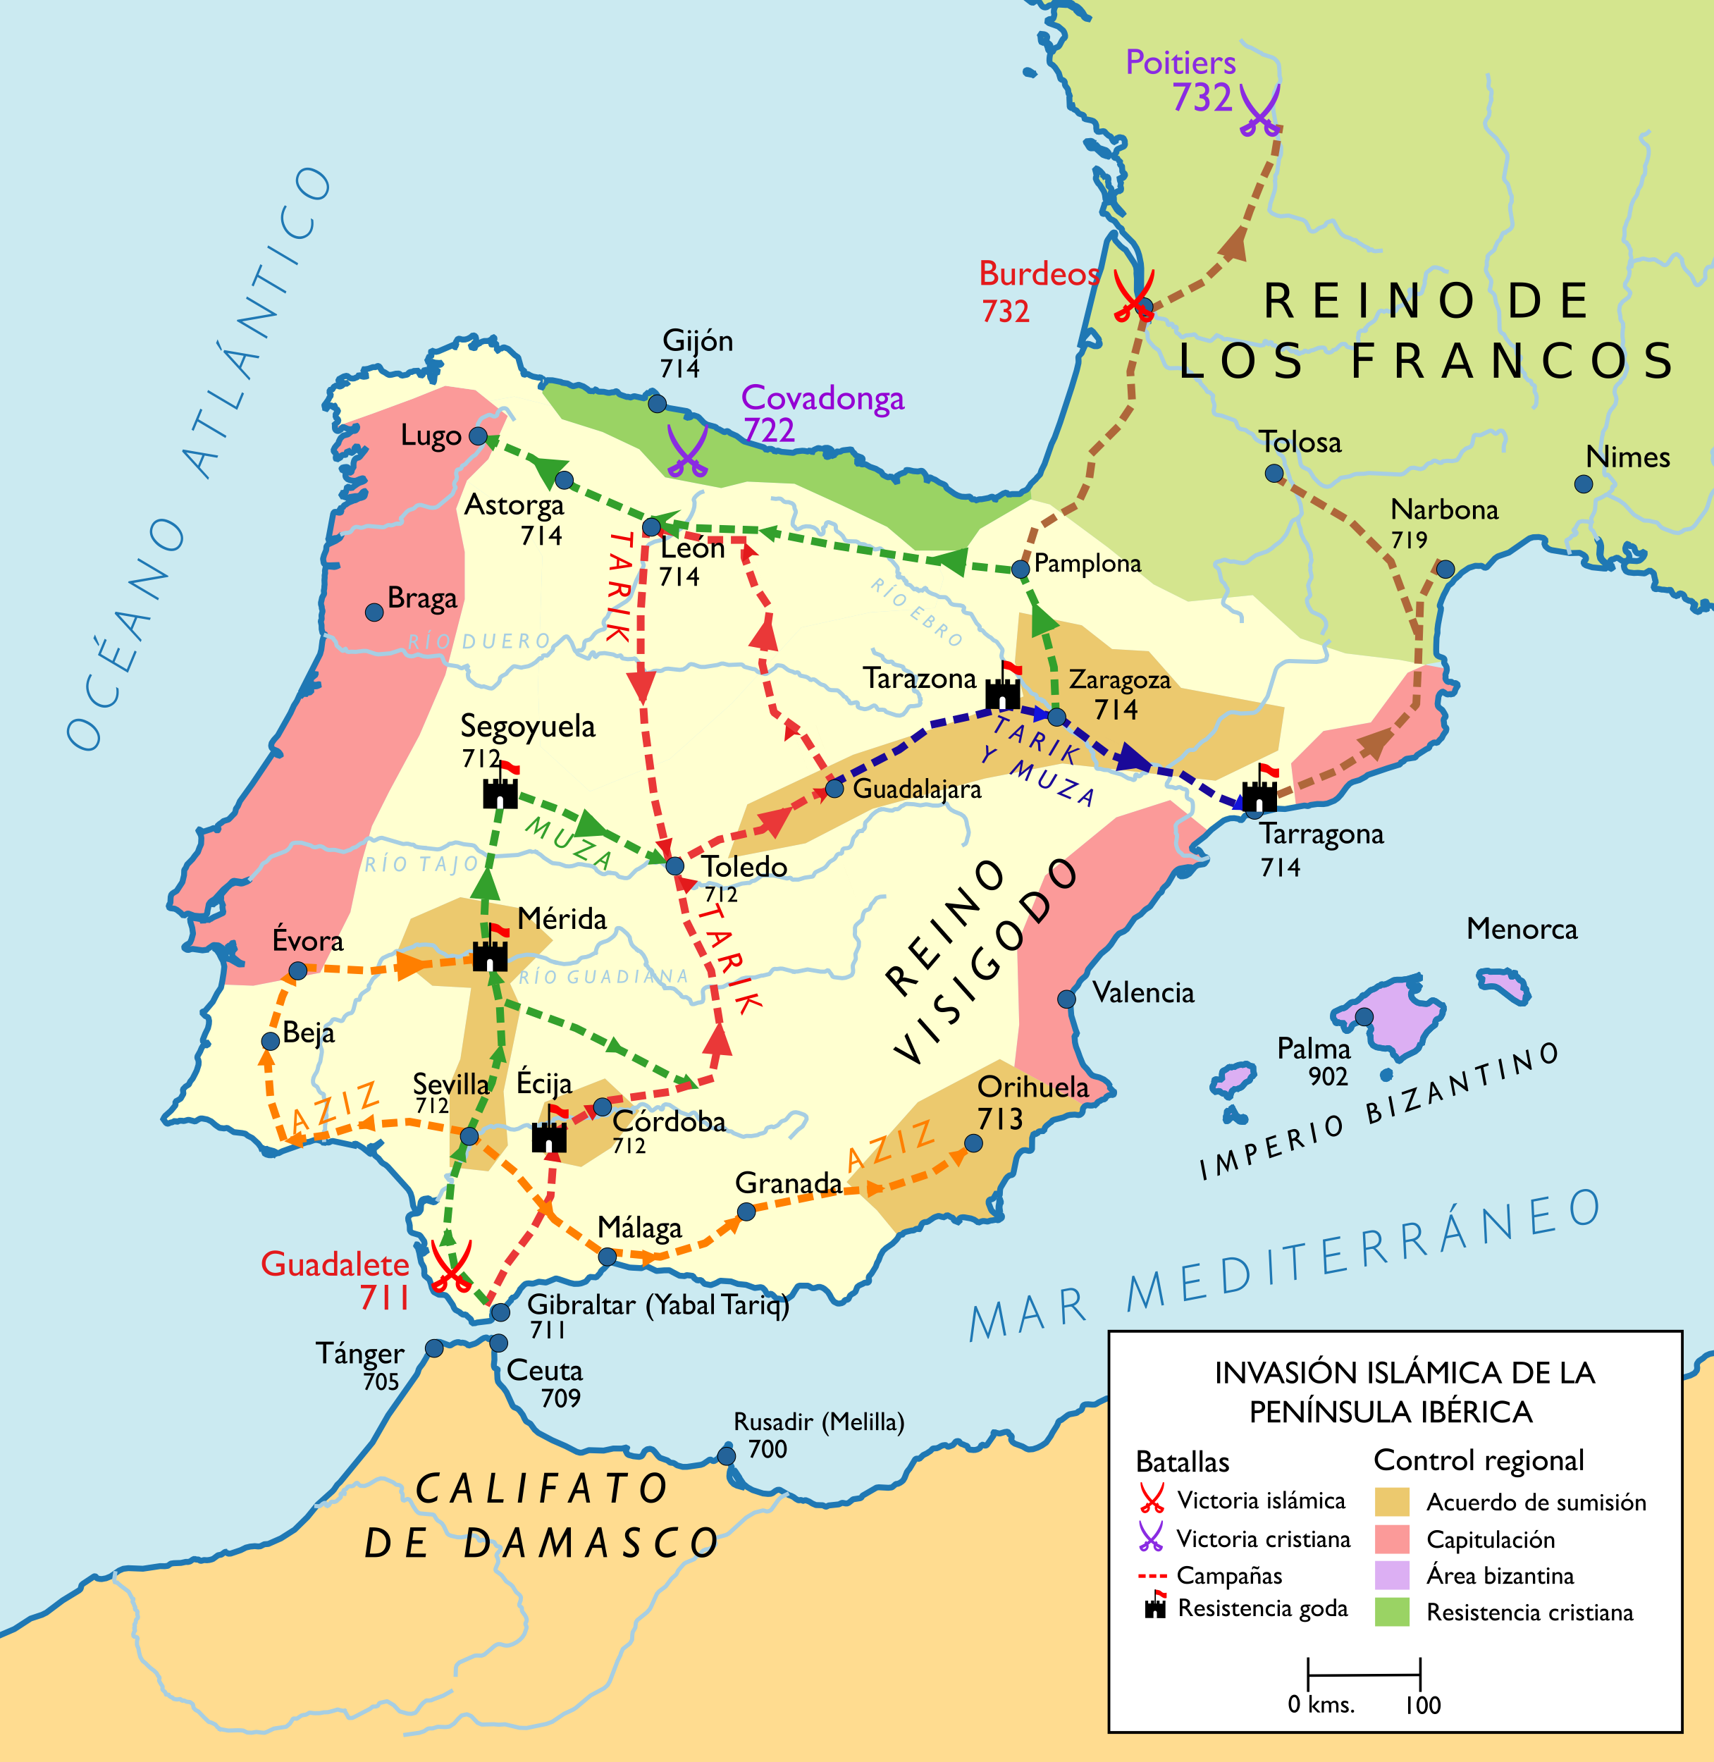
Map Legend:
Treaty of Submission
Capitulation
Byzantine Control
Remaining Christian
Territory
Invasions led by:
Musa ibn Nusayr
Tariq ibn Ziyad

Slide 6
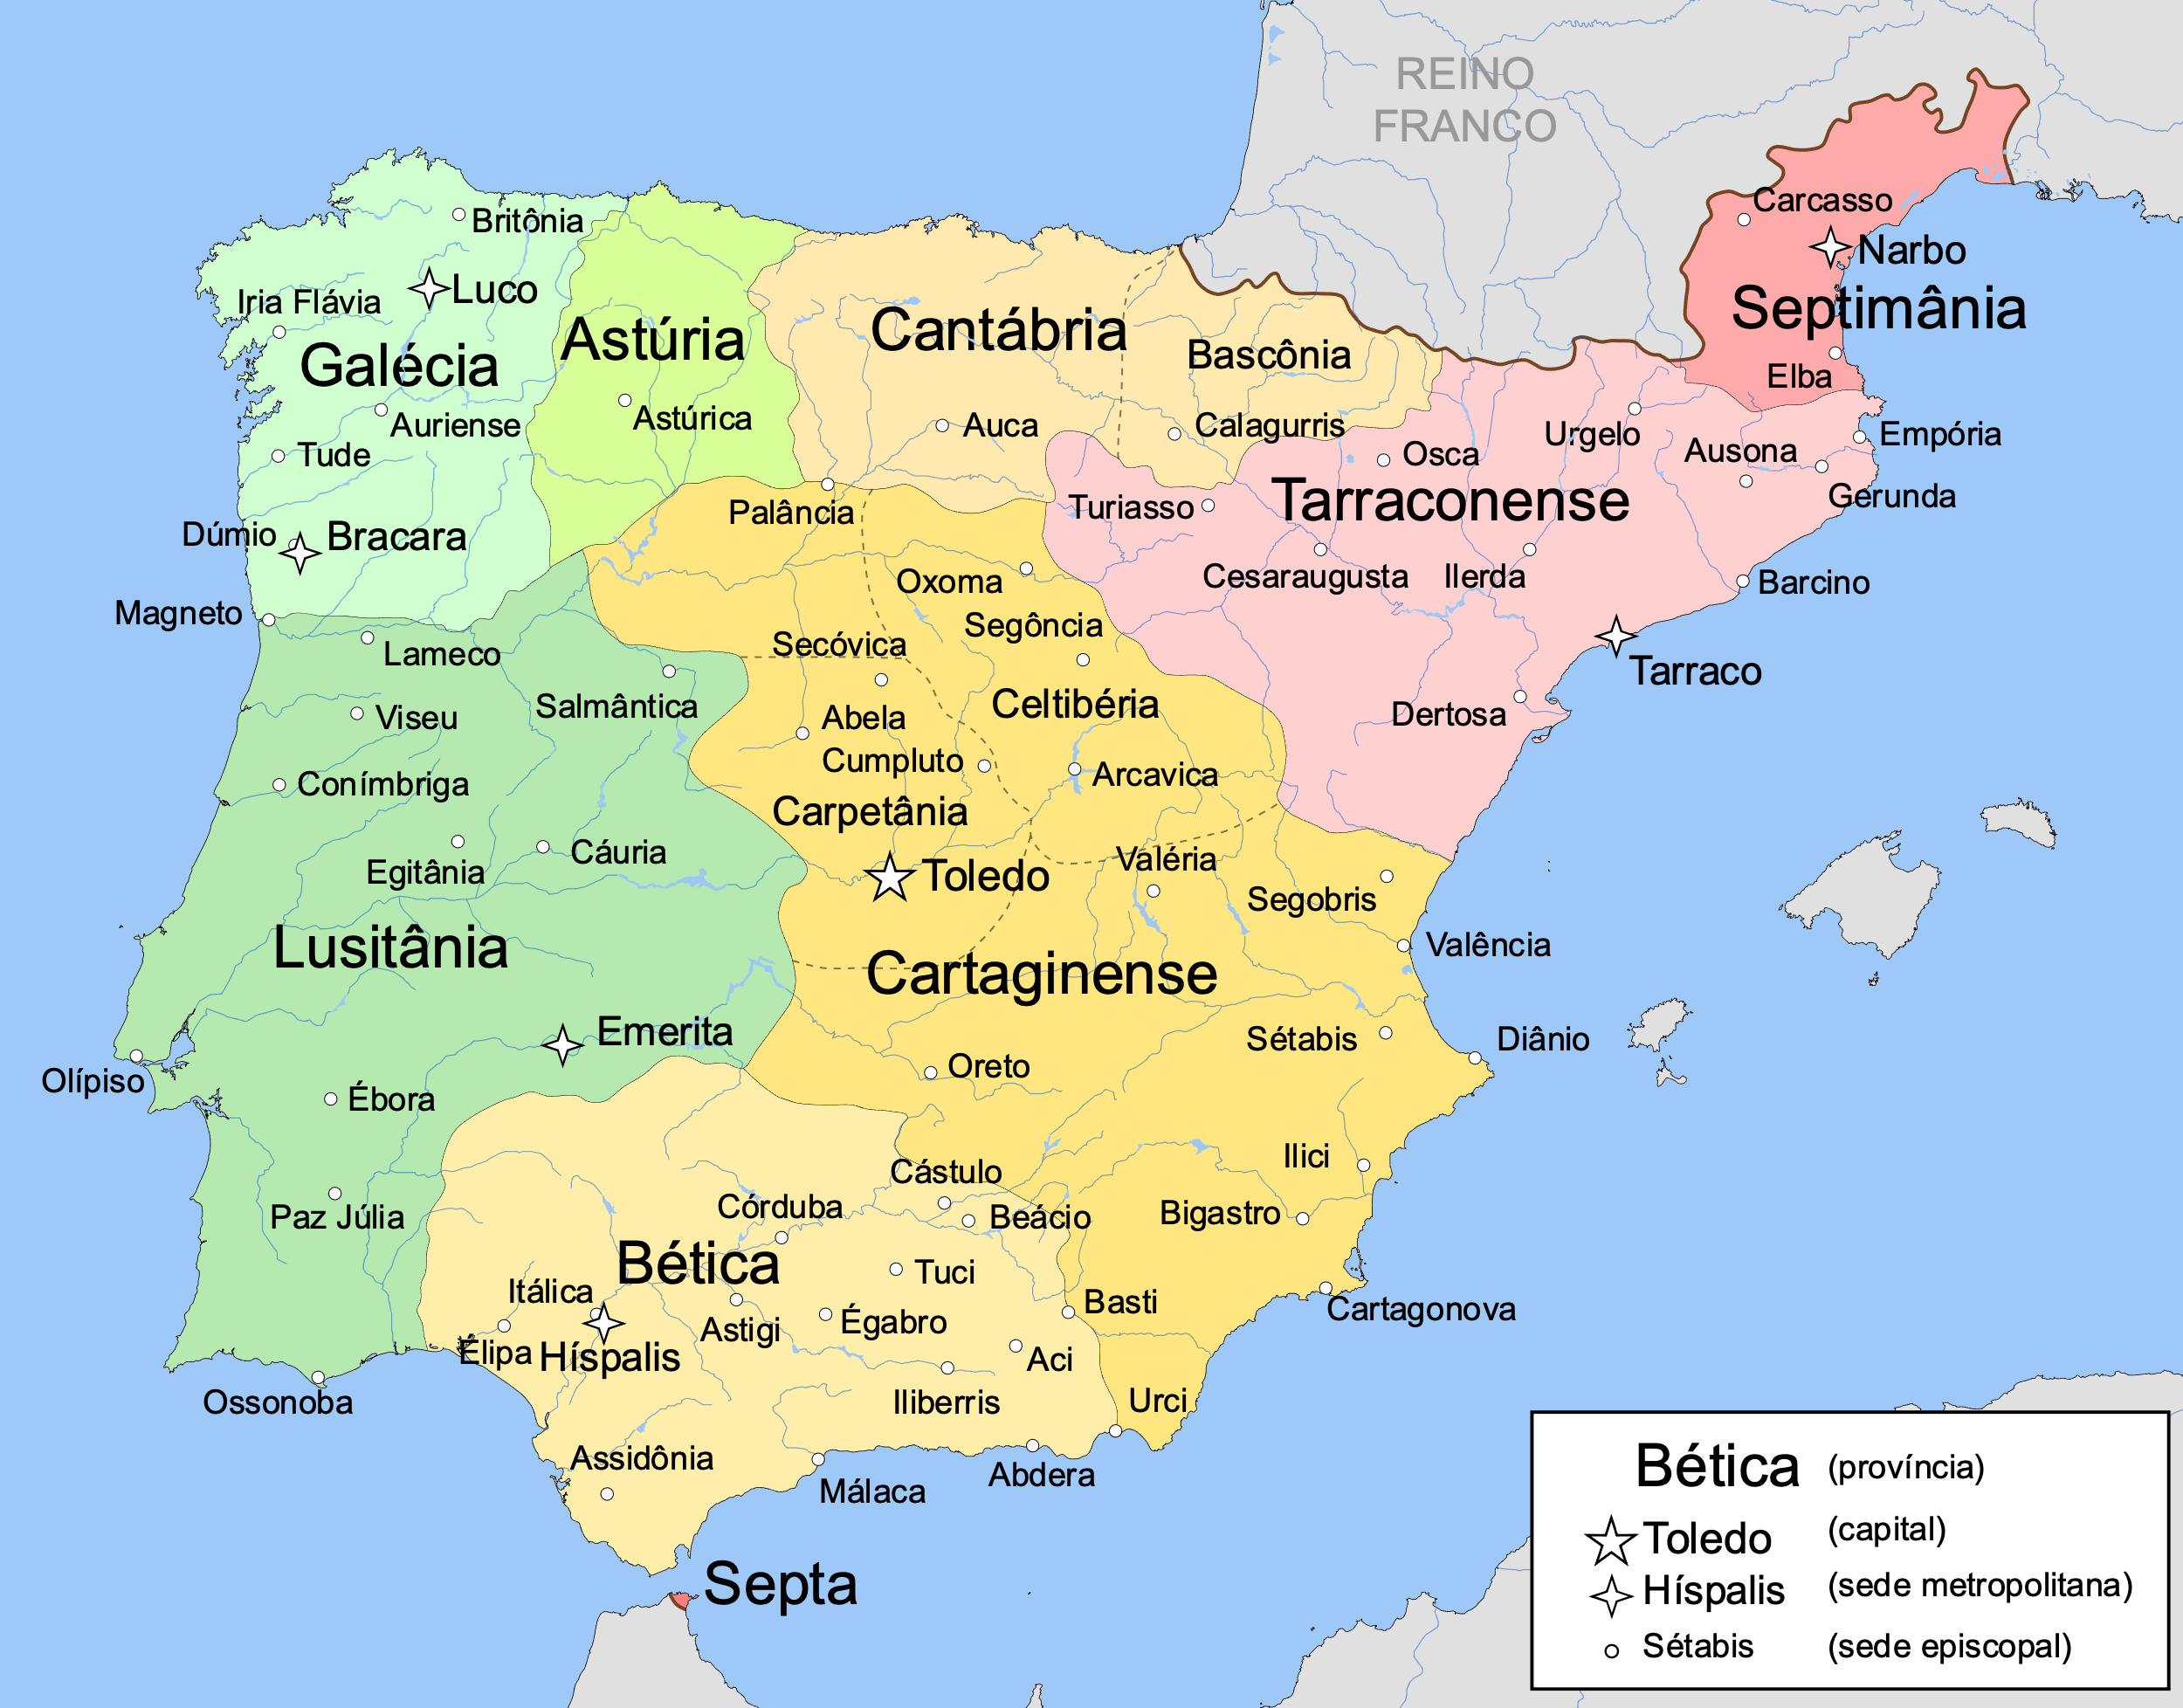
Legends of the Fall
Achila
Legend One:
The sons of Witiza
Problems:
Dating
Ruderic

Slide 7
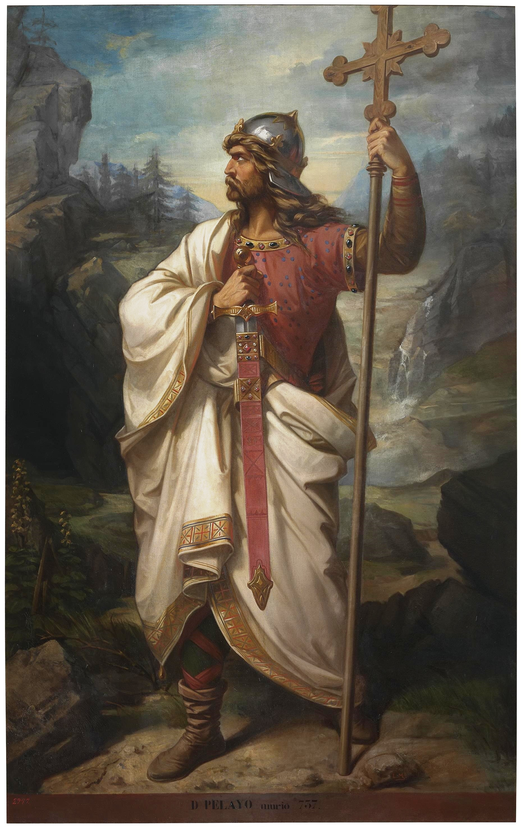
Legends of the Fall
Legend Two:
Pelayo and the Christian Defense in the North
Chronicle of Alfonso III (880s)
“Christ is our hope that through this little mountain…the well-being of Spain and the army of the Gothic people will be restored.”
Image: Luis de Madrazo, 19th c.

Slide 8
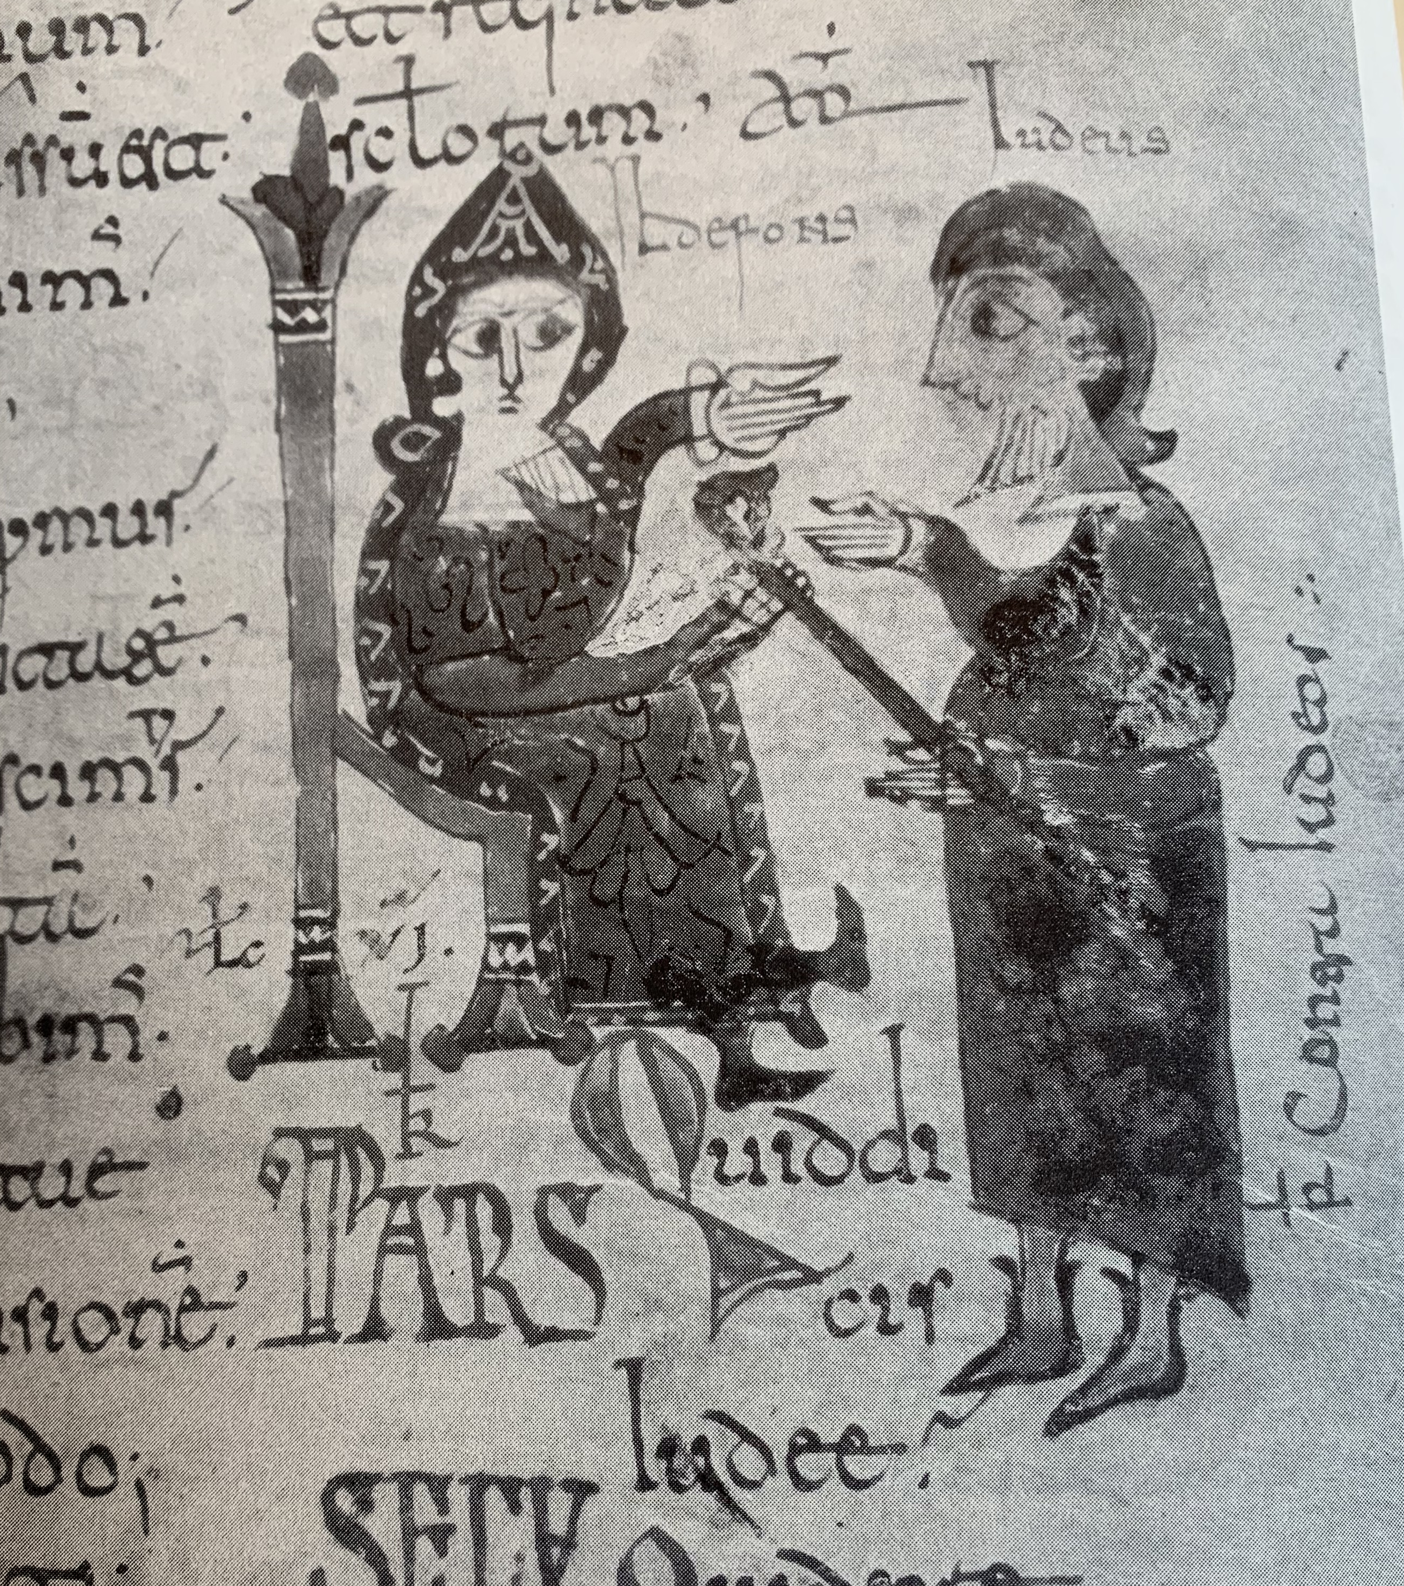
Legends of the Fall
Legend Three: Blame the Jews
Image: St. Isidore and a Jew, 10th c.

Slide 9
Christians and Jews in Al-Andalus
D himmis “Peoples of the Book”
Freedom of religion
Live according to own laws (Liber Judiciorum for Christians; Halakhah for Jews)
Pay poll tax = Jizya

Slide 10
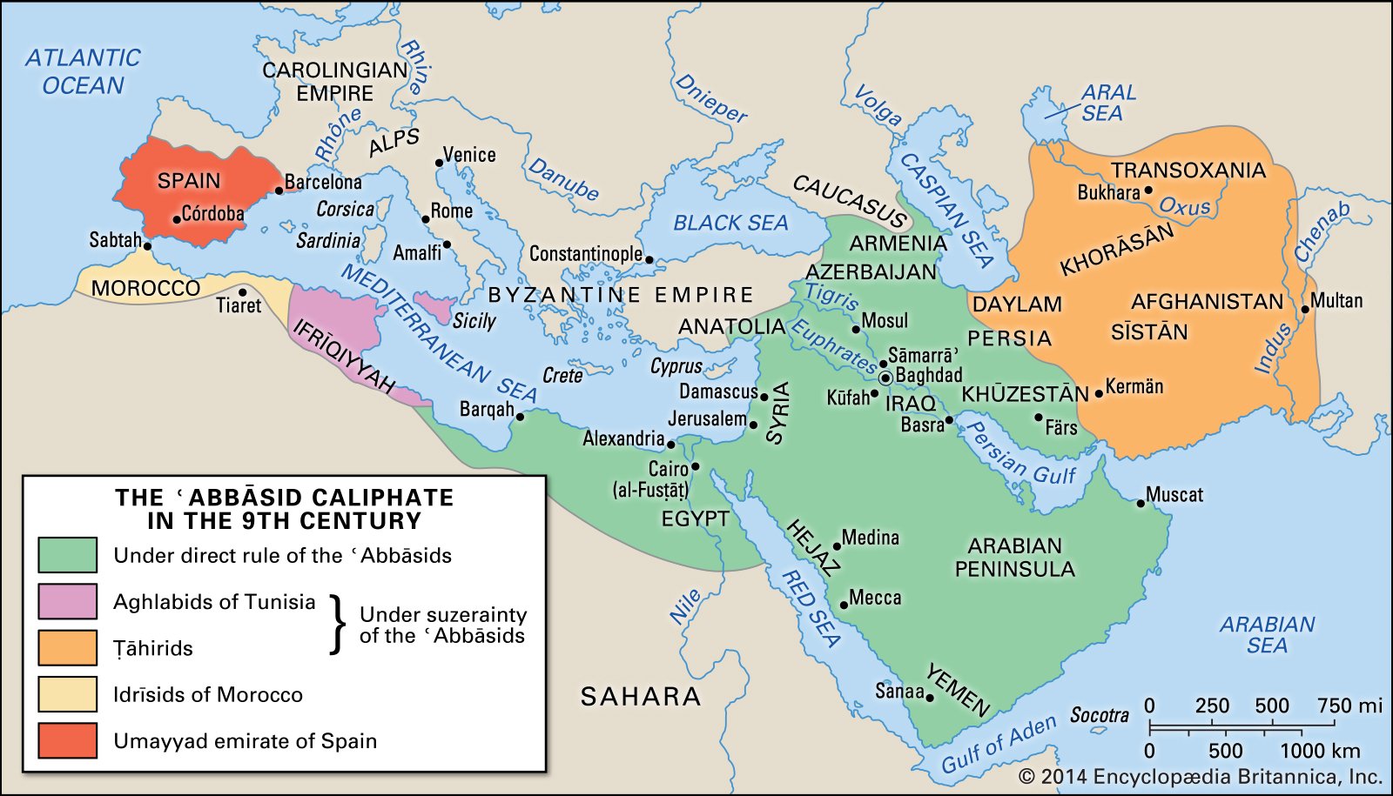
750 Umayyads overthrown by Abbasids

Slide 11
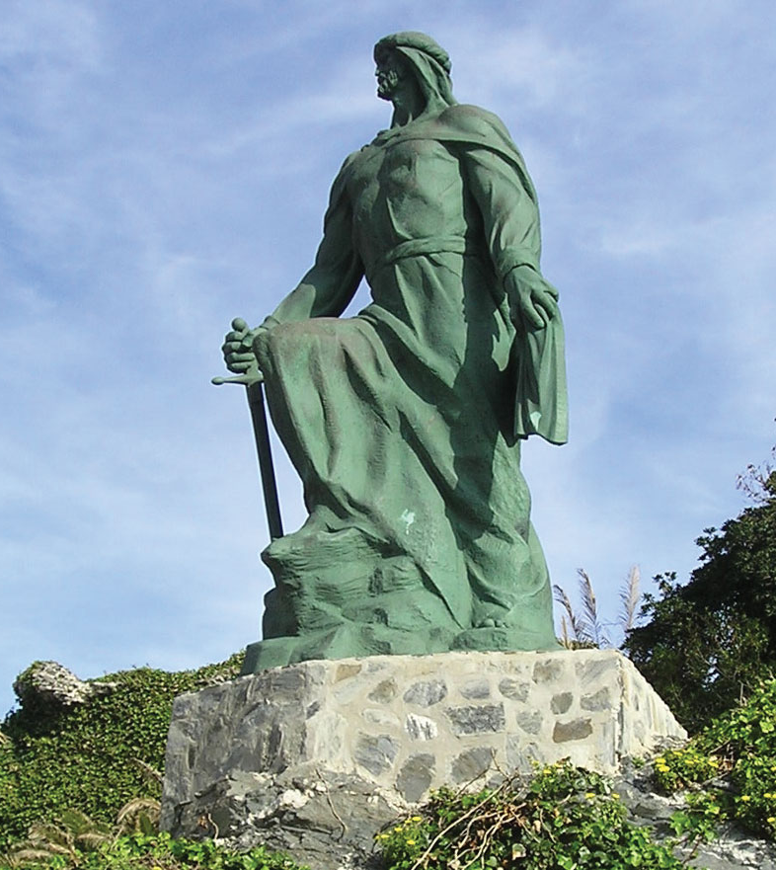
Abd al-Rahman I,
Emir of Al-Andalus
Ruled 756-788
Established Umayyad dynasty in Al-Andalus
Image: Statue of Abd al-Rahman I at Almuñécar

Slide 12
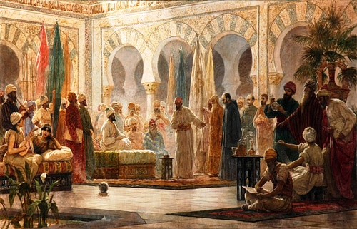
Abd Al-Rahman III
Grandson of Abd Allah and Onneca (princess of Navarre)
Son of Muhammad and Christian slave-concubine from northern Spain
Ruled 912-961
Image: Dionisio Baixeras Verdaguer, 19th century

Slide 13
Deputy of God’s Messenger
Descended from Muhammad
Emir
Caliph
912-929
Jan. 16, 929 ->

Slide 14
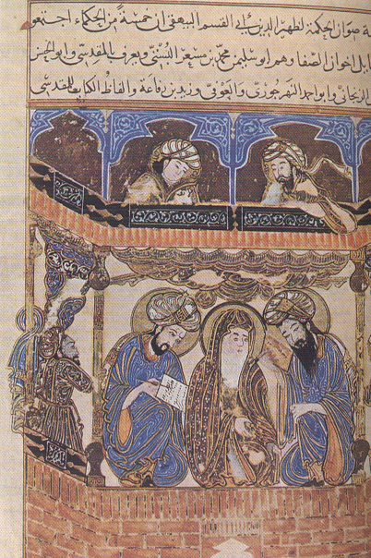
Muslim Social Structures in Al-Andalus
‘Ulama
Qadis (judges) and faqihs (jurists)
Faqihs = interpret the law
Qadis – enforce the law
Sharia law (deals with all aspects of society)
A Muslim Faqih and his students (possibly 12th c?)

Slide 15
Muslim Social Structures in Al-Andalus
Marriage
Endogamy (marry within family, esp. cousins)
Exogamy (done for alliances)
Muslim men marry Christian women

Slide 16
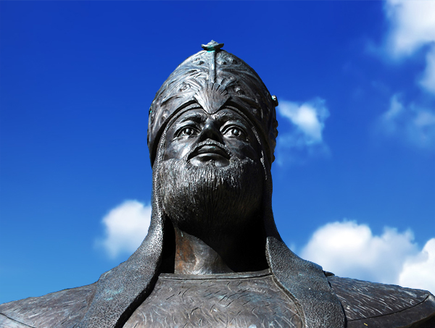
Al-Mansur (r. 976-1009)
Al-Hakam as successor to Abd Al-Rahman (r. 961-976)
Son Hisham II aged 10 in 976
Al-Mansur as First Minister

Slide 17
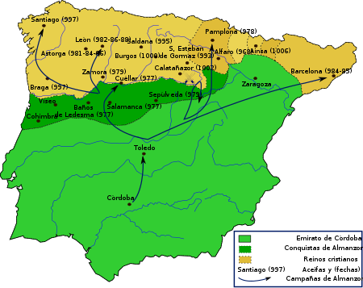
Al-Mansur raids
(976-1009)

Slide 18
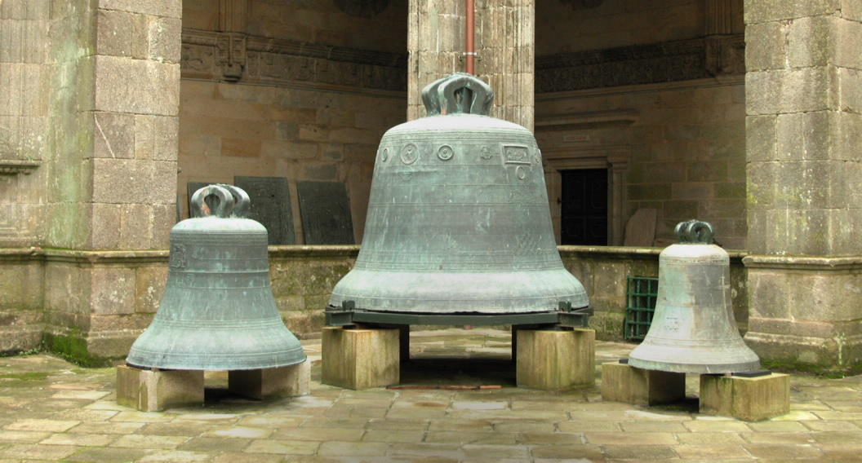
Son and heir of Al-Mansur:
Abd al-Malik (died 1008)
Bells of Church of Compostela

Slide 19
Successes of the Umayyad Caliphate
Centralized kingdom
Economic strength
Plural society

Slide 20
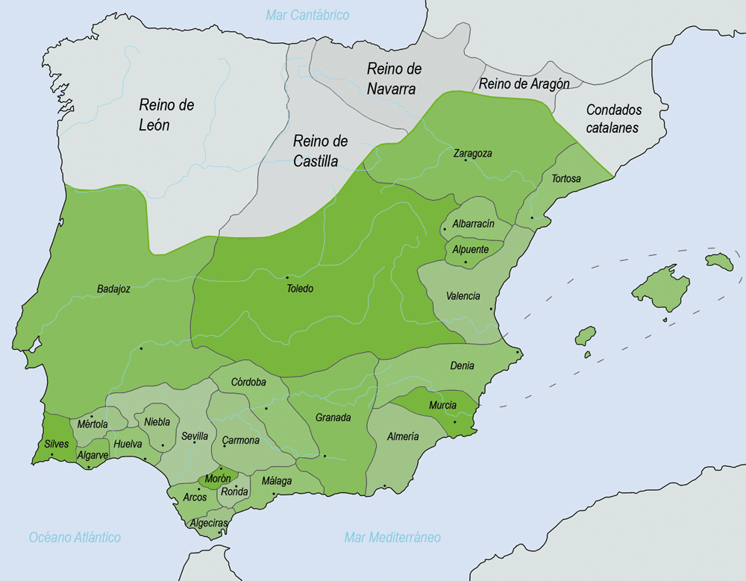
Taifa
Kingdoms
1031

