Slide 1
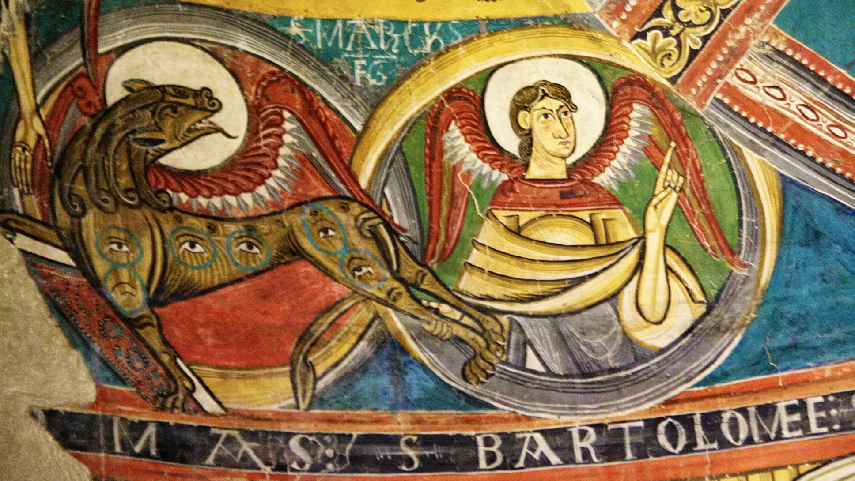
HIST 365: Medieval Spain

Slide 2
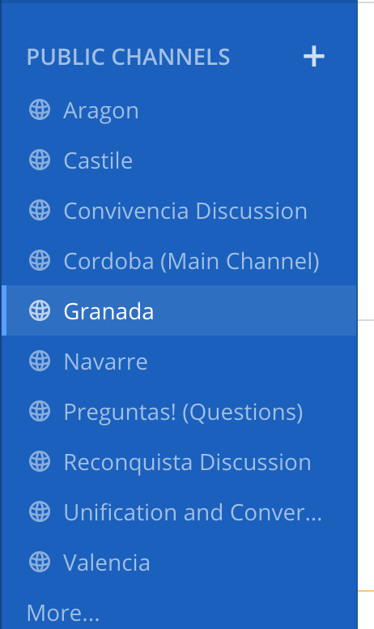

Slide 4
Podcast Episodes
“Convivencia” with Dr. Sarah Ifft Decker and Dr. Alexandra Guerson
“Reconquista” with Dr. Miriam Shadis
“Unification and Conversion” with Dr. Mark Meyerson

Slide 5
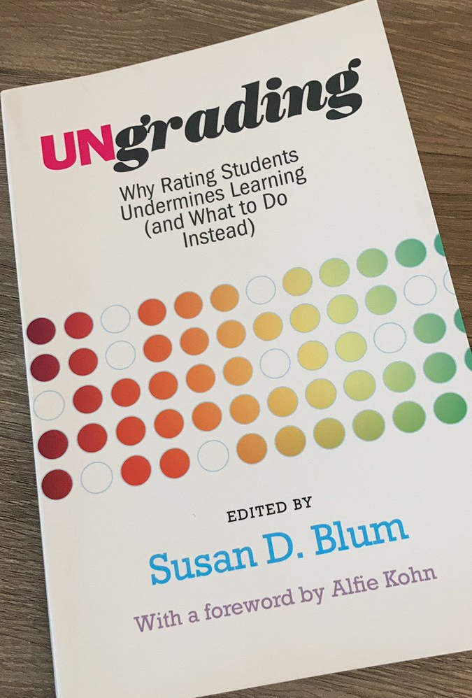
Ungrading

Slide 6
Formative Assessment
Emphasis on feedback
Source Analysis and Proposal
Summative Assessment
Graded
Based on final project (but take into account other steps)
Structured Self-Assessment
Focus on strengths, growth, and achievement
Structured Self-assessment
Research Project Assessment

Slide 7
Jesse Stommel, “Why I don’t grade”
https://www.jessestommel.com/why-i-dont-grade/

Slide 8
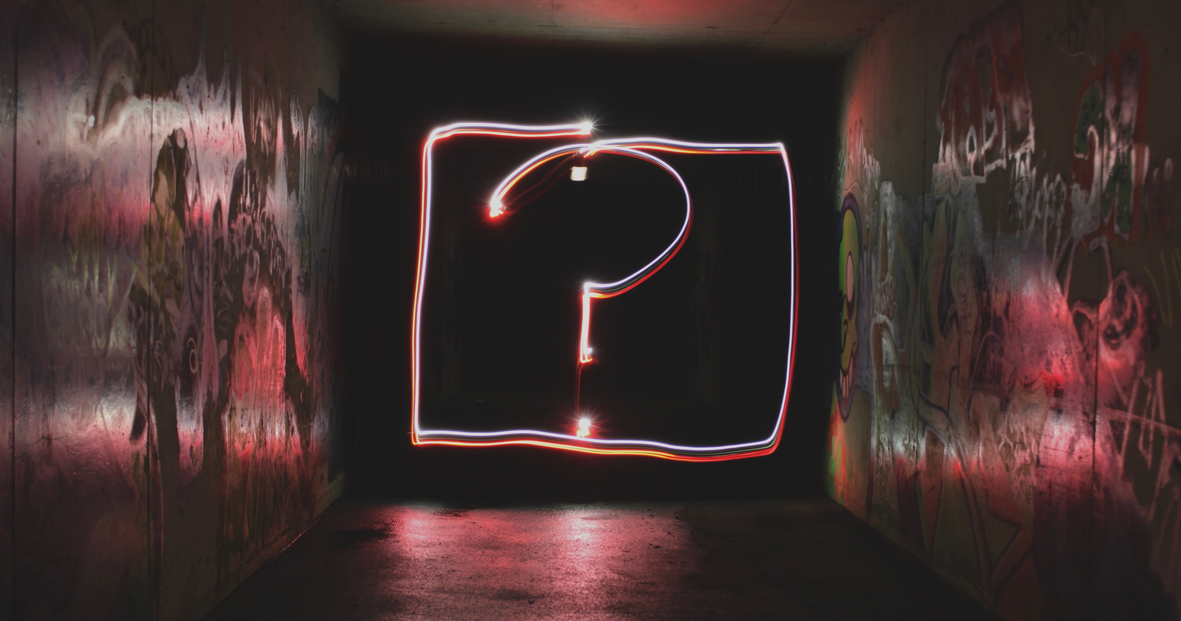
Notes:
Photo by Emily Morter on Unsplash

Slide 9
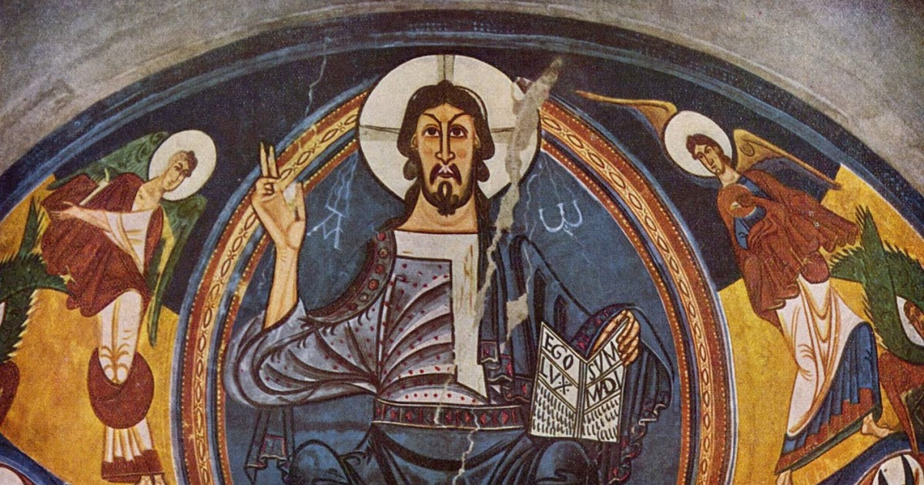
The Idea of “Spain”

Slide 10
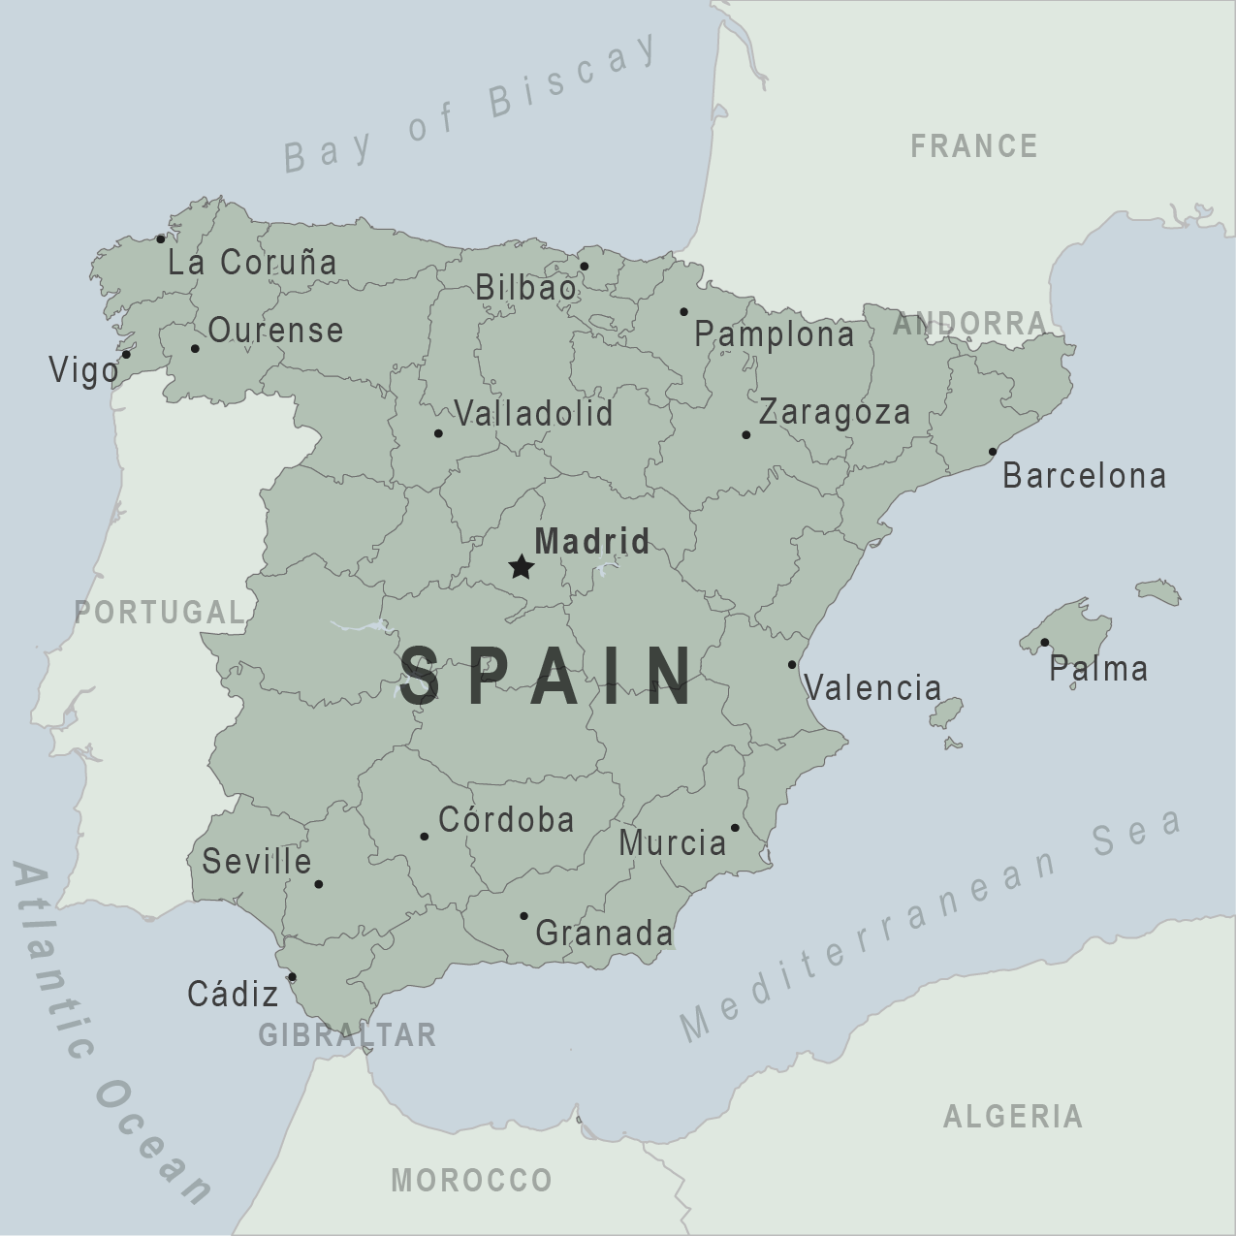
Diversity (language artistic representation, religion, institutions)
No static borders
Politically unified under Carlos I (1516)

Slide 11
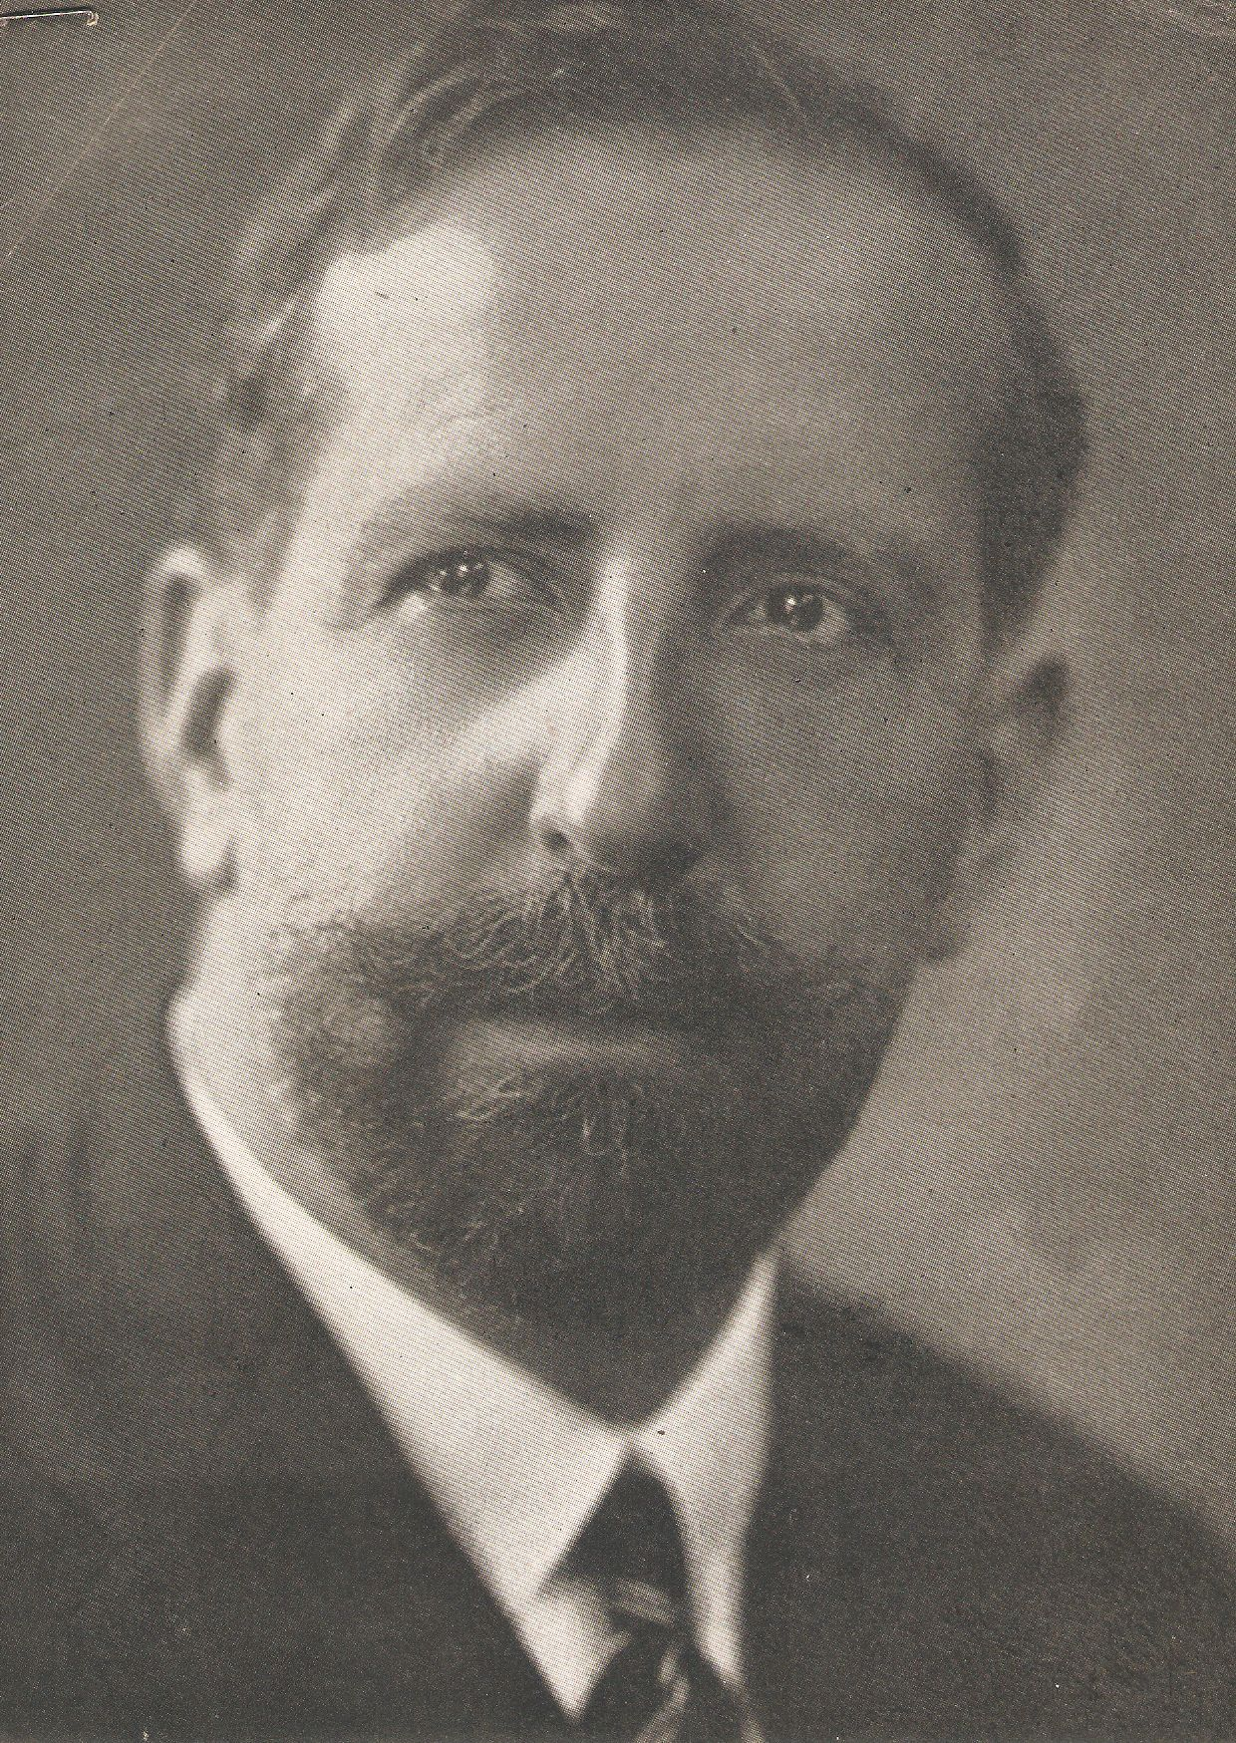
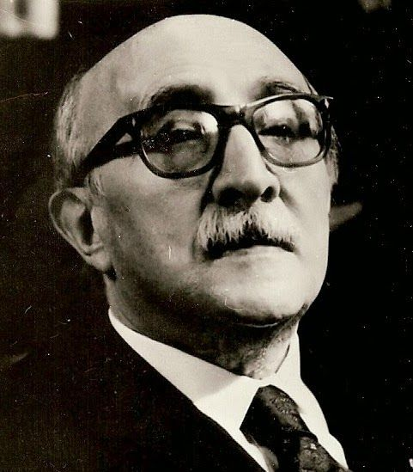
Spanish character???
Américo Castro (1885-1972)
Claudio Sánchez-Albornoz (1893-1984)

Slide 12
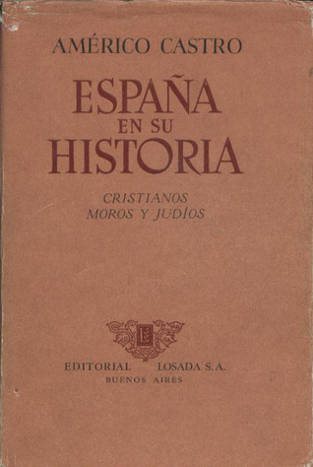
The Spaniards: An Introduction to their History (1948)
Coexistence of Muslims, Christians, and Jews from 8th to 15th centuries = fundamentally religious nature of the Spanish character + deep rooted intolerance

Slide 13
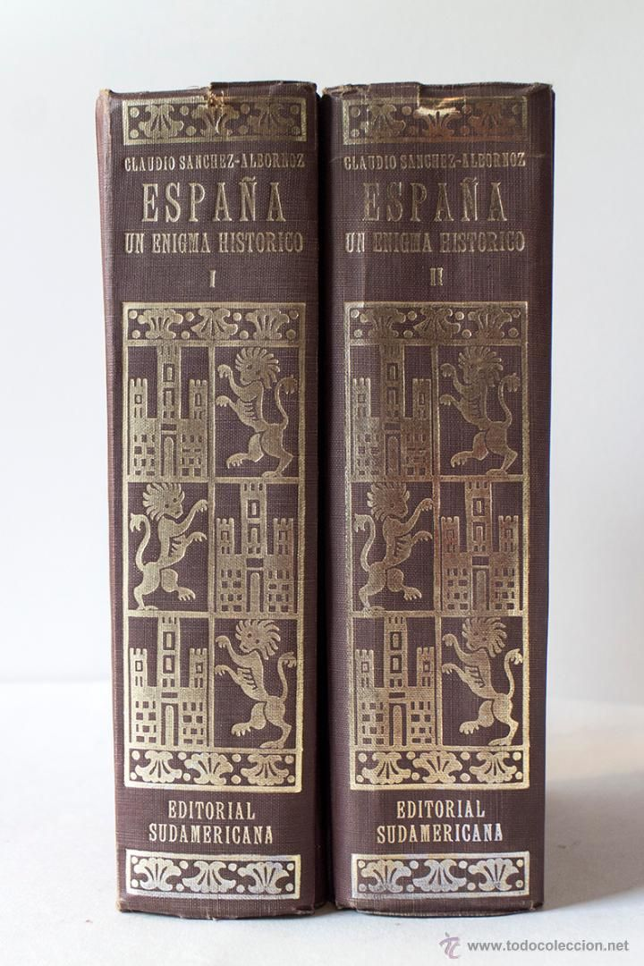
Claudio Sánchez-Albornoz, Spain: A Historical Enigma (1957)
All peoples who lived in Iberian peninsula (Iberians, Romans, Visigoths, medieval Christian/Muslims/Jews) made contributions

Slide 14
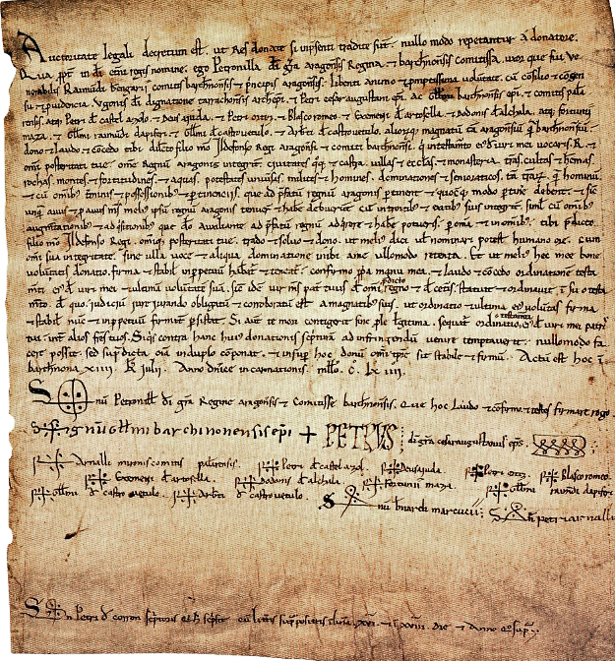
Primary Sources
1164: Queen Petronilla transfers right to Aragon to her son Alfonso

Slide 15
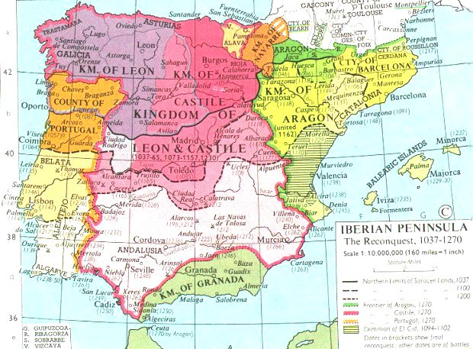

Slide 16
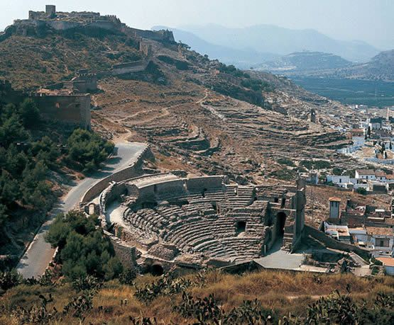
Sagunto castle
Roman
Visigothic
Muslim
Christian

Slide 17
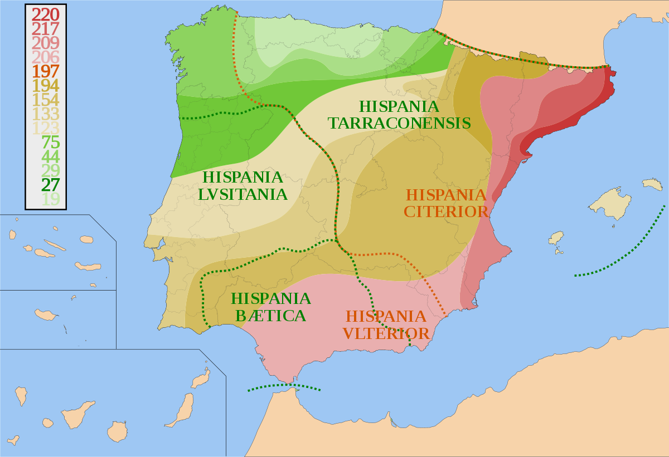
Hispania (Roman Spain)
220 B.C.E. to 400 C.E.

Slide 18
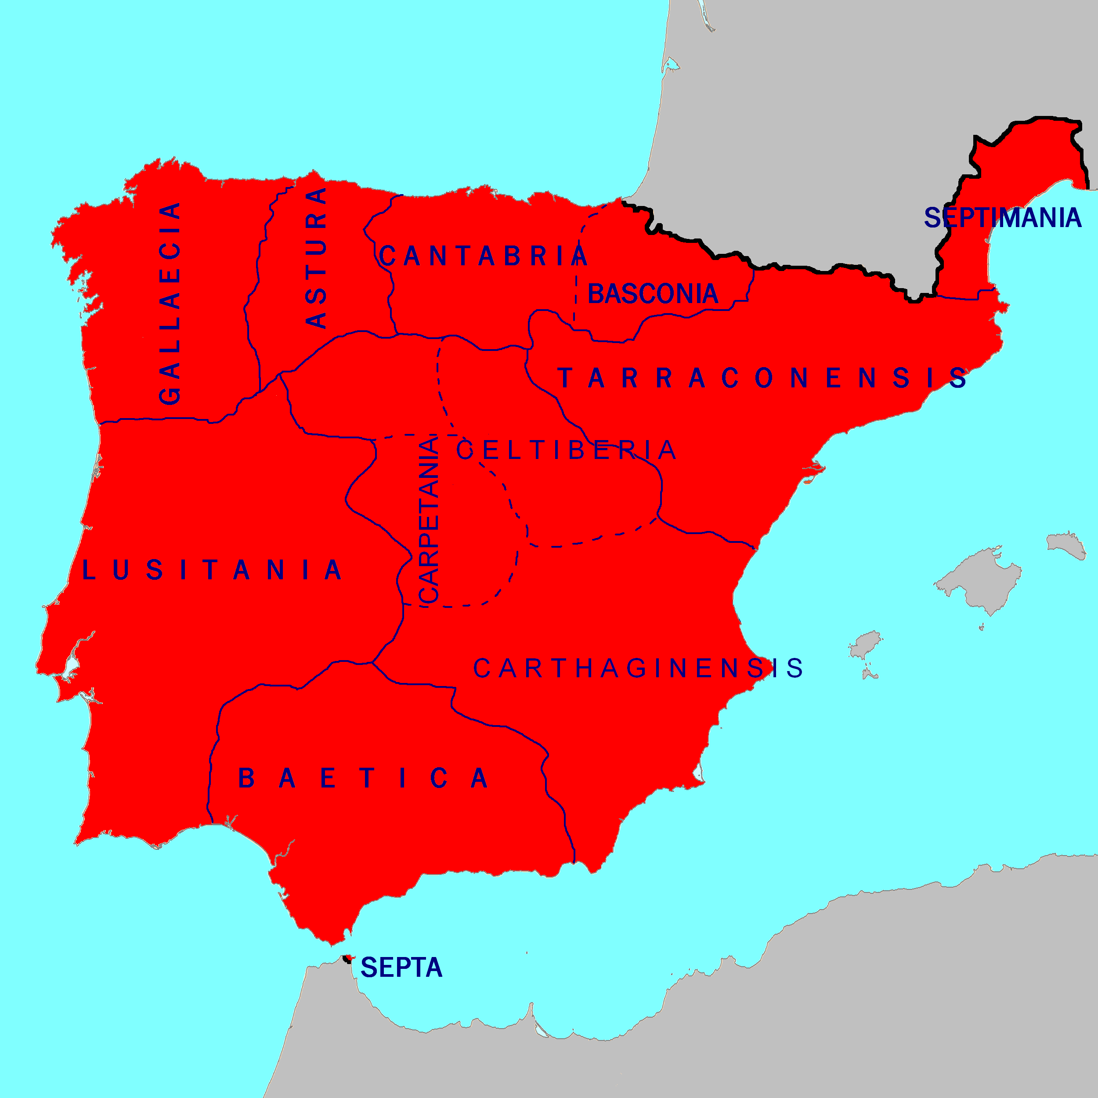
Visigothic Spain
507 C.E. to 711 C.E.

Slide 19
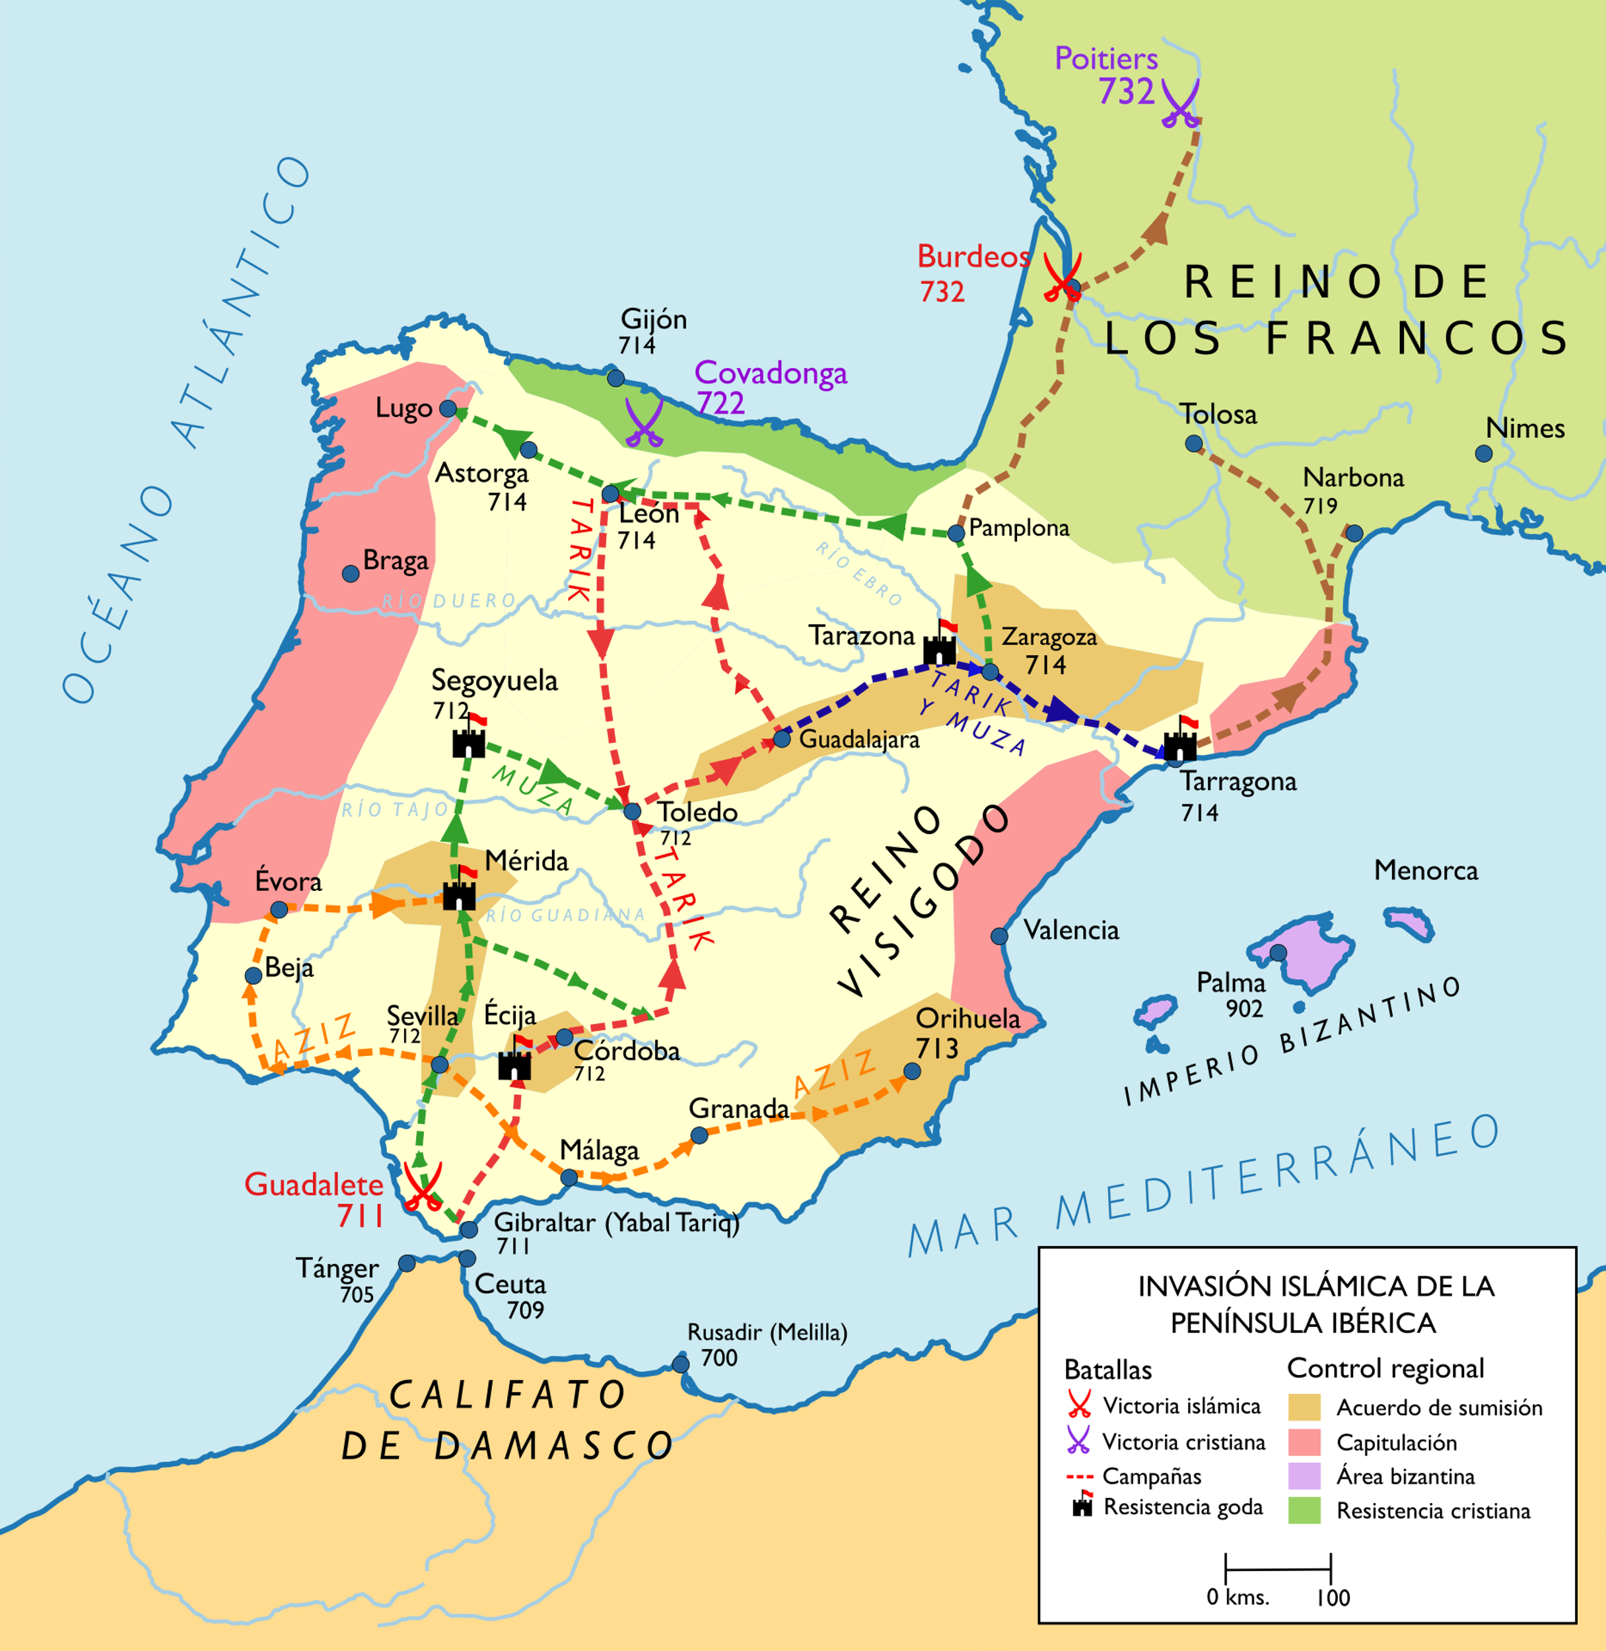
Muslim invasions (711->)

Slide 20
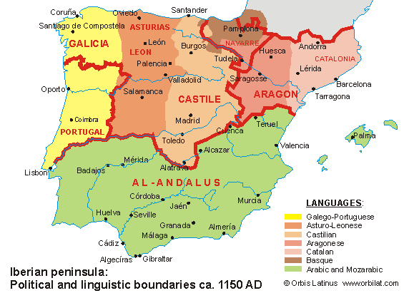
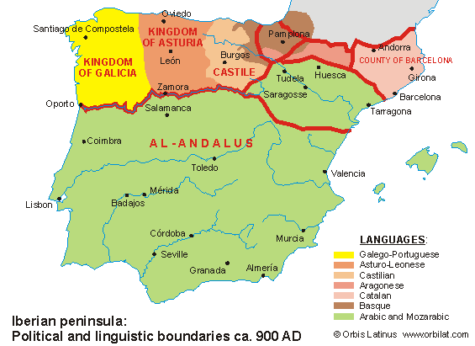

Slide 21
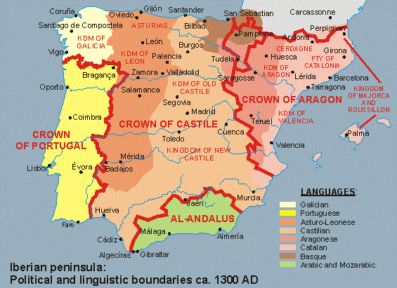

Slide 22
Political and Legal Institutions
Law = Roman law
= Customary law (Germanic)
= Canon (Catholic church) law
RESULT? = Legal overlap and contradictions
Castile
Cortes
(less authority)
Municipal council = nobles
Crown of
Aragon
Corts
(more authority)
Municipal council = urban leaders (oligarchs)

Slide 23
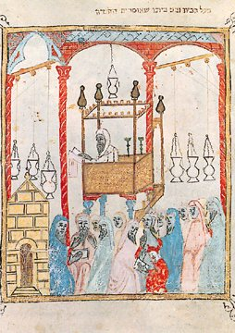
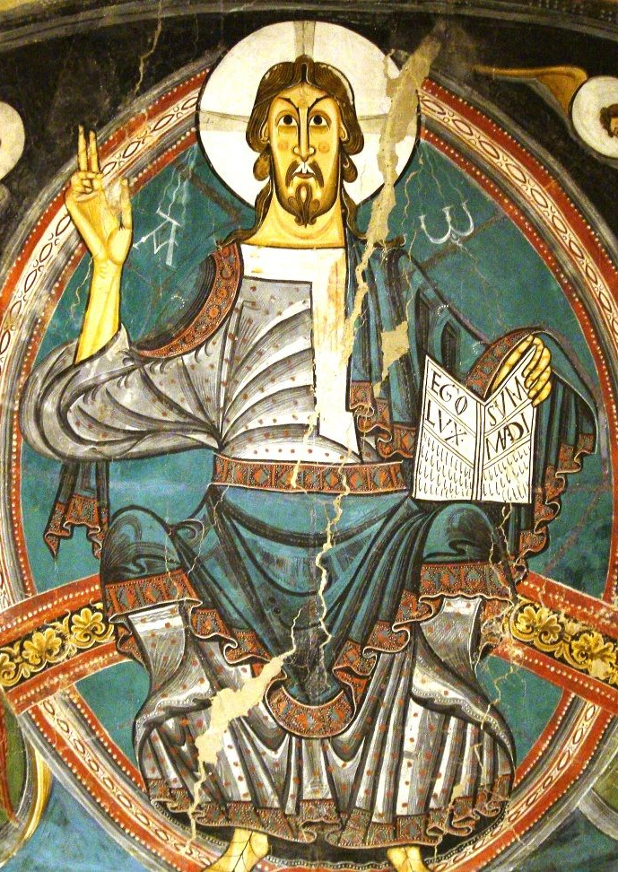
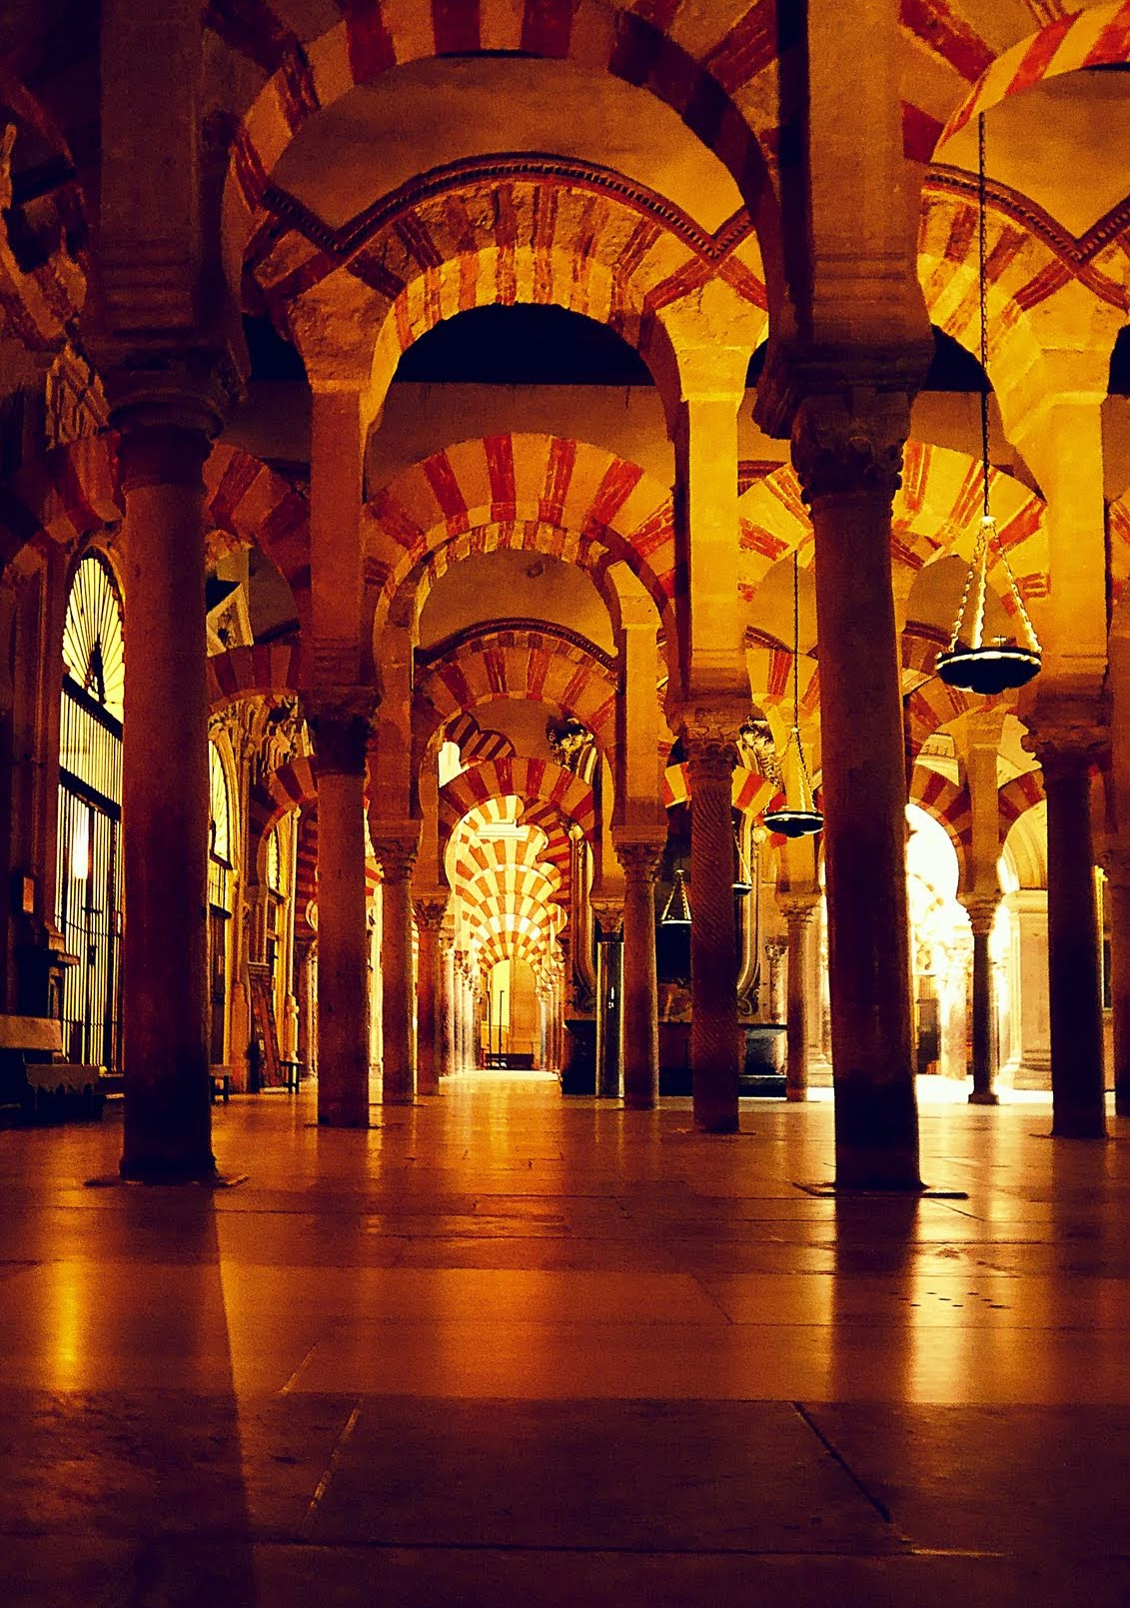
Christianity
Islam
Judaism

Slide 24
by
DIS
A society organized for war?
--Peter Linehan

Slide 25
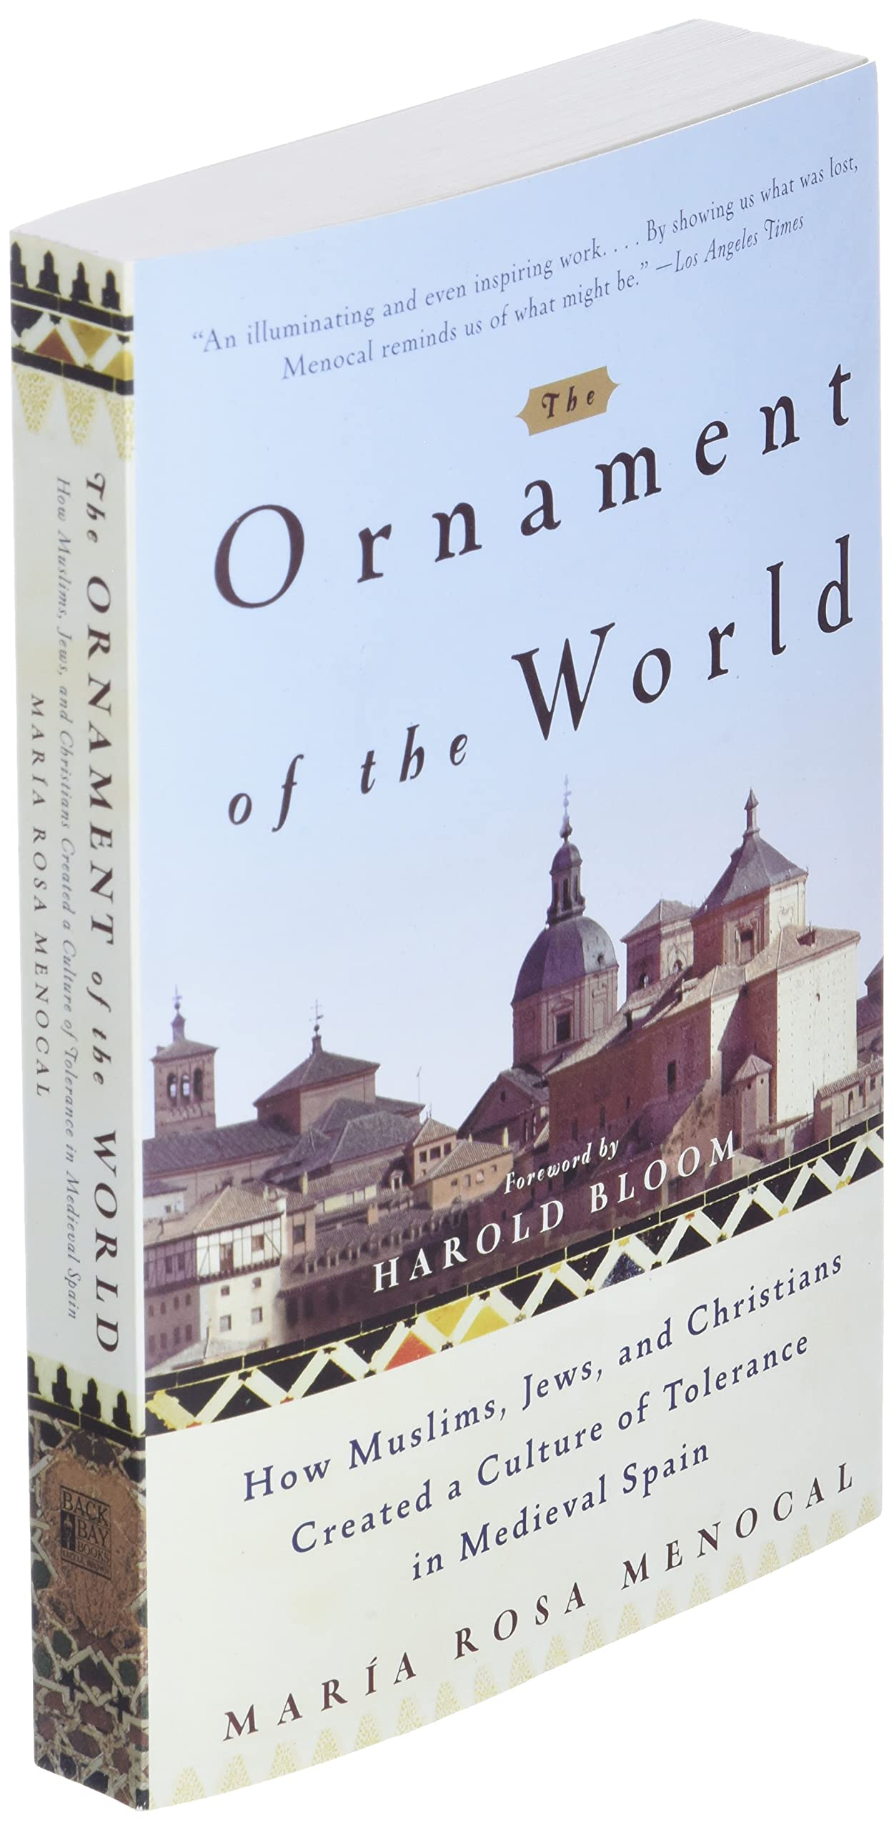
Maria Rosa Menocal, The Ornament of the World (2001)
“Jews, Christians, and Muslims lived side by side and, despite their intractable differences and enduring hostilities, nourished a complex culture of tolerance.”
“
“often unconscious acceptance that contradictions…could be positive and productive”

Slide 26
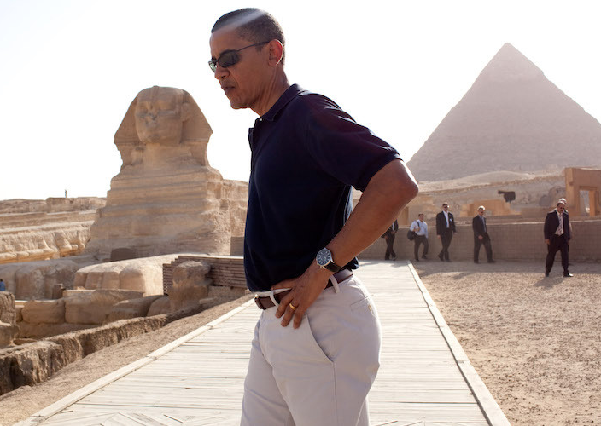
“The relationship between Islam and the West includes centuries of co-existence and cooperation, but also conflict and religious wars.”
“Islam has a proud tradition of tolerance. We see it in the history of Andalusia and Cordoba.”
Barack Obama (2008)

Slide 27
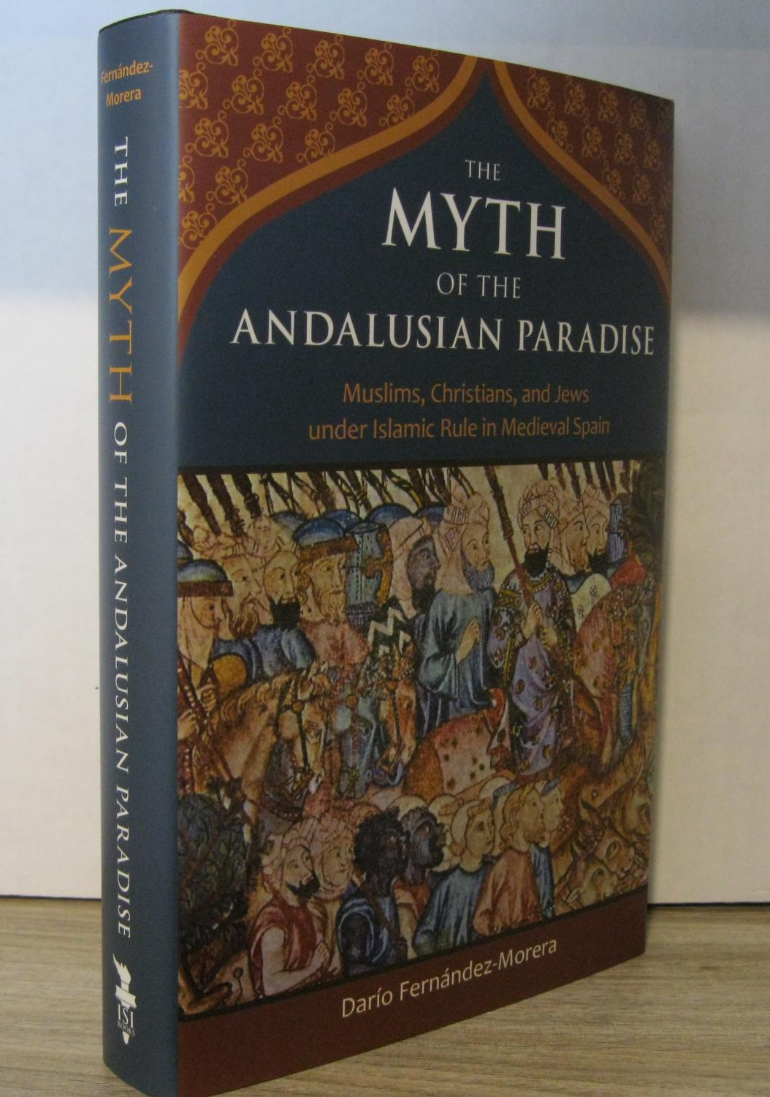
Dario Fernández-Morera, The Myth of the Andalusian Paradise
“…by definition a subaltern group, a fourth or fifth-class marginalized people in a hierarchical society…victims of an extortion system that gave them the choice that gangsters give to their victims: pay to be protected or else.”
“in cultural terms alone, the invasion, conquest, and colonization of Christian Spain during the first half of the eighth century…was a disaster for the Christian population…”

